Slide 1
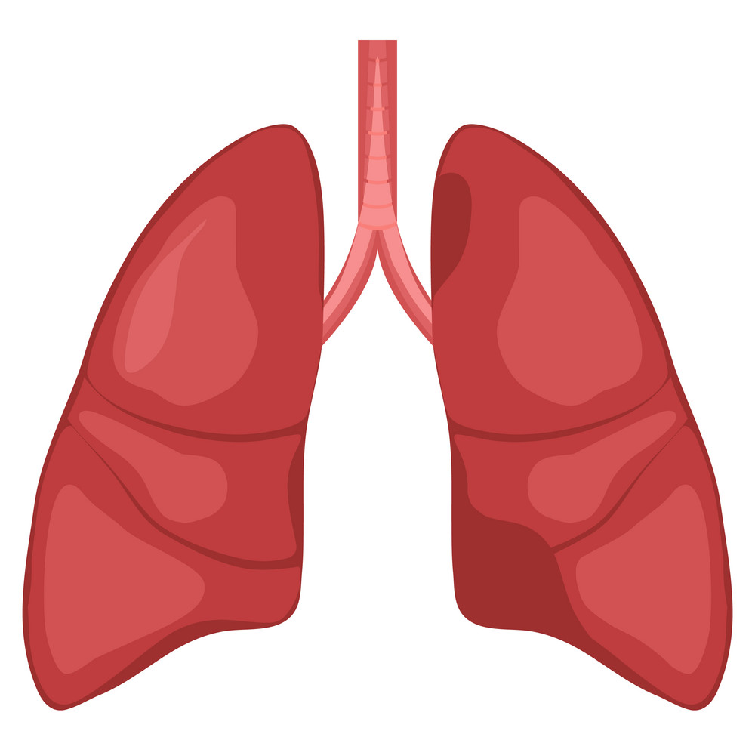

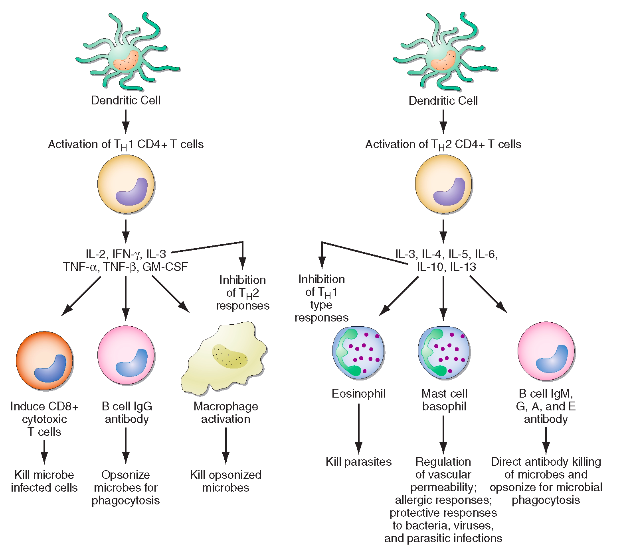

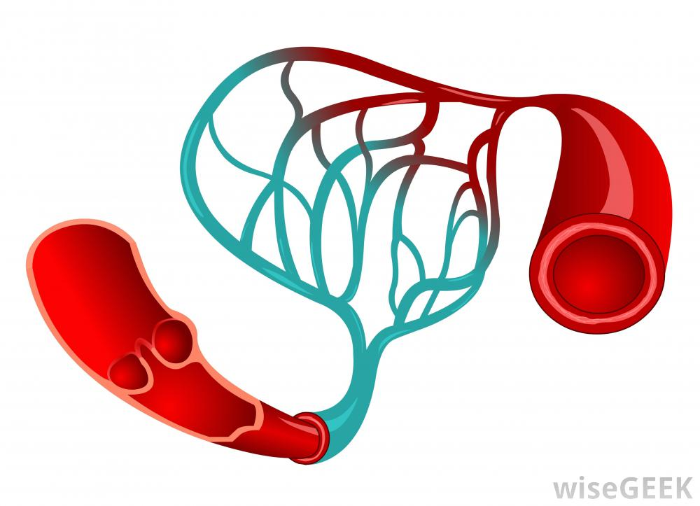
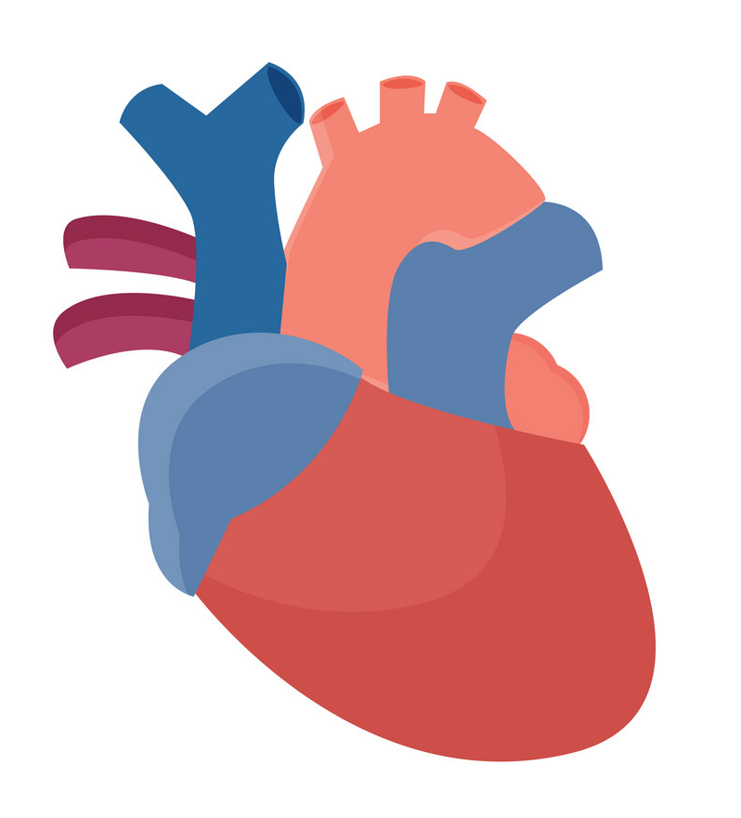
Grab 1 Handout
HPHY 324 - Physiology II
Form groups of 3 or 4!

Slide 2


ORE CONCEPTS
Flow Down Gradients
Cell-cell communication
Structure/Function
Homeostasis

Slide 3

in-class group worksheets
Here's WHAT: learn by DOING
Here's WHAT: focus on UNDERSTANDING concepts & the journey
Here's WHAT: to the answer (not just finding the correct answer)
Here's WHAT: build SOFT SKILLS: critical thinking, team collaboration, & problem-solving skills
→ talk about these in personal statements
QUESTIONS → engage with teaching team member right away
Moog, R.S., Creegan, F.J., Hanson, D.M., Spencer, J.N., & Straumanis, A.R. (2006). Process-Oriented Guided Inquiry Learning: POGIL and the POGIL Project. Metropolitan Universities Journal, 17, 41-51
Notes:
have a condensed version of what is on Canvas page
move to day 1
Text = the cardiac cycle consists of alternate periods of systole (Contraction/emptying) and diastole (relaxation/filling)
The events during one heartbeat
Each cardiac cycle consists of one period of relaxation (diastole) and one period of contraction (systole)
(Marieb) = The cardiac cycle includes all events associated with blood flow through the heart during one complete heartbeat - atrial systole/diastole followed by ventricular systole/diastole ECG is total electrical activity of the heart not just specific point.
What are the atria doing during Ventricular diastole? (well when they are not in systole, they are in diastole) relaxation period here is when they are both relatxing at the same time. (end of t wave, mid P wave)

Slide 4
Learning Objectives
Pathway of blood through cardiovascular system
Right vs. left heart
Heart valves - opening/closing
Fibrous skeleton of the heart
Cardiac vs. skeletal muscle
Autorhythmic vs. contractile cells
Different action potential waveforms

Slide 5

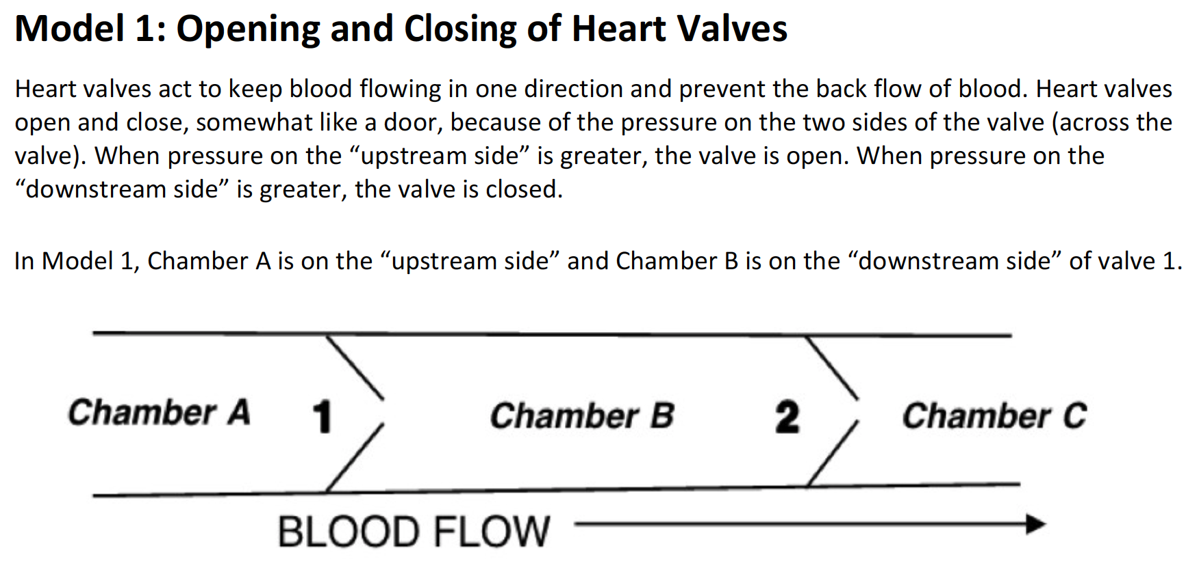
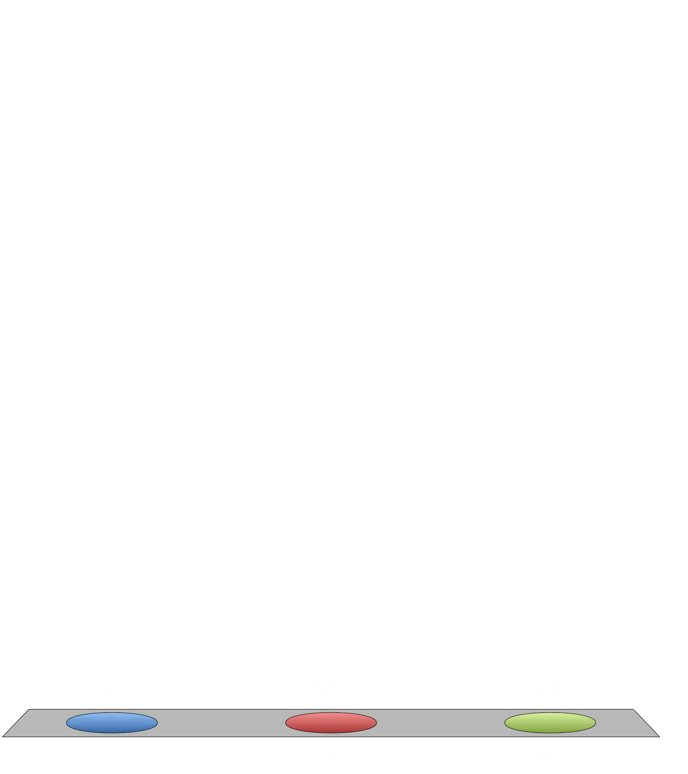
Unidirectional Blood Flow
5-6 minutes
FLOW DOWN GRADIENTS
720
10 minutes
2.3 - Differences in pressure (pressure gradient) between two points in a system cause substances to move toward a region of lower pressure
3 - The magnitude of flow is a direct function of the magnitude of the energy gradient that is present (the larger the gradient, the greater the flow)

Slide 6
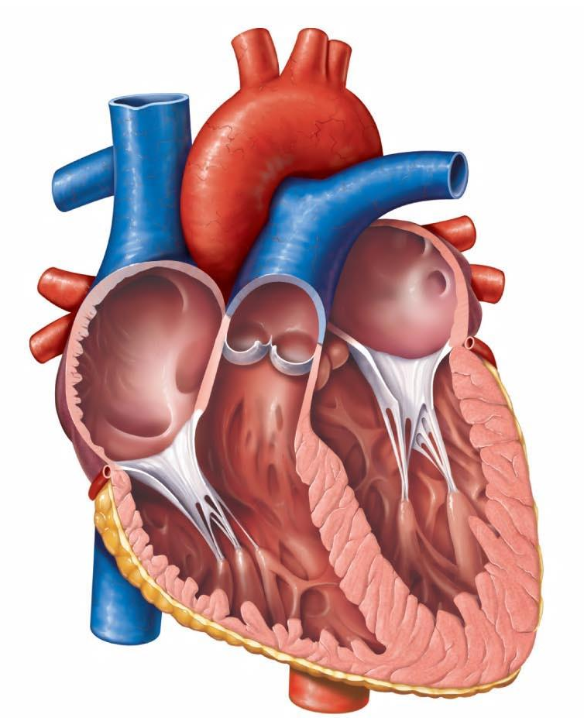
What are we really looking at in Model 1?
#4
Chamber A = left atrium
Valve 1 =
Chamber B = left ventricle
Valve 2 =
Chamber C =

Slide 7
Post Model 1: When right ventricular pressure is greater than right atrial pressure, what is happening to the tricuspid valve?
It is open
It is closed

Slide 8
GRADIENT
FLOW
difference in pressure
blood flow through heart valves
direct
relationship (+)
inverse
relationship (-)
RESISTANCE TO FLOW
pathology narrowing or closing off valve
ex: valve ___________
myxoma
FLOW DOWN GRADIENTS
2.3 - Differences in pressure (pressure gradient) between two points in a system cause substances to move toward a region of lower pressure
3 - The magnitude of flow is a direct function of the magnitude of the energy gradient that is present (the larger the gradient, the greater the flow)
5.1 - Resistance and flow are inversely related—the greater the resistance, the smaller the flow.

Slide 9

Due Sunday at 11:59 pm
QUIZ - Syllabus
LAB – Acknowledgment of Risk and Release of Liability
EB Heart 1A (Heart Structure)
Due before next class
EB Heart 1B (Electrical Activity of the Heart)
*See MODULE tab on Canvas for lab due dates and reminders!
Notes:
Break! 2-3 human minutes

