Slide 1
Teaching US Undergraduates: Strategies and Tips for International Graduate Students
Welcome to the workshop!​
Please grab a card for a name tent and a pen—we’ll fill these out soon.
Alicia Going (she/her) argoing@uoregon.edu
Trish Pashby (she/her) pashby@uoregon.edu
Dr. Ali Söken (he/his) alisoken@uoregon.edu

Slide 2
Agenda (9 am-noon)
Check-in: How are you feeling about teaching at UO?
Discussion: Handling challenging teaching situations
Pronouns
Teaching: How to Handle the First Day of Class
Teaching Engagement Program (TEP) - Ali
Panel Q & A: Experienced international GEs share their advice (11 am-noon)

Slide 3
Name Tent
Please write:
Name you want to be called
Department & program
Place you call HOME
Favorite free time activity

Slide 4
Raise your hand if…
Notes:
You are excited to be here
You are nervous about being a GE
Taught before
You've been to the US before
You have been to Oregon before
Came with your family
You have found a good restaurant in Eugene yet
You have found a good place to spend free time
You know why Oregon's mascot is the Duck
You brought too much stuff with you
You are returning to school after being away from academia for a while

Slide 5
Group Check-in
How are you feeling about teaching at UO?
Form a group with 3 or 4 of your neighbors.​
Briefly introduce yourself (just your name and department)
Chat about the following:
What are you most looking forward to?
What are you feeling anxious about?
What challenges might international GEs face teaching or working with undergraduate students from the United States?
Notes:
12-15 minutes

Slide 6
Discussion: Teaching Challenges
Read the three scenarios.
Discuss the scenario assigned to your group.
Be ready to later share highlights of your discussion with the whole group.
Notes:
Count off to new groups 4-6 per group
Ask each group to start with A, B, or C
5-7 minutes to brainstorm

Slide 7
Teaching Scenarios
You are insecure about your English skills, especially your pronunciation. What strategies will you use to make sure students can understand you?
Students are not paying attention to your lessons. How can you get them more interested in what you are teaching? Or when you ask a question, no one answers. What can you do?
Students are eating during class, not responding when you make requests, and sometimes complain or ask annoying questions while you are teaching. You are feeling disrespected. What can you do?
Notes:
Include in debrief acceptable/not acceptable behavior and when to bring in extra help.
Debriefing: A=Alicia, B=Trish, C=Ali

Slide 8
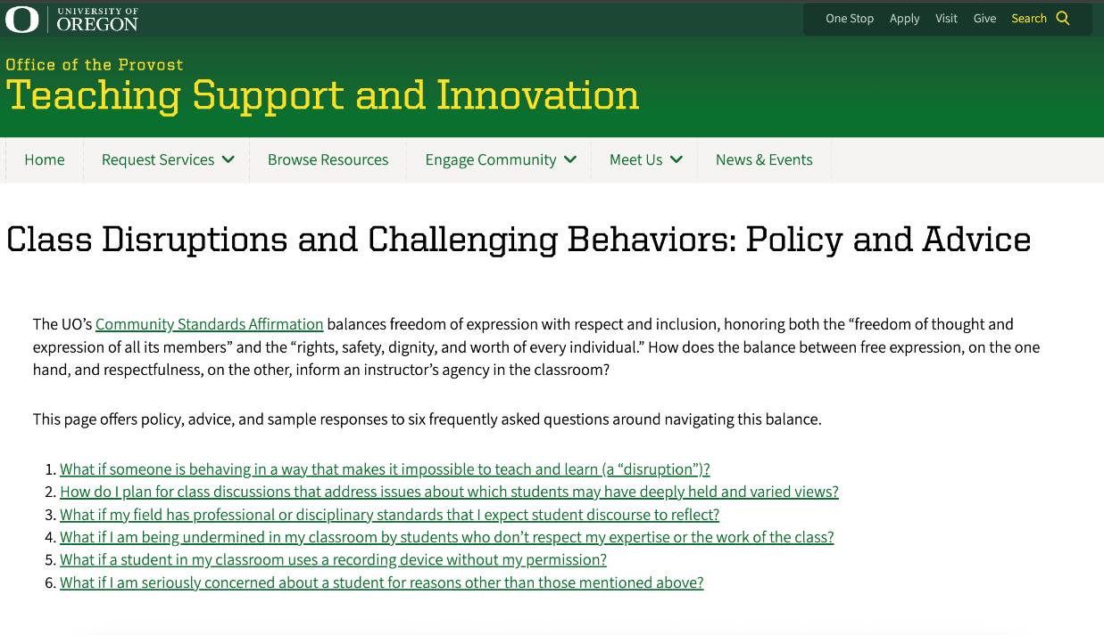
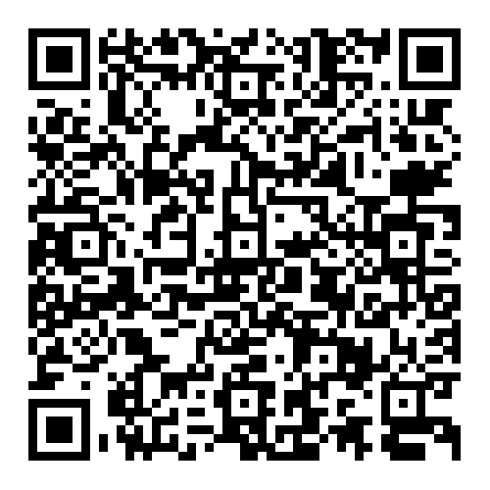
Debrief (C)
Cultural differences vs Class disruption
https://teaching.uoregon.edu/resources/class-disruptions-and-challenging-behaviors-policy-and-advice

Slide 9
Quick Break!
5 minutes only
Notes:
10 am

Slide 10
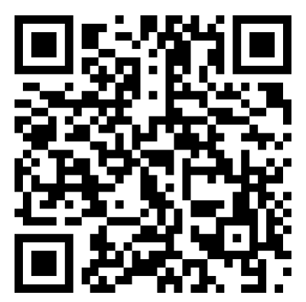
Pronouns
Important!
Avoid assumptions about gender
What pronouns do the presenters use—how do you know?
Many students use "they” instead of “she/he”
Best practice: If a student hasn’t revealed their gender, use ‘they’.
Add pronouns to your name tent, if you wish.
See details at UO's Division of Student Life
Notes:
Student life page—refer to this for our own info
Plus add link to the handout
5 minutes
Trish

Slide 11
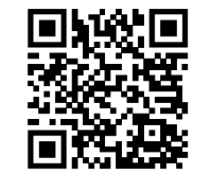
Public Service Announcement
Speak Test
Who Needs It? International students who…
plan to teach as GEs
have a speaking score lower than 26 on TOEFL or lower than 7 on IELTS
have no scores at all
What is the deadline?
BEFORE Fall term starts
How can you schedule it?
Email Alicia argoing@uoregon.edu
See me after this session!
For more information: https://ylc.uoregon.edu/aeis/speak-test
Notes:
SPEAK Test: International students who plan to teach as GEs and are entering UO with a speaking score lower than 26 on TOEFL or lower than 7 on IELTS or no scores at all are required to take the SPEAK test. Email Alicia (argoing@uoregon.edu) to schedule a test before the Fall term starts.

Slide 12

GRST 610 US Teaching: Culture and Communication
4 credits
CRN 16862
Time: Fridays 10:00-11:50
For international graduate students who expect to teach or serve as GEs during their time at UO. In this course, we focus on communication skills, understanding the U.S. university culture, and basic teaching skills at the university level.

Slide 13
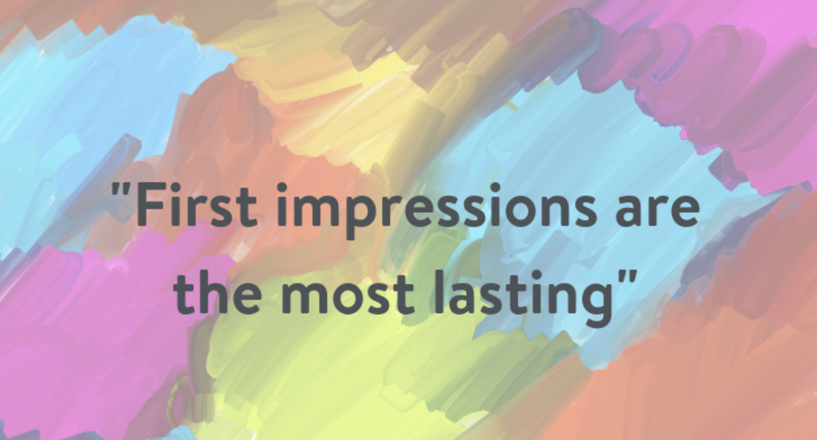
Teaching: The First Day of Class
What should happen on the first day of class?
From: https://theralph.vet/first-impressions-count/
Notes:
Alicia

Slide 14
Welcome to
GRST 610!
US Teaching: Culture & Communication

Slide 15
Instructor Intro
Alicia Going
uh-LEE-shuh
(she/her/hers)​

Slide 16
Office: McKenzie 160
Email: argoing@uoregon.edu
Office
Hours: Tuesday and Wednesday 10-12, or by appointment
Office Hours

Slide 17
Ice-breaker information
At this point in the class, I would do name tents and an icebreaker of some sort…just like we did at the beginning of this session…
Notes:
Some of my favorite icebreakers – Quote or Motto,

Slide 18
By the end of this 610 course, you’ll be able to…
Learning Objectives
• demonstrate strategies to communicate clearly with your students​
• use multiple teaching techniques that work effectively with U.S. undergrads
• design and create effective slides for teaching
• create interactive lessons that engage and motivate students
• identify and access UO resources that are available to students and teachers

Slide 19
Essential Course Information
This is a hybrid course.
Two hours in person weekly (Fridays).
All other work on Canvas.
This course is Pass/No Pass.
Active participation in class is expected.
Questions are welcome!

Slide 20
Teaching: The First Day of Class
How will you introduce yourself and the course?
Tell students what to call you (important!) (Hint: first names are the most common.)
Share a bit about yourself.
Find out a bit about your students. (Simple questions or self-introductions work or you could do a longer ice-breaker.)
Make clear that questions are welcome. Point out your UO email and office hours.
Share a bit about class expectations.
Most important: Share one or two real assets that you are bringing to the course and the students’ learning.

Slide 21
First Day of Class: Practice
Task: In groups of 3-4, practice introducing yourself on the first day of class.
1-2 minutes per person
Ask for feedback:
What worked well?
Any suggestion for improvement?

Slide 22
Teaching US Undergraduates: Strategies for International GEs
Dr. Ali Söken, Faculty Consultant, Teaching Engagement Program

Slide 23
Who I am
Ali Söken, he/his
Faculty Consultant
First-gen, international student from Turkey. Coming from a low-income family
Ph.D in Teacher Education and Curriculum Studies
Family – 6 year-old daughter, love cooking
Notes:
Very brief

Slide 24
You are ENOUGH! You are not alone… You already have what it takes to succeed.

Slide 25
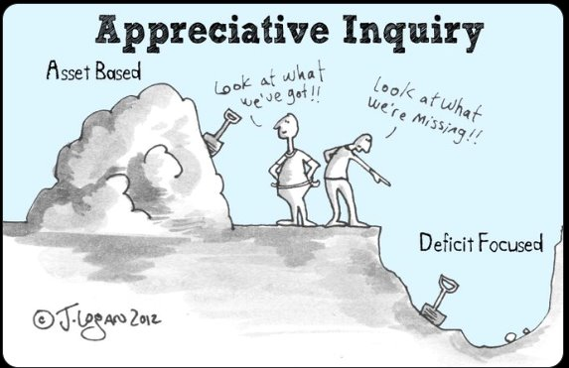
Asset vs. Deficit based Approach
Asset Based | Deficit Based
Strengths Driven | Needs Driven
Opportunity focus | Problems focused
Internally focused | Externally focused
What is present that we can build upon? | What is missing that we must go find?
May lead to new, unexpected responses to community wishes? | May lead to downward spiral of burnout, depression, or dysfunction?
Reference: https://www.memphis.edu/ess/module4/page3.php
Notes:
Rather than asking ‘what am I missing,’ ask: ‘what do I already bring?’ You bring global insight, multilingualism, persistence, and new ways of thinking. These are teaching strengths.

Slide 26
Navigating Emotional Labor
Teaching in a new setting is real work
Struggle ≠ failure—it means you care
Emotional labor → empathy, insight, growth
Notes:
Teaching in a second language or unfamiliar classroom culture is both emotionally and cognitively demanding. It’s okay to name that.
The emotional labor you’re doing isn’t a weakness—it’s a strength. It builds empathy, deepens your preparation, and allows you to connect meaningfully with students.
Normalize the idea that “this is hard”—and that’s not a sign of inadequacy.

Slide 27
Building a Supportive Community
Quick check-ins → trust & care
You bring global perspectives
Polls & feedback = shared ownership
Belonging grows with presence + structure
Notes:
Start with short check-in questions—“What’s one word for your week?” or “What’s one thing you’re proud of?” Small gestures build long-term trust.
Your identity, accent, and culture are assets. Invite your students into a space that embraces inclusion and difference.
Use low-stakes surveys or polls to understand students’ needs and preferences. Let them help shape the class.
Classroom community is built with, not for, students—be clear and responsive, but also gentle with yourself.

Slide 28
Humanize Your Teaching Practice
You're a facilitator
Everyone teaches and learns
“I don’t know”—models curiosity
Grow with your students
Notes:
You don’t need all the answers—what matters is that you guide, encourage, and create a space for inquiry.
Teaching is relational. You’re not just teaching at students—they’re teaching you too.
Saying “I don’t know, but I’ll find out” is a powerful, trust-building move.
Especially in a new cultural setting, every class is an opportunity to learn and grow together—this is a partnership.

Slide 29
TEP is here to help!

Slide 30
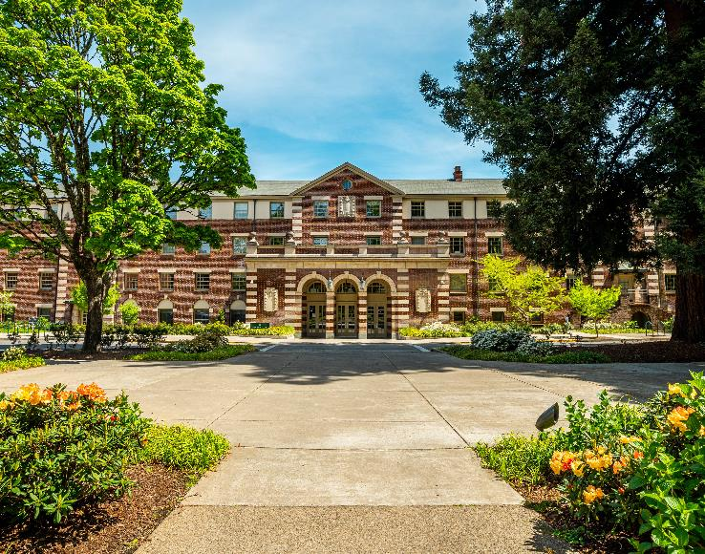
Teaching Engagement Program [TEP]
We provide teaching support to GEs and faculty across campus through:
Individual consultations
Teaching workshops
Graduate Teaching Initiative certificate
Teaching Support and Innovation website
Teaching awards, like the Kimble Award for GEs
TEP offices located in Straub Hall—4th Floor
Notes:
Very brief—one minute or less.

Slide 31
You are not alone!
For teaching support, in addition to your unit:
In supporting your students:
Connect with TEP and UO Online for
Consultations (aka any teaching related questions or discussion)
Workshops
Course observations
Graduate Teaching Initiative certificate and community
Connect with AEC for any questions on student accommodations in your courses
You can always reach out or refer your students to:
Dean of Students, including their Student Care Team
Tutoring and Academic Engagement Center (TAEC)
Counseling Services
Not sure where to refer a student or what to do? Contact the Dean of Students.

Slide 32
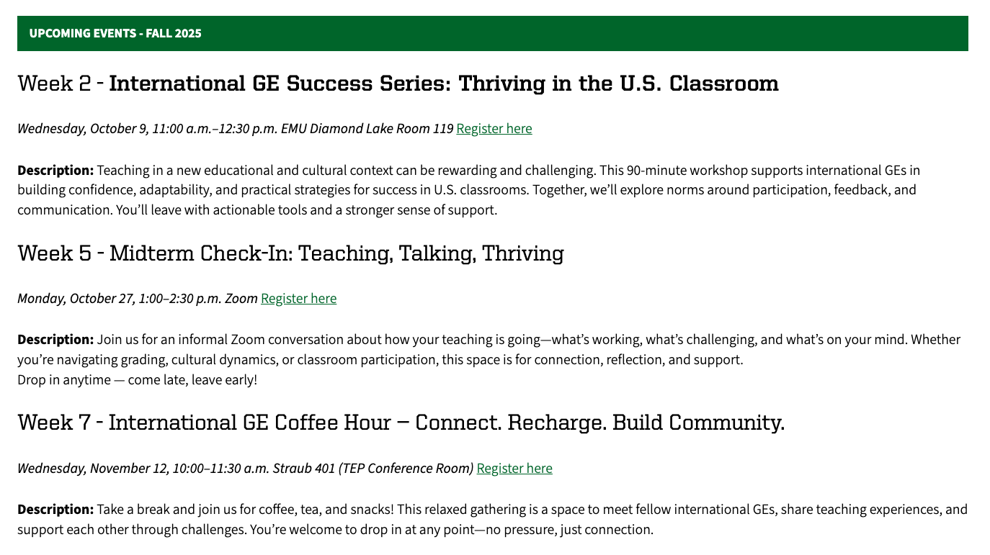
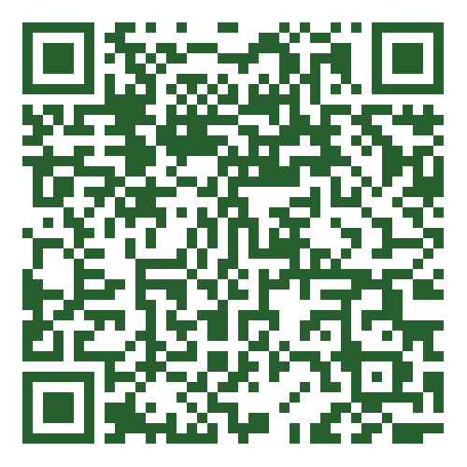
TEP International GE Success Series
teaching.uoregon.edu/services/graduate-employee-teaching-support

Slide 33
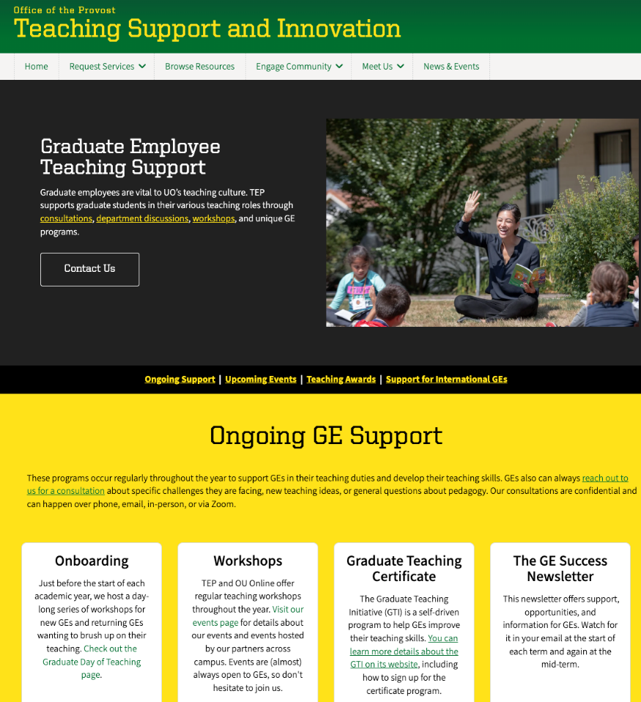

TEP – GE Support

Slide 34

You are not alone!
Please reach out! alisoken@uoregon.edu
Straub Hall – Room404
Contact us at tep@uoregon.edu with any questions
Visit teaching.uoregon.edu for more resources

Slide 35
Teaching Engagement Program

Slide 36
Break
5 min

Slide 37
Panel of Experienced GEs
Luis Claveria Cambon
Political Science
Giovanni Francischelli
School of Journalism and Communication
Sophia Suo
East Asian Languages & Literatures
JY Lin
Sociology

Slide 38
Panel Questions
Please briefly introduce yourself (name, department, where is home for you, teaching experience)
What is one piece of advice you have for someone new to teaching at UO?
What do you wish you had known when you first started teaching?
What is one challenge you’ve experienced while teaching, and how did you overcome it?

Slide 39
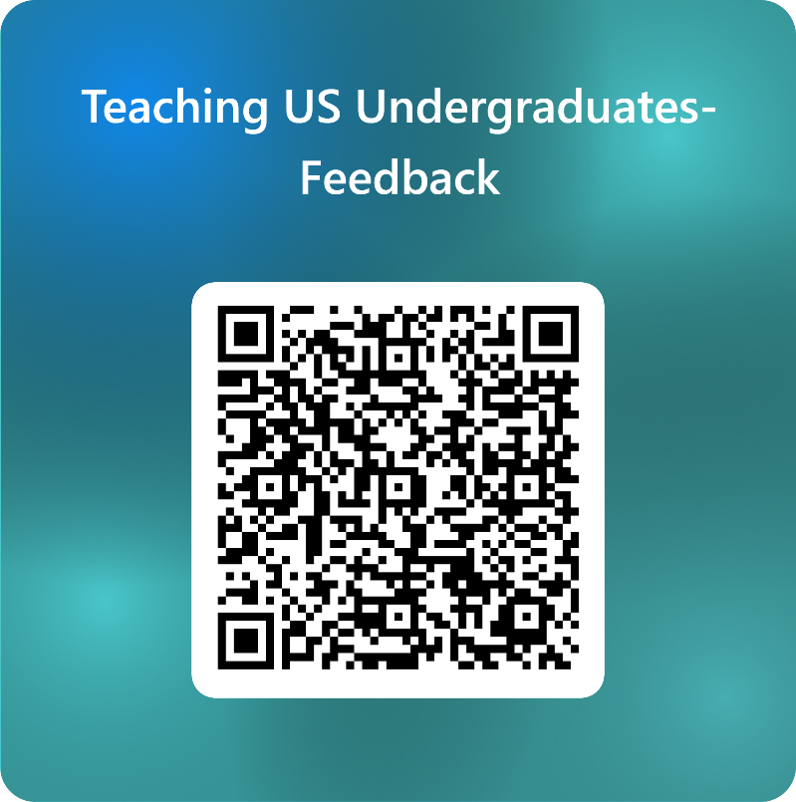
Please share your feedback!

