Slide 1

TEP Teaching Team Tidbits
These slides are to help you introduce your teaching team members to key teaching ideas. Share ones that fit your teaching style and pedagogy to keep all of you on the same page and unify the learning experience of your students.
Inspired by work from Nicola Barber
and Jana Prikryl, UO Biology
Adobe Stock Image #26897656, used under an educational license.
Version 1, Sept 2025
Notes:
Be

Slide 2
Using These Slides
These aren’t intended to be a single presentation. Slides contain individual ideas that you can pick and choose from to fit your needs. They are (hopefully) brief and hit key points on (1) how to use the ideas and (2) the reason they are beneficial to students.
Try showing one slide/idea during team meetings, for example by
  spreading your pedagogy out by adding one to each team meeting,
  introducing a new idea just before you use it in class, or
  sharing an idea to support GEs in enacting good teaching practices.
Boxes with blue headers have prompts or activities for GEs. Just like using active with your students, this will get GEs thinking about the ideas, instead of just listening to you talk.
Some slides are set up to have textboxes appear sequentially (animations). If you do not want that, follow Microsoft’s directions to remove animations from PowerPoint slides.

Slide 3
Contents of this Slide Deck
Pick and choose slides to share that fit your pedagogy and course
Big Picture Ideas
UO Defines Good Teaching as…
TEP & GEs (programing we offer)
Student Anonymity
Growth Mindset
Universal Design in Learning
Metacognition
Scaffolding
Student Learning Skills
Hidden Curriculum*
Facilitating Class
Use Student Names and Pronouns
Wait Time and Equal Participation
Active Learning
Easing Students in Participation
Use Student Roles for Group Work*
Ice-Breakers*
Active Learning Methods
Minute Paper
Document Analysis
Think-pair-share
Strip Sequence
Exit Ticket
Circle of Voices
Jigsaw
Small Group Discussion
Gallery Walk
Ideas with an asterisk (*) are split over two slides – the first slide has multiple prompts for GEs to consider and the second has “answers” to the prompts. You could just use the second slide on its own.

Slide 4
Big Picture Ideas
UO Defines Good Teaching as…
TEP & GEs (programing we offer)
Student Anonymity
Growth Mindset
Universal Design in Learning
Metacognition
Scaffolding
Student Learning Skills
Hidden Curriculum*

Slide 5
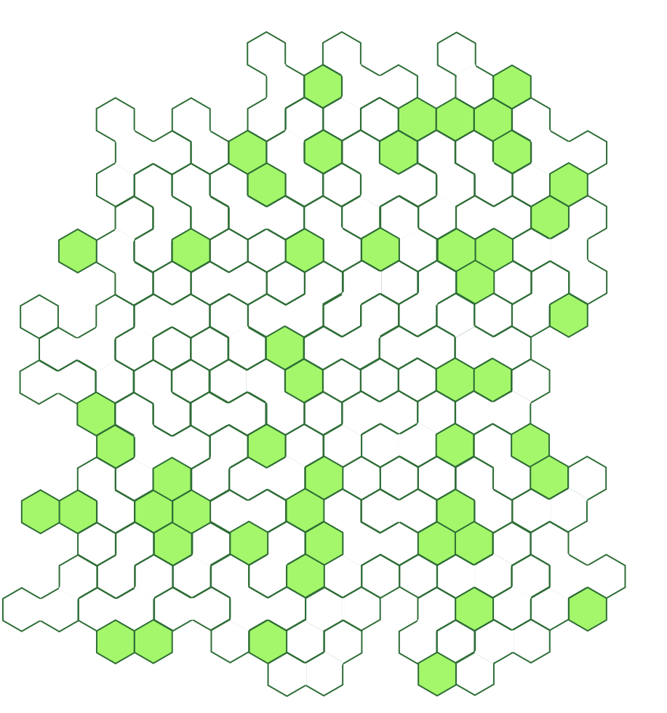


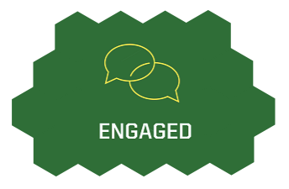

UO Defines
Good Teaching As…
Professional: Basic practices necessary for a high-quality course.
Inclusive: Every student belongs and is valued. Materials are diverse and evolving.
Engaged: Instructors reflect on and revise their course and teaching strategies.
Research-informed:
Evidence-based teaching strategies
Models a process or culture of inquiry.
Learn more: https://teaching.uoregon.edu/PIERS
Notes:
Professional: Course is organized. Communication is timely and clear. Activities maximize student learning.
Note that these are not just internal TEP definitions. This is a definition the University created and are how faculty teaching is evaluated. Departments choose how GEs get evaluated, and hopefully would closely follow these.
Each of these have specific actions associated with them to guide instructors in how to be a good teacher. Learn more at link!

Slide 6
Teaching Engagement Program (TEP) & GEs
TEP is the department within the Office of the Provost dedicated to helping faculty and GEs improve their courses and teaching.
GE Onboarding
Graduate Teaching Initiative
On the Wednesday before Fall term, TEP runs the GE Day of Teaching - a series of workshops for new GEs and returning GEs wanting to brush up on their teaching.
The GTI is TEP’s self-driven program to help GEs improve their teaching skills. Work at your own pace on activities toward earning a (non-transcript) certificate.
Workshops & Consultations
GE Success Newsletter
TEP and UO Online run workshops through the year on a variety of teaching topics. Consult one-on-one with TEP about challenges or questions.
This newsletter offers support, opportunities, and information for GEs. Watch for it in your email twice per term.
Learn more: https://teaching.uoregon.edu/GEs

Slide 7
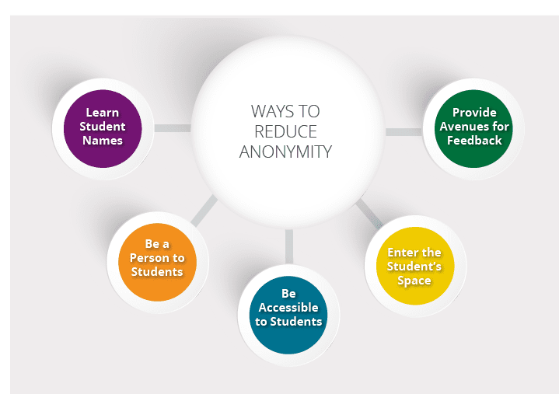
Student Anonymity
Brainstorm together…
Ways to reduce anonymity
Why does it matter?¹
High anonymity…
reduces student satisfaction with a course
increases distracting actions (talking in class, web-surfing, etc.)
can foster temptation for academic misconduct
reduces students’ personal accountability and engagement with the course
Learn student names
Be a person to students
Be accessible to students
Enter the student’s space
Provide avenues for feedback
Image from [1]
The Center for Teaching and Learning. (N.D.) Teaching Large Classes. UNC Charlotte.
Notes:
Learn Student Names – Ask students to say their name when speaking in class. Thank them for their input and repeat their name. call on folks by name if you know them. Ask for and use names in office hours. Use early term survey to learn about a student before they come to an appointment.
Be a person to students – When introducing you (and your teaching team), share details about you outside of class.
Be accessible to students – chat with students before and after class. Invite students to grab an informal coffee with you after class. Remind folks of office hours regularly.
Enter the Student’s Space –Don’t just hide behind a podium. Walk around. Go up stairs, in between rows. Sit with students while they work in groups, or present for the class.
Provide Avenues For Feedback – exit tickets (muddiest point), M-SES. After collecting in feedback, debrief it with students and note what changes you will make and why you are unable to make other changes students have suggested.

Slide 8
Growth Mindset
In a small group…
“the belief that intellectual abilities are not fixed but rather can be developed, for example, through hard work, good strategies, and help and mentoring from others.” [1]
Why does it matter?
Student racial achievement gaps were half as large for faculty who reflected a growth mindset over a fixed mindset [2]
A faculty’s mindset was faculty characteristic that influenced achievement the strongest [2]
A faculty’s fixed mindset beliefs harmed student motivation and their sense of belonging. It also influenced students to adopt a fixed mindset for themselves. [3]
Which of these example homework feedbacks better reflect a growth mindset?
This isn’t the correct method. As we did last Friday, you should calculate the salinity inside and outside the cell and then use the difference to figure out the concentration of ions (and their type) that flowed into the cell.
Your calculations of salinity are correct and on the right track, but you didn’t quite use your results correctly this time. How could you adapt our approach from a similar problem last Friday to work here? Come visit office hours If you want to practice working on more examples of this type of problem together.
Notes:
Dweck, C.S. & Yeagar, D.S. (2020). A Growth Mindset about Intelligence. In Ed. Walton G.M. & Crum, A.J. (Eds), Handbook of Wise Interventions (pp. 9-35). New York: Guilford Press, 2020
Canning, E., Muenks, K., Green, D. J., & Murphy, M. C. (2019). STEM faculty who believe ability is fixed have larger racial achievement gaps and inspire less student motivation in their classes. Science Advances, 5(2).
Muenks, K., Yan, V. X., & Telang, N. K. (2021). Who Is Part of the "Mindset Context"? The Unique Roles of Perceived Professor and Peer Mindsets in Undergraduate Engineering Students' Motivation and Belonging. Frontiers in Education, 6, 633570.

Slide 9
Universal Design in Learning (UDL)
Key UDL Principles
Use multiple ways to share content and information
Examples: use texts that are screen-readable, provide multiple definitions, define acronyms.
Use multiple ways to connect to students through their interest and motivation
Examples: options to engage with activities, activities authentically connect to real life, low-risk assignments, metacognitive activities.
Use multiple ways students can demonstrate their learning
Examples: use accessible tools and software, different formats to turn in work, scaffold learning for students.
Strategy to design learning materials and environments to be accessible to all to reduce need for individual modifications or accommodations.
Why does it matter?
46.5% of incoming 2023 UO undergrads self-identify as having one or more disabilities
14% of UO undergrads have accommodations through the AEC
In 2011, 47% of UO students screened positively for major or moderate depression, 41% for anxiety.

Slide 10
Metacognition
Model Expert Metacognition for Students
“Think aloud” for students by talking about
your initial impressions to a problem or text,
basic questions you ask yourself to get started,
immediate associations or connections you make,
your preliminary speculations or hypotheses, etc.
Self-reflection on how and why students learn through planning, monitoring, and evaluating their own learning process.
Why does it matter?
Improves student exam performance, written or designed products, and problem-solving ability (Nilson, 2013).
Helps students improve their sense of self-efficacy and independent agency, which in turn increases their motivation to learn (Ambrose, et al. 2010).
Use Metacognitive Activities
Assignment Wrappers: Before a paper/lab/exam, students describe a plan for completing it. After the assignment, students reflect on if their plan supported success or if changes could benefit future assignments.
Exit Tickets: To conclude a class, lesson, or reading, students write about what they learned or questions they still have after completing it.
Nilson, L. B. (2013). Creating self-regulated learners: Strategies to strengthen students' self-awareness and learning skills. Sterling, VA: Stylus.
Ambrose SA, Bridges MW, DiPietro M, Lovett MC, Norman MK. 2010. How Learning Works: Seven Research-Based Principles for Smart Teaching. Jossey-Bass, San Francisco, CA.

Slide 11
Scaffolding
1. Brainstorm together…
From our course, what ideas, processes, or assignments could be broken into their component skills to help students’ learning?
Breaking down complex tasks and ideas into steps, stages, parts or pieces (often called component skills) that students can develop.
Why does it matter?¹
Students lacking component skills can struggle to master the full task
Targeted practice on component skills can improve full task performance
As experts, we can see how a complex task is built from its component skills. Novice students may not.
2. Write on your own…
For one item in our list, what are component skills that students need to learn or practice to succeed in developing the full task?
3. Discuss in Small Groups…
Compare your component lists. What type of assignments or activities could support students in developing each component?
Ambrose SA, Bridges MW, DiPietro M, Lovett MC, Norman MK. 2010. How Learning Works: Seven Research-Based Principles for Smart Teaching. Jossey-Bass, San Francisco, CA.
Notes:
See also: https://www.buffalo.edu/catt/teach/develop/build/scaffolding.html
Chapter 4 of Ambrose,, et al (2010).

Slide 12
Student Learning Skills
Elaboration
Cognitive psychology research^{1,2} points to effective learning and studying strategies.
Why does it matter?
Students often use ineffective
methods to study and learn
Helping our students learn should include helping them do it effectively
They are our students, we should support their success in our course
Have students describe ideas with as many details as they can.
Interleaving
Switch between topics, ideas, etc. rather than focusing on one at a time.
Retrieval Practice
Recall information from prior lessons, courses, etc. before looking back at notes
Chat with a neighbor…
How have these skills been built into our class or what are ways we could include them in activities or assignments?
Spaced Practice
Spread out studying over time (no cramming!)
Smith, M. & Weinstein, Y. (2016) Six Strategies for Effective Learning. The Learning Scientists
Ambrose SA, et a.. 2010. How Learning Works: Seven Research-Based Principles for Smart Teaching. Jossey-Bass.

Slide 13
Hidden Curriculum
1. Brainstorm in a small group…
What is some guidance, information, or ideas you wished someone had shared with you early in your college career?
The unwritten rules, expectations, values, behaviors, etc. of college.
2. Chat with a neighbor…
What populations of students do you think might be most impacted by not knowing about the hidden curriculum?
3. Brainstorm together…
What can we do to reveal the hidden curriculum to our students?
Notes:
Active Learning Slide
Revealing hidden curriculum to support first-gen and transfer students

Slide 14
Hidden Curriculum 2
Reveal the Hidden Curriculum
Remind students about support – office hours, Counselling Services, TAEC and other campus help centers, etc. Normalize and explain their use
Guide learning/study skills – assign reading questions to answer, use reading annotations tools, provide study guides, share partial notes or half-completed slides for students to fill in
Write assignments that clearly describe purpose, task, and grading criteria. Use good rubrics.
Make learning personal – share your experiences and interests, connect content to student lives
Use metacognitive assignments to help students reflect on their own learning
Share the reasons for your pedagogical choices
Define academic/university terms clearly
The unwritten rules, expectations, values, behaviors, etc. of college. For example,
How should I prepare for class?
What are office hours? Can I go?
What do I take notes on during class?
How do I study for exams?
I’m struggling. What can I do?
Why does it matter?
Students without knowledge of hidden curriculum can struggle in courses and feel excluded from the community
Class, department, campus support structures can be difficult to navigate
These challenges particularly impact first generation and transfer students.
Notes:
Revealing hidden curriculum to support first-gen and transfer students
https://lthechat.com/2025/02/03/lthechat-317-the-hidden-curriculum/
https://link.springer.com/article/10.1007/s11217-018-9608-5

Slide 15
Facilitating Class
Use Student Names and Pronouns
Wait Time and Equal Participation
Active Learning
Easing Students in Participation
Use Student Roles for Group Work*
Ice-Breakers*

Slide 16


Use Student Names and Pronouns
Tips for Using Name Tents
Half-sheets of paper,
folded in half again
Thick, card-stock paper lasts longer than regular copier/printer paper.
Write with markers (not pen/pencils) to greatly improve readability.
Write name on front and back of the tent so neighboring students can see names too.
To reduce name tent loss, collect them at the end of class. Passing them out next class helps you practice connecting names and faces.
Allie
Name tents to help you learn names. Peak at them to call on a student by name while you are still learning.
Invite students to share their pronouns and model by sharing your own.
Why does it matter?
Learning and using student names and pronouns improves sense of belonging.
Helping students learn each other’s names improves collaboration and engagement.
Learn more: the Division of Student Life has resources on understanding pronouns.
Allie she/her/hers

Slide 17
Wait Time and Equitable Participation
Make a prediction…
How long do instructors typically wait for students to answer their question?
Students don’t immediately know the answer to your questions. That includes when you ask them what questions they have.
Why does it matter?
Improves number of students willing to speak out in class
Improves quality of student answers
Sets tone that you want to hear ideas and input from all students
Increases number of voices heard in class (not always the same few)
Research often measures under 3 seconds^{1,2}. It is better to wait 10+ seconds.
When asking if students have questions, wait even longer for them to figure out what they want to know.
Multiple hands, Multiple voices
When asking students a question, do not call on the first person who raises their hand. Wait for multiple hands and call on them in reverse order of being raised.
Deborah Allen, D. & Kimberly Tanner, K. (2002). Approaches in Cell Biology Teaching. Cell Biology Education, 1(1).
Tobin, K. (1987). The Role of Wait Time in Higher Cognitive Level Learning. Review of Educational Research, 57(1).
Notes:
Wait time and equitable participation. 3-5 seconds after posing question. Multiple hands, multiple voices.

Slide 18
Active Learning
Chat with a neighbor…
What was the most beneficial in-class activity that you remember from being a student? What made it so powerful to you?
“Anything that ‘involves students in doing things and thinking about the things they are doing’” [Bonwell and Eison, 1991]
Why does it matter?
Decades of evidence for improvement in student learning. For example, Martella, et al. (2024) found improvement in student scores and self-reported enjoyment when active learning methods were mixed into lecturing.
Implementation
Describe the activity to students (at least the first time you use that type).
Give students ample time to work on it. Check in on them as they work.
Wrap up by having students share their ideas before you give “the answer,” if there is one.
Bonwell, C. C., & Eison, J. A. (1991). Active learning: Creating excitement in the classroom. ASHE-ERIC Higher Education Report No 1. Washington, DC: The George Washington University, School of Education and Human Development.
Martella, A.M., et al. (2024) Investigating the Intensity and Integration of Active Learning and Lecture. Journal of Applied Research in Memory and Cognition. 13(3).

Slide 19
Easing Students into Participation
Ice Breakers
Have students discuss a fun or a course-related question with neighbors.
Particularly early in a term, students may hesitate to engage with each other and the class. Help get the gears turning and build early confidence.
Why does it matter?
Builds community between students
Sets expectations about student participation in class
Can be used for metacognitive questions to help students judge their own understanding
Getting Students Thinking
Have students draw on their own experiences or past course work. Give students time to think on their own or chances to chat with a peer.
Soliciting Questions
Ask “What questions do you have?”, “What have I forgotten?“, or “What is still unclear?” to normalize uncertainty and reaching out for support.
Notes:
Ice-breakers in class. Soiciting student thinking. What questions do you have instead of do you have any questions?

Slide 20
Use Student Roles
For Group Work
On Post-It Notes…
Brainstorm tasks students may need to complete while working in a group. Record your tasks on the Post-its — one task per note.
Assign roles and rotate them each class
As a group…
Combine notes with similar tasks and create 4-5 “roles” for students to take on. Give each task list a name for its role and write a short description you could share with students.
Brainstorm together…
What benefits are there to having students use rotating roles to guide their group work?
Notes:
Active Learning Slide
https://ctl.wustl.edu/resources/using-roles-in-group-work/

Slide 21
Use Student Roles
For Group Work 2
Possible Group Roles
Analyst – calculates values or leads other analysis from recorded data
Checker – verifies all pieces are completed
Data recorder – records measured values in chart or other format
Facilitator – guides the group’s work
Measurer – Manages tools used to make lab measurements
Notetaker – takes notes on work done and group’s discussion or ideas
Presenter – speaks for the group in full class discussions
Questioner – Challenges group’s assumptions and pushes for alternative ideas or approaches
Assign roles and rotate them each class
Why does it matter?
Improves participation by all group members
Rotating roles disrupts stereotypical and gendered role assignments
Improves attentiveness to the task at hand
Reduces distraction and improves time on task
Encourages individual student accountability
Notes:
https://ctl.wustl.edu/resources/using-roles-in-group-work/

Slide 22
Ice-Breakers
With a neighbor…
Come up with:
2 ice-breakers that are general or “fun” questions, and
2 ice-breakers that are questions related to the course. Ice-breakers aren’t a quiz, so they should not be about course content.
Brief discussion questions for students for the first day of class or to start off any class session. Students can talk with neighbors or share their answers with the whole class.
In small groups…
What benefits do you think are there for asking students to engage with each other early in the class using low-stakes questions?
Notes:
Active Learning Slide

Slide 23
Ice-Breakers 2
Example Ice Breaker Questions
General / Fun Questions
What did you do this past weekend/class break?
When you cook for yourself, what is your go-to?
If a song played every time you walked into a room, what would that song be?
What is your favorite snack, TV show, or hobby?
Course-Related Questions
Why are you taking this course?
How did you prepare for the recent exam?
What topic did you find most interesting last week (or last class)?
When you get stuck on homework, what’s your plan for getting help?
Brief discussion questions for students for the first day of class or to start off any class session. Students can talk with neighbors or share their answers with the whole class.
Why does it matter?
Helps build community within your class
Jump-starts student interactions
Sets the expectations that students will engage with each other (and you) during the class
Notes:
Ice-breakers in class.

Slide 24
Active Learning Methods
UO Defines Good Teaching as…
TEP & GEs (programing we offer)
Student Anonymity
Growth Mindset
Universal Design in Learning
Metacognition
Scaffolding
Student Learning Skills
Hidden Curriculum*

Slide 25
Minute Paper
Steps
Give students a prompt and two or three minutes free writing a response.
Ask at least one student to share what they wrote.
(Optional) Collect responses to review. Don’t grade responses, but you can give completion credit.
Students spend a few minutes free writing about a prompt you give them.
Benefits:
Provides you immediate feedback about student understanding,
Helps students prioritize items for review or discussion
Affords students the opportunity to put material into their own words
Prompt Ideas
Correct the Error: Present students with a statement, equation, or visual that you have intentionally made incorrect and have them correct the error.
Prediction: Students predict the result of a demonstration, the result of a research study you have described, or that day’s lab.
Retrieval Practice: Without using their notes, students describe an idea from earlier in the term that will be critical to that day’s lesson, activity, or lab.
Find more prompt ideas on our
Student Engagement Techniques page

Slide 26
Document Analysis
Steps
Student read a document (article, essay, infographic, etc.) during class and discuss it after. Documents can be handed out in hard copies, be a section of the textbook, or shared as a digital file on Canvas.
Benefits:
Promotes critical thinking
Practices real world skills
Revealing prompts before reading helps students focus on key ideas
Students can often read faster than you can lecture on a new topic. Use a reading to introduce straightforward ideas and then dig deeper with your activity.¹
Provide students with a copy of a document to read or study during class.
Help guide student reading with prompts: questions to discuss after reading, key ideas to look for, or ask them to come up with their own questions about the reading.
Give students time to read the document.
After a set time, use the prompts you've given as a starting point for an activity - discuss the document as a class, talk about it in smaller groups or pairs, or have students write a short reflection on it.
Felder, R. M., Brent, R. (2024). Teaching and learning STEM : a practical guide (Second edition.). John Wiley & Sons, Inc. [Chapter 4]

Slide 27
Think-Pair-Share
Steps
Pose a question and give students time to think about their response.
Students get into pairs and discuss their answers, coming to some resolution.
Each student pair then shares conclusions with entire class or what concepts they were exploring as responses (in large classes or when time is limited, call on as many pairs as time allows).
Spur student thinking and discussion.
Benefits:
Promotes critical thinking
Encourages collaborative learning
Reduces anxiety of sharing individual thoughts to the class
The bread-and-butter of student engagement techniques.
Variations
Turn and Talk: Skip the "think" step and jump right into paired discussion with a neighbor
1-2-4: After students chat in pairs, have each pair join with another to build on their joint ideas or to probe the other pair’s thinking

Slide 28
Strip Sequence
Steps
Provide students with an out of order list of steps in a multi-stepped process (can be written on small strips of paper or on the class screen).
In groups or individually, have students put the “strips” into the correct order from beginning to end.
Have student groups compare answers with another group.
Review “correct” order and answer questions (especially to clarify misconceptions) for the whole class.
(Optional) Discuss impacts of changing the order of steps.
Students order steps in a process.
Benefits:
Promotes critical thinking
Encourages collaborative learning
Potential Uses:
Review a process that students have previously studied
Check students understanding of pre-class reading (particularly instructions in labs or studios)
Investigate relationship between different pieces of a sequence

Slide 29
Exit Ticket
Steps
At the very end of class, give students a prompt and two or three minutes to free write a response.
As students leave, collect their responses and review them. Don’t grade responses, but you can give students completion credit.
Before students leave class, have them reflect in their learning.
Benefits:
Provides you feedback about student understanding.
Affords students the
opportunity to put material into their own words
Can track student attendance,
if you ask students to sign responses
It’s good practice to reflect student ideas back to them, particularly to address common student questions or misconceptions.
Powerful Prompts
Knowledge Growth: Ask students to reflect on what ideas, skills, understanding, etc. are clearer at the end of a class than they were before the class.
Main Point: Ask students to articulate what they think was the main point(s) of that day's lesson.
Muddiest Point: Pose a question such as “What was the least clear idea from today’s class?”

Slide 30
Circle of Voices
Steps
Present a question, case study, or quotation to the group.
Participants have two minutes to reflect silently or write down their response.
Participants form groups of five.
Each participant discusses their ideas for one minute each. *Direct listeners not to interrupt, interact with, or offer commentary for any speaker.
After the listening period is over, participants can offer their thoughts in open discussion; however, they are directed only to respond to others’ contributions, not their own.
In the final round, participants reflect on new perspectives and new questions that came up during discussion.
Students reflect on a prompt and everyone is given space to share their opinions and insight.
Benefits:
Encourages participation from all members
Ensures the widest possible range of views is heard early
Promotes active listening
Prevents dominant voices from overshadowing the discussion

Slide 31





Jigsaw
Steps
Students divide into small groups.
Each group answers a different question, works on a different step of a problem, studies a different topic, examines an idea through a different lens, etc.
Students form new groups with one member from each of the initial groups.
The new groups share ideas or answer a larger question, using insight from each initial group.
Students collaborate to pull different ideas together to answer a prompt.
Benefits:
Promotes collaborative learning
Requires all students to engage with the material
Solidify and Share Knowledge
Before forming new groups, have each initial group submit a written description of their conclusions / information to solidify it for all members. Share these descriptions with the whole class.

Slide 32
Small Group Discussion
Steps
Ask students to get into groups of 2-4
Pose a question for the group to consider.
Wrap up by inviting groups to share responses, calling on all groups to respond, have groups share with a neighboring group, or share conclusions digitally in a class-wide document.
Students work with others to answer a prompt posed to the class.
Benefits:
Promotes critical thinking
Encourages collaborative learning
Be careful: Make sure your prompt is challenging enough to require group members to spend time considering what they know (from readings, experience, data, etc.) and that multiple options could be considered before coming to any conclusion.
Prompt Idea - Group Graphic
Ask groups to illustrate lecture content by constructing a picture, diagram, flowchart, or other visual illustration that represents their understanding. When complete, have groups share and explain their images.

Slide 33
Gallery Walk
(Silent Discussion Wall)
Steps
Before class, place multiple prompts, images, or work products on the walls of the room. Give students their own small sticky notes or include a large, blank Post-it note on the wall at each station.
Invite each student to visit a station and interact with it by taking notes, adding responses, voting, rating using the Post-it notes, or discussing with others at the station.
After a set amount of time, students move to new stations and repeat.
Students discuss and answer prompts posted around the classroom.
Benefits:
Promotes critical thinking
Encourages collaborative learning
Engages kinesthetic learning

Slide 34
Closing Slide with the University of Oregon Logo
Unless otherwise noted, and except for University of Oregon logos and branding, this document is released under CC BY-NC-SA 4.0 licensing.

