Slide 1
Welcome & Getting Oriented

Slide 2
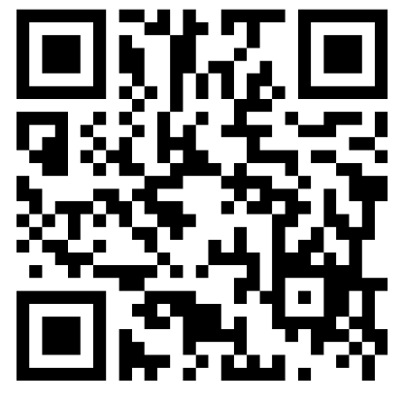

Teaching as the Instructor of Record: Welcome!
1
2
Sign in using the QR code or the physical sheet at the front table.
Introduce yourself to a neighbor
Talk about a particularly good instructor you’ve had. What made them so good?

Slide 3

Teaching as the Instructor of Record
GE Day of Teaching 2025
Julie Mueller, (she/her)
Senior Faculty Consultant
September 24, 2024
Notes:
Be

Slide 4
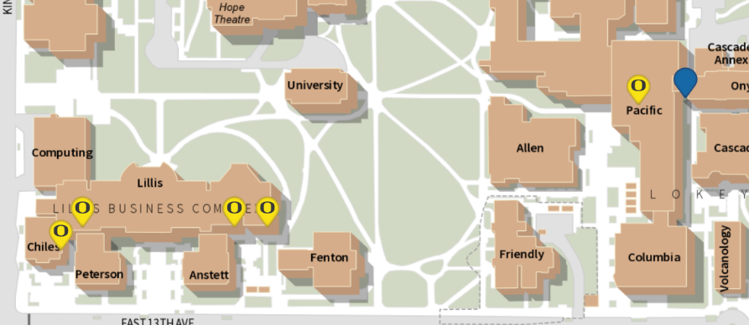
GE Day of Teaching Schedule
Time
9:00 | Teaching as the Instructor of Record Pacific 123 | Teaching US Undergraduates: Strategies and Tips for International Graduate Students Chiles 128
10:00
11:00
12:00
1:00 | Leading Labs Chiles 128 | Leading Discussion Sections Lillis 111, 175, 185
2:00
3:00 | Canvas Features and Tools – Pacific 123
4:00 | Teaching Insights Forum – Pacific 123

Slide 5
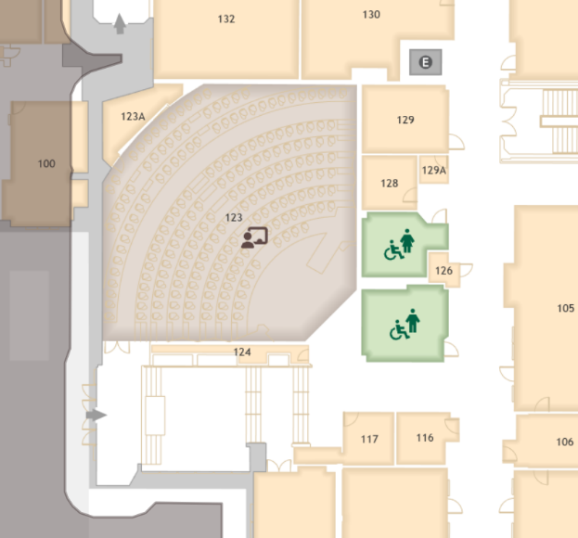
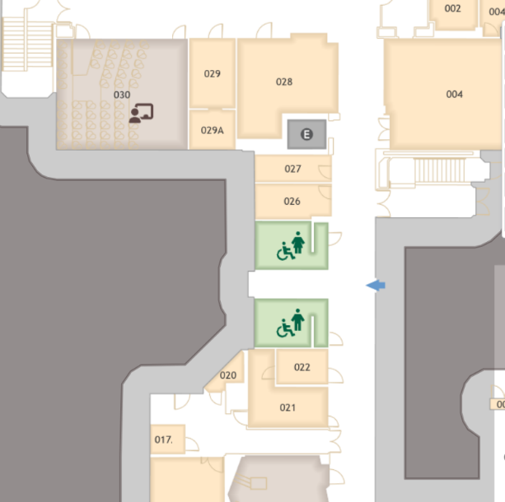
Restrooms!
Main floor
Basement floor
We are here
We are here
Lower exit
All Gender:
Pacific 2nd floor, Allen Hall 1st floor
Upper exit

Slide 6
Access the slides & other materials
teaching.uoregon.edu/ge-day-teaching-resources
teaching.uoregon.edu/uo-course-builder

Slide 7

Who are we?
Teaching Toolbox
Stand up if you’re new to UO.
Standing
Raise your hand if you’re in a Master’s program
Hand raising
How do you feel about the prospect of teaching on your own?
Throat vote
1
4
Paralyzed with nervousness and/or worry
Confident and eager to get started
Notes:
Very brief

Slide 8
Teaching as the Instructor of Record
How is teaching as the instructor of record different from other GE assignments? What will you need to do that you haven’t done before?
What are you excited about helping your students learn to know, do, experience, or feel?
What are you most concerned about? Teaching particular content? Course mechanics, administration? Other things?
Gather your thoughts.
Find a partner or two.
One be prepared to report out.
5 min
Think, pair, share

Slide 9
Our learning objectives for today: practical
By the end of the workshop, I hope you’ll feel confident:
Defining good teaching
Developing lesson plans that align with course objectives and engage students.
Employing active learning strategies in your teaching.
Assessing student performance and providing constructive feedback.
Creating a welcoming classroom.
Identifying the key components of an effective course syllabus.
Finding materials and resources to help you plan and teach your course.

Slide 10
Defining “good” teaching

Slide 11
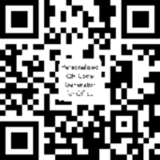
How would you describe "good teaching"?
With 2 partners:
Think of an excellent instructor you’ve had. What did they do that made them so good?
Go to Padlet site.
Tap the plus, input your ideas!
https://tinyurl.com/5b452b3d
7 min
Padlet

Slide 12
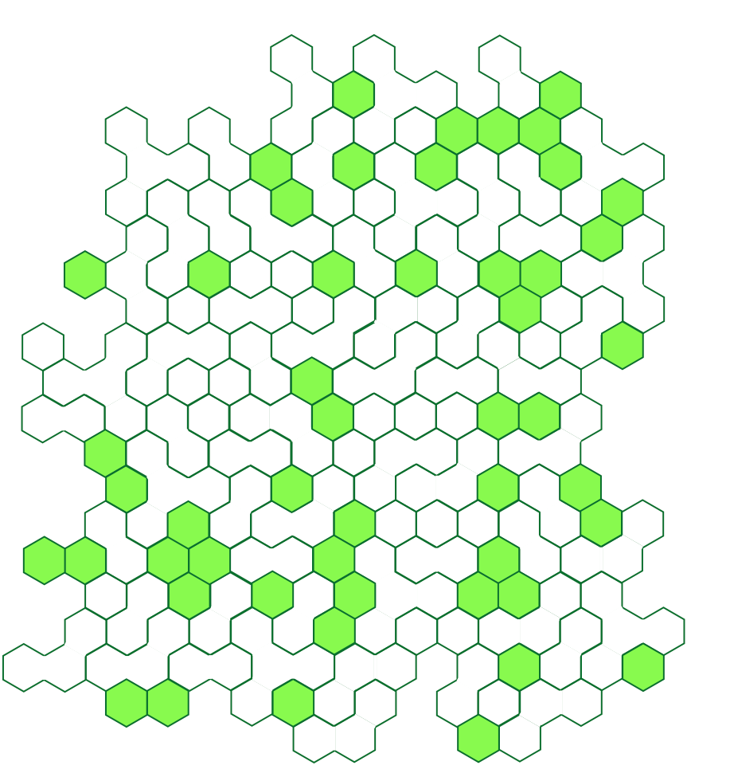




UO Defines Good Teaching As…
Professional: Basic practices necessary for a high-quality course.
Inclusive: Every student belongs and is valued. Materials are diverse and evolving.
Engaged: Instructors reflect on and revise their course and teaching strategies.
Research-informed:
Evidence-based teaching strategies
Models a process or culture of inquiry.
Learn more: https://teaching.uoregon.edu/PIERS
Notes:
Professional: Course is organized. Communication is timely and clear. Activities maximize student learning.
Note that these are not just internal TEP definitions. This is a definition the University created and are how faculty teaching is evaluated. Departments choose how GEs get evaluated, and hopefully would closely follow these.
Each of these have specific actions associated with them to guide instructors in how to be a good teacher. Learn more at link!

Slide 13
Designing a course: Principles and practices

Slide 14

Students must be engaged in their learning
“Learning is not a spectator sport. Students do not learn much just by sitting in classes listening to teachers, memorizing prepackaged assignments, and spitting out answers. They must talk about what they are learning, write about it, relate it to past experiences and apply it to their daily lives. They must make what they learn part of themselves.”
- Chickering and Gamson, 1987
Chickering, A. W., and Gamson, Z. F. (1987). “Seven principles for good practice in undergraduate education.” AAHE Bulletin, 39, 3-7.

Slide 15









What factors shape student engagement?
Information & Ideas
Environment
Value
Student Engagement
Ambrose, S.A., Bridges, M.W., DiPietro, M., Lovett, M.C., and Norman, M.K. (2010). How learning works: Seven research-based principles for smart teaching. San Francisco: Jossey-Bass.
Reflection
Experiences
Fink, L.D. (2003). Creating significant learning experiences: An integrated approach to designing college courses. San Francisco: Jossey-Bass.
Barkley, E.F. (2010). Student Engagement Techniques: A handbook for college faculty. San Francisco: Jossey-Bass.
Self-Efficacy

Slide 16
Checklist for Planning: Learning activities
Active Learning
Information and Ideas: How are students engaging content? [lecture, reading, research, discussion, etc.]
Experiences: What are students “doing” or “observing” to bring content to life and make it “theirs”? [activities, exercises, assignments, etc.]
Reflection: How are students being asked to determine, for themselves, the meaning and significance of their learning experiences? [debriefs, journals, portfolios, metacognitive exercises, etc.]

Slide 17
Checklist for Planning: Motivation
Motivation
Value: How has the value of the course, and particular aspects of it, been articulated? [goals, purpose, relevance, interest, significance, etc.]
Self-Efficacy: How do students develop a realistic sense of agency, confidence, and progress about their performance in the course? [expectations, rigor, feedback, strategies for success, etc.]
Environment: How has a supportive learning environment been cultivated? [communications, approachability, organization, check-ins, etc.]

Slide 18
Aligned “Backward” Design
Goals
What will students learn?
Learning Outcomes
What should students know or be able to do?
Summative Assessment
What evidence will demonstrate student learning?
Formative Assessment
How can students get feedback about their learning?
Activities
How will you help students meet goals?
Wiggins, G. P., & McTighe, J. (2005). Understanding by design. Ascd.
Notes:
Backward design is an approach to course design that focuses on student learning rather than on teacher performance. It is called “backward” because it starts with what students should know, understand or be able to do by the end of the unit/course/degree and works backward from there to inform development of course materials that specifically target successful achievement of the learning goals.
-The first step is to identify the learning goals/outcomes. Next, determine what evidence will convince you that students achieved the desire goals which become the course assessments. And, finally, with the achievement target clearly defined, create learning activities that will help students achieve the desired goals.

Slide 19
Key questions to ask
What should students know or be able to do?
How do students demonstrate what they know or can do?
How do students prepare for demonstrating their knowledge or skills?
How are students introduced to the content they’ll be using?
[What is the learning outcome?]
[What kind of assessment?]
[What kinds of experiences – activities, interactions, etc?
[How exposed to – retrieve or receive – the content?]

Slide 20
An example - 1
Try it! Work with a partner to answer questions 2, 3, & 4.
10 min
An example
What should students know or be able to do?
How do students demonstrate what they know or can do?
How do students prepare for demonstrating their knowledge or skills?
How are students introduced to the content they’ll be using?
Design (and follow) a study plan that uses strategies whose effectiveness is supported by research.
[What kind of assessment?]
[What kinds of experiences – activities, interactions, etc?
[How exposed to – retrieve or receive – the content?]

Slide 21
An example - 2
An example
What should students know or be able to do?
How do students demonstrate what they know or can do?
How do students prepare for demonstrating their knowledge or skills?
How are students introduced to the content they’ll be using?
Design (and follow) a study plan that uses strategies whose effectiveness is supported by research.
Students create a study plan that details which strategies they will use.
[What kinds of experiences – activities, interactions, etc?
[How exposed to – retrieve or receive – the content?]

Slide 22
An example - 3
An example
What should students know or be able to do?
How do students demonstrate what they know or can do?
How do students prepare for demonstrating their knowledge or skills?
How are students introduced to the content they’ll be using?
Design (and follow) a study plan that uses strategies whose effectiveness is supported by research.
Students create a study plan that details which strategies they will use.
Answer questions about prep material, practice recalling information about strategies, work in groups to define strategies and identify places to use them.
[How exposed to – retrieve or receive – the content?]

Slide 23
An example - 4
An example
What should students know or be able to do?
How do students demonstrate what they know or can do?
How do students prepare for demonstrating their knowledge or skills?
How are students introduced to the content they’ll be using?
Design (and follow) a study plan that uses strategies whose effectiveness is supported by research.
Students create a study plan that details which strategies they will use.
Answer questions about prep material, practice recalling information about strategies, work in groups to define strategies and identify places to use them.
Watch a video, read an article, class discussion.

Slide 24
“Backward” design
Design (and follow) a study plan that uses strategies whose effectiveness is supported by research.
1
Students create a study plan that details which strategies they will use.
2
3
Instructor Planning Steps
Answer questions about prep material, practice recalling information about strategies, work in groups to define strategies and identify places to use them.
Student Learning Experience
3
2
Watch a video, read an article, class discussion.
4
1

Slide 25
Creating a lesson: Have a throughline
Creating a lesson: Have a throughline
Pre-class prep
Required for
In-class activities
Required for
Post-class work
What activities might happen in each of these time frames?
How can we be sure students do the work?
Assign points to it
Link it to things they are interested in

Slide 26
Take a break!
Take a break!
Challenge: Wander around and find a piece of art in the vicinity of our classroom. What is it and why is it located here?
Possibilities: Pacific Lobby, Cascade Charley waterfall, Lawrence Hall.
If you haven’t signed in yet, please do so using the QR code or the paper at the front of the room.

Slide 27
Creating a lesson: Make it active
Information and Ideas
Primary / secondary
Accessing them in-class, out-of-class, online
Reflection
On what one is learning and how one is learning
Alone and with others
Experiences
Doing, observing
Actual, simulated
Fink, L.D. (2003). Creating significant learning experiences: An integrated approach to designing college courses. San Francisco: Jossey-Bass.

Slide 28
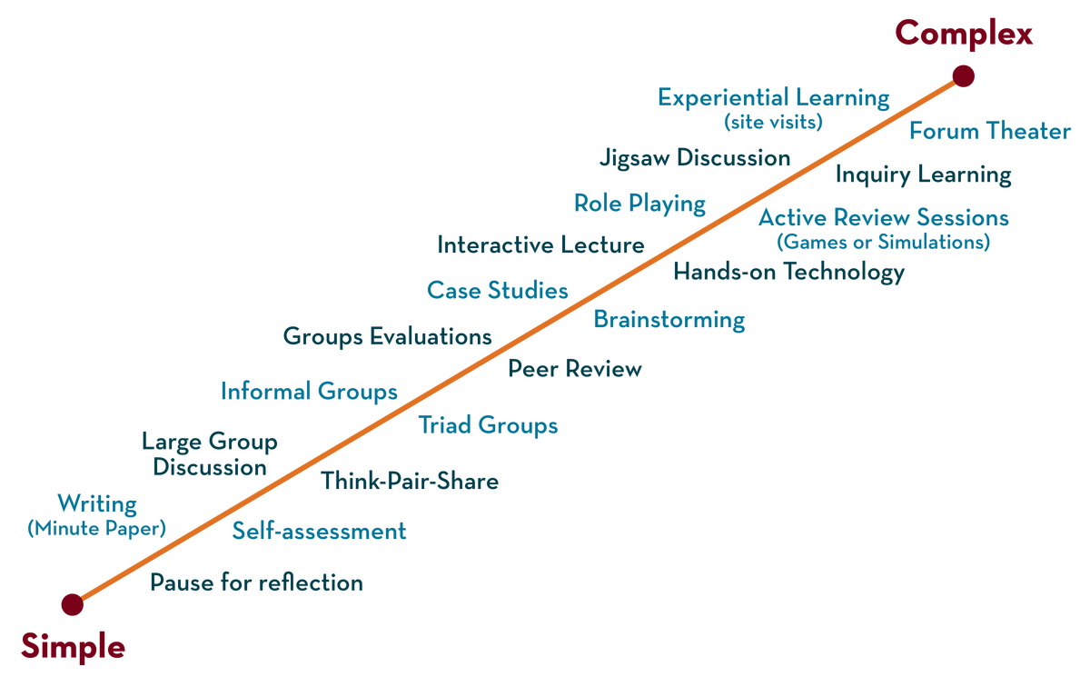
Types of activities
Types of activities
Provide opportunities for all students to engage with the material
Underprepared and underrepresented students benefit most from structure and active learning.
https://cei.umn.edu/teaching-resources/active-learning

Slide 29
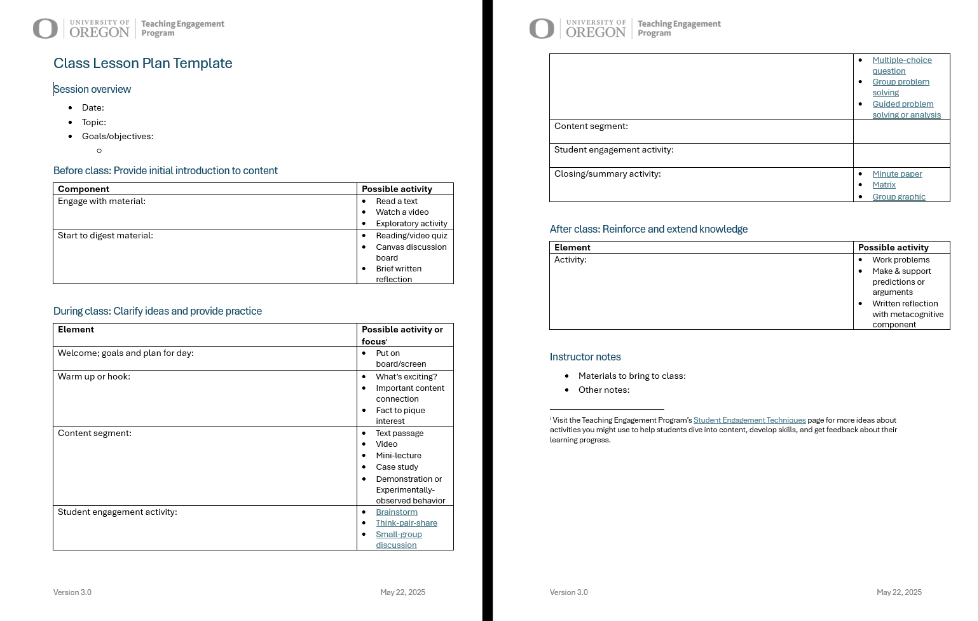
How to integrate it all?
tinyurl.com/class-session-planner-v-3
Try it! Sketch out a lesson for your course.
10 min
Worksheet

Slide 30
How to integrate it all? Across the term
How to integrate it all?

Slide 31

Creating a lesson: Make it transparent
Creating a lesson: Focus effort on the learning task
What questions arise for you when you get an assignment?
Minute paper
“What am I supposed to do, and how am I supposed to do it?”
“How am I being graded?”
“When is it due and where?”
“Why are we doing this?”
(aka “Why should I care?”)

Slide 32

What is transparency?
Over 25,000 students…
…in hundreds of courses…
…at more than 40 institutions…
…in seven countries.
A change to assignment design:
Purpose, Task (or Process), Criteria

Slide 33
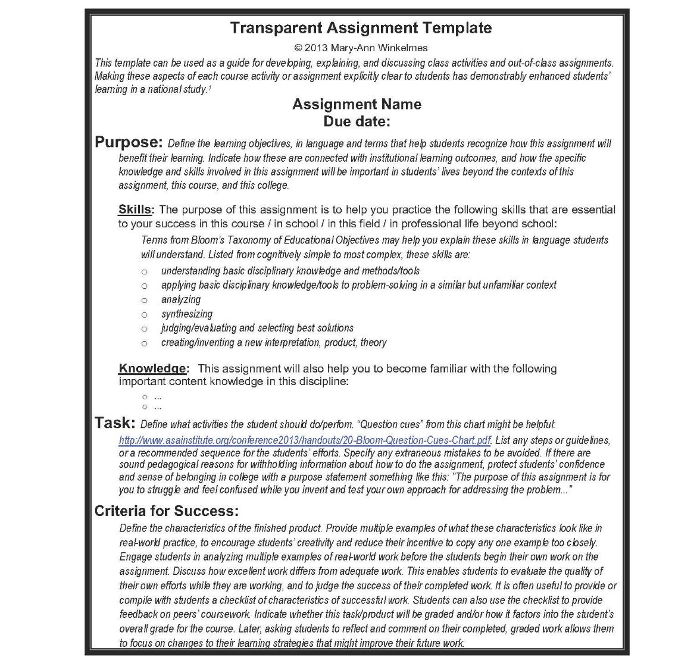
The Transparent Assignment Template
“When is it due and where?”
“Why are we doing this?”
(aka “Why should I care?”)
¹ Winkelmes, Mary-Ann. “Transparency in Teaching: Faculty Share Data and Improve Students’ Learning.” Liberal Education 99,2 (Spring 2013); Winkelmes et al, “A Teaching Intervention that Increases Underserved College Students’ Success.” Peer Review 18,1/2 (Winter/Spring 2016).
© 2013 Mary-Ann Winkelmes Principal Investigator
“What am I supposed to do, and how am I supposed to do it?”
“How am I being graded?”
teaching.uoregon.edu/transparent-assignment-design-template

Slide 34
Assessment

Slide 35
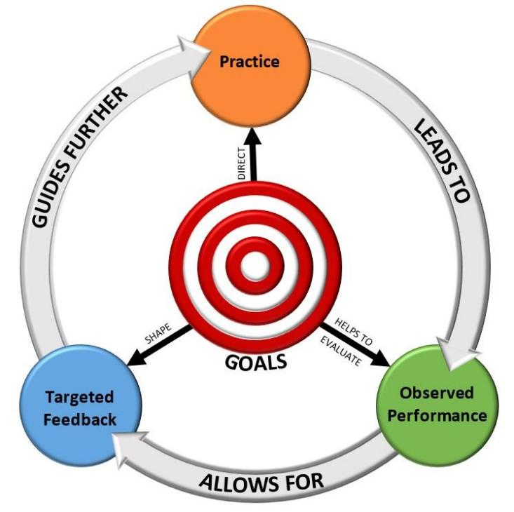

Cycle of Practice and Feedback
Encounter material
Assessment:
Can be Formative or Summative.
https://ecampusontario.pressbooks.pub/ticl/chapter/10-2-importance-of-feedback/

Slide 36
Types of Assessment
Formative
Helps students learn and practice
Summative
Final assessment of progress toward learning objectives
Happens throughout the course
Identifies gaps and improves learning
Focuses on the process
Happens at the end of an instructional period
Collect evidence of student knowledge and skills
Focuses on end result
More feedback needed
Less feedback needed

Slide 37

Formative assessment: Examples
Formative assessment: Examples
Usually low-stakes, relatively frequent
Poll questions
Low-stakes quizzes
Think-pair-share
Minute paper
Muddiest point
Exit ticket
Reflections
Etc.
(Wise)
https://elearningindustry.com/types-of-learner-feedback-tools-and-goals

Slide 38

Summative assessment: Examples
Often higher-stakes, individual or group
Written exams
Oral exams
Papers
Projects
Presentations
Portfolios
If possible, include variety and choices.

Slide 39
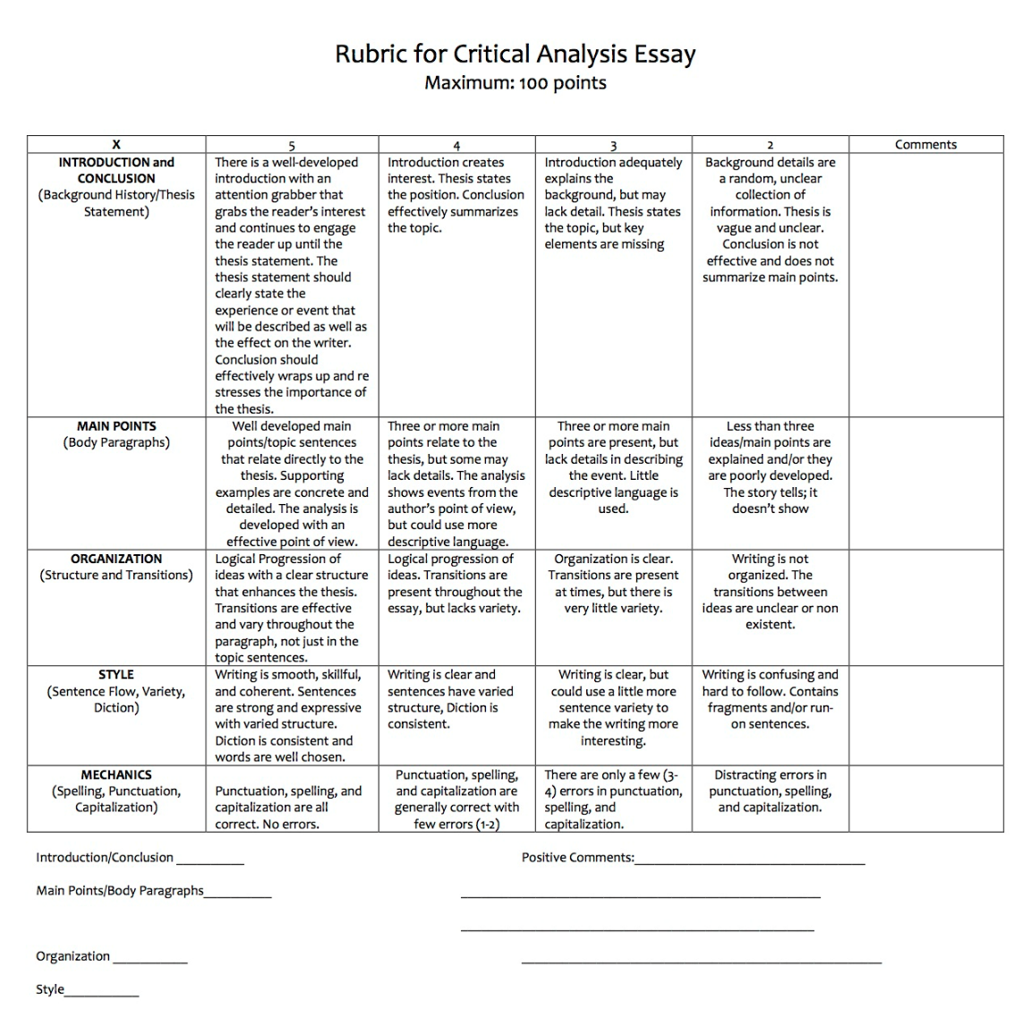
How to assess with more transparency?

Slide 40
Build a sense of belonging

Slide 41
Help people feel they belong
Help people feel they belong
Learn about each other
Everyone has something valuable to contribute
Use names
Foster student-student relationships
Positive error climate
Be flexible where possible
Activity
With one or two (new) partners, discuss HOW to implement the strategy.
Share ideas if time.
5 min
Divide and conquer

Slide 42
Take a break!
Take a break!
Challenge: Find an interesting tree or plant. What kind is it?
Possibilities: Google UO Campus Trees of Interest
If you haven’t signed in yet, please do so using the QR code or the paper at the front of the room.

Slide 43
Course Materials

Slide 44

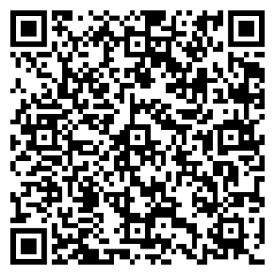
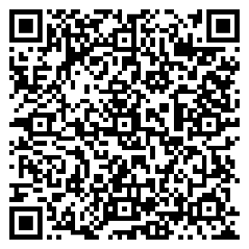
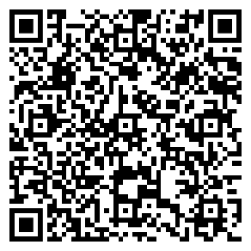
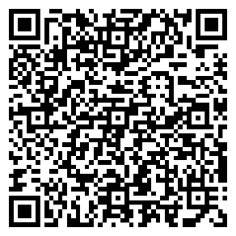
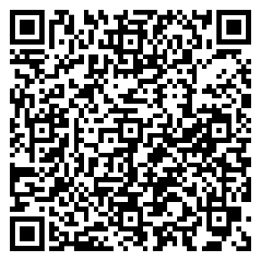
The Syllabus: Examples
5 min
Look at some sample syllabi. What do you notice about:
Content Tone Design
Document analysis
Astro 122: Birth and Death of Stars
Dr. Andrea Goering
Data Sci 101: Intro to Data Science
Dr. Sabrina Mostoufi
Phil 335: Medical Ethics
Prof. Camisha Russell
Econ 101: Contemporary Econ. Issues
Dr. Mike Urbancic
UGST 109: Secrets to Success in STEM
Dr. Julie Mueller

Slide 45
The Syllabus: Key takeaways
Resource: TEP’s Syllabus Essentials
teaching.uoregon.edu/syllabus-essentials
Friendly tone: Instructor seen as more approachable, motivated to teach well.
Make document accessible to screen readers.
digitalaccessibility.uoregon.edu/training/web

Slide 46
The Canvas Site
Design so students spend their energy on learning content, not figuring out what to do, how to find materials.
Today @ 3:00 pm: Canvas Features and Tools
Pacific 123
teaching.uoregon.edu/browse-resources#how-to

Slide 47
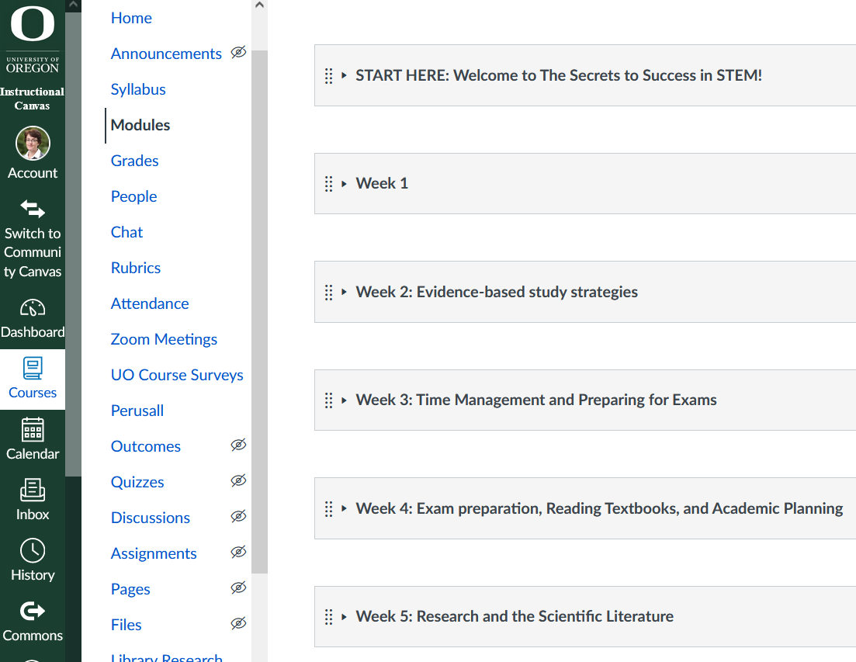
Recommended Canvas design: Use modules
One module per week/unit/chapter
Consistent module structure
Streamline blue course navigation menu

Slide 48
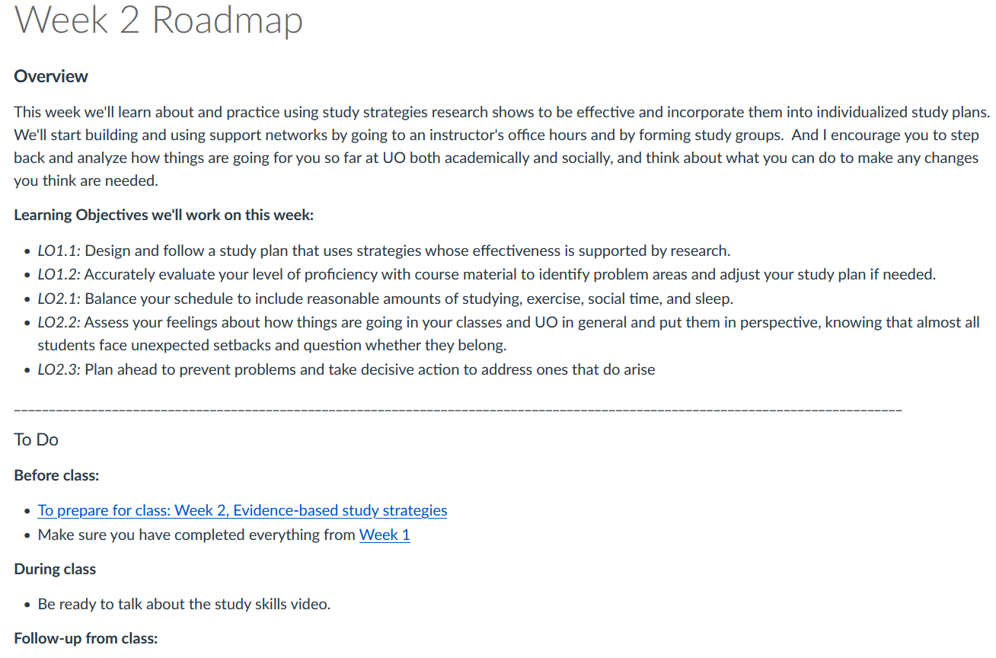
Recommended Canvas design: Stable wayfinder
Where students learn “the plan” for the week
Overview
Learning objectives
Tasks
teaching.uoregon.edu/resources/providing-clear-path-through-your-course

Slide 49
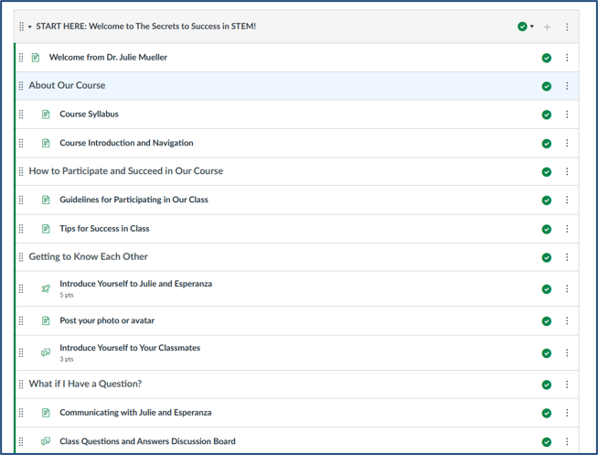
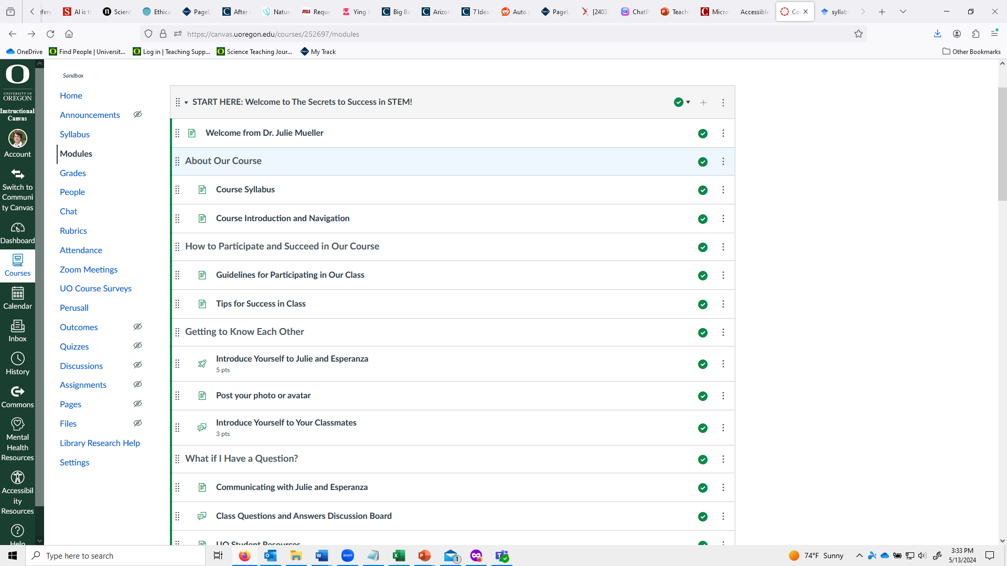
Recommended Canvas design: “Start here” module
Intro to the course
How to navigate the Canvas site
Start to build community
How (& why) to communicate with you
Resource: Providing a clear path through your course.

Slide 50
Course Policies/Requirements

Slide 51
Policies/requirements to be aware of
ADA accommodations:
Letters from AEC.
Can’t ask about nature of disability.
Legal requirement.
Can consult with AEC on how to accommodate.
Course attendance and engagement policy: Reason neutral.
Academic misconduct: Refer all suspected cases to Office of Student Conduct and Community Standards.

Slide 52
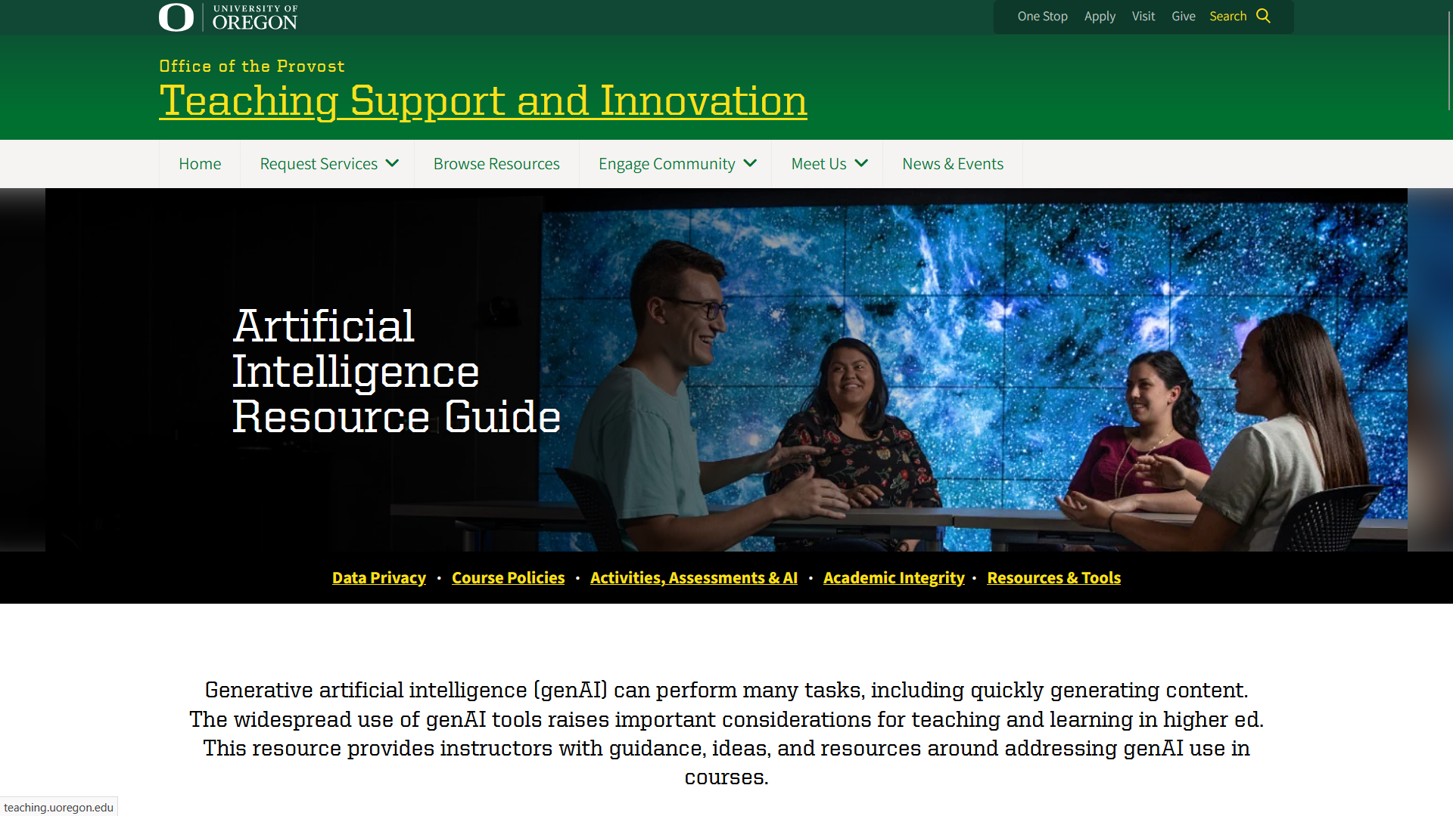
Artificial Intelligence Resource Guide
https://teaching.uoregon.edu/ai

Slide 53
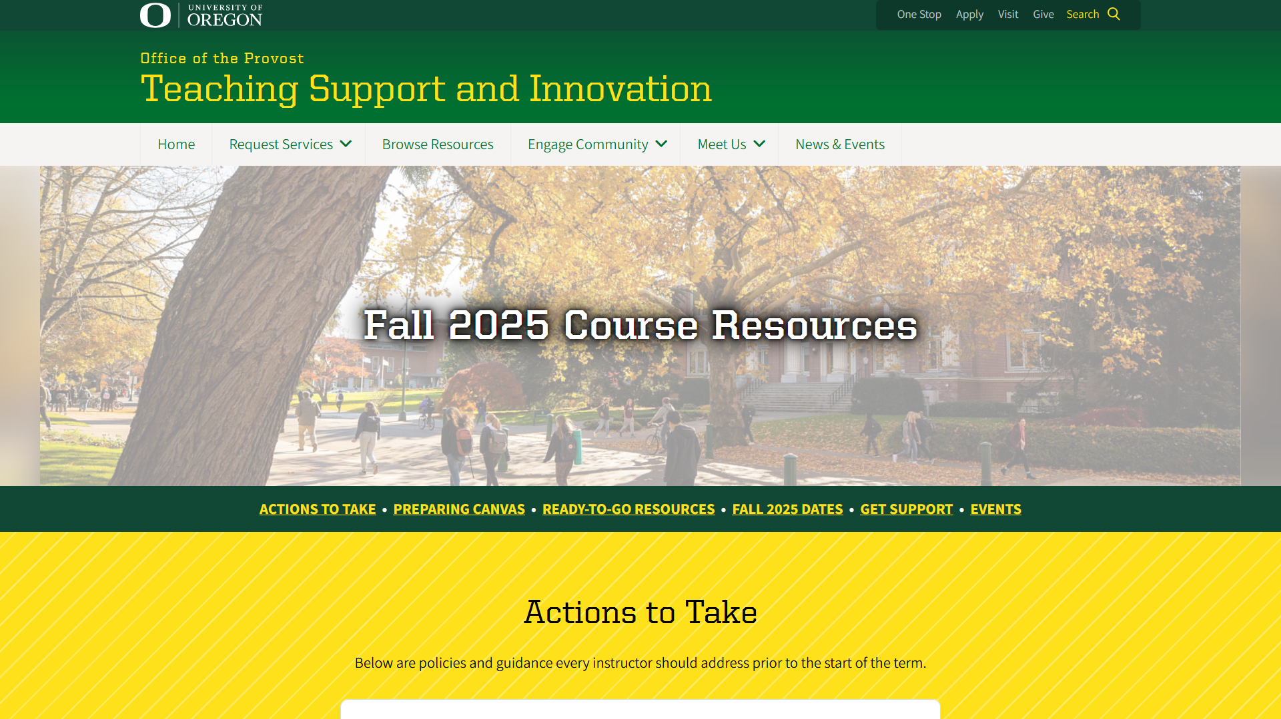
TEP’s Course Resources webpage
https://teaching.uoregon.edu/term-resources-page

Slide 54
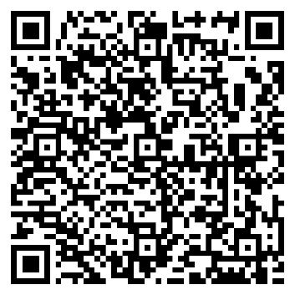
Advice from Experienced Instructors
Activity
Read your assigned section
Discuss it with your group
Write down one or more questions or observations relating to your section
Share with the whole group, if time.
Develop and use a network of colleagues
Be prepared
Be yourself
Be professional
Take feedback
Advice document
5 min

Slide 55
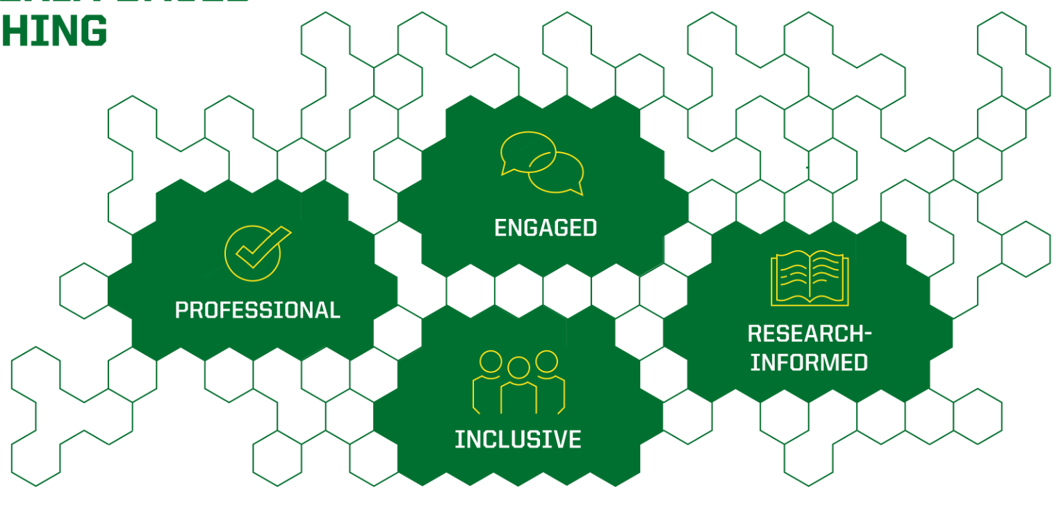
PIERs Connection: Where do today’s activities and concepts fit?

Slide 56

Any questions?

Slide 57
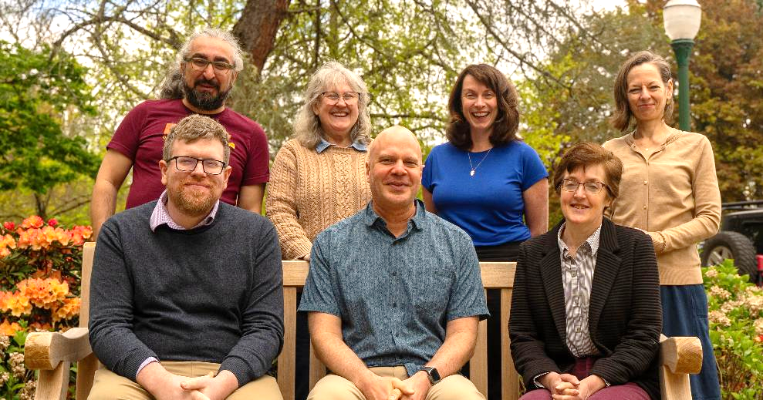
Develop your teaching
Questions? Contact me – Julie (jmueller@uoregon.edu)
General Questions: tep@uoregon.edu
Engage with TEP
Website
(teaching.uoregon.edu)
Consultation
(confidential)
Class observation
Workshops

Slide 58
GE-focused programming
Graduate Teaching Initiative
Complete a range of teaching development activities
Earn a certificate of completion
Upcoming GE-focused TEP Events
Workshop | Description | Time & Location
GTI Meet & Greet | Meet other GEs and learn about our teaching certificate program: the Graduate Teaching Initiative. | Mon Oct 6, 10:00am Knight Lib Dream Lab
Grading with Canvas | Learn more about Canvas’s SpeedGrader. Practice using it in our closed Grading Practice Sandbox. | Wed Oct 8, 11am Knight Lib Dream Lab
International GE Success: Thriving in the U.S. Classroom | Build community and share ways to navigate teaching challenges in the US with confidence and care. | Thurs Oct 9, 11am EMU Diamond Lake Rm
Efficient Grading | Discuss tips for getting through that stack of exams, homework, lab reports, or assignments quickly. | Wed Oct 15, 10am Zoom!

Slide 59
Exit ticket: Help us improve!
What was most helpful or most supported your learning?
What could we do next time to improve the learning experience?

Slide 60
GE Day of Teaching Schedule
Time
9:00 | Teaching as the Instructor of Record Pacific 123 | Teaching US Undergraduates: Strategies and Tips for International Graduate Students Chiles 128
10:00
11:00
12:00
1:00 | Leading Labs Chiles 128 | Leading Discussion Sections Lillis 111, 175, 185
2:00
3:00 | Canvas Features and Tools – Pacific 123
4:00 | Teaching Insights Forum – Pacific 123

Slide 61
Closing Slide with the University of Oregon Logo

