Slide 1


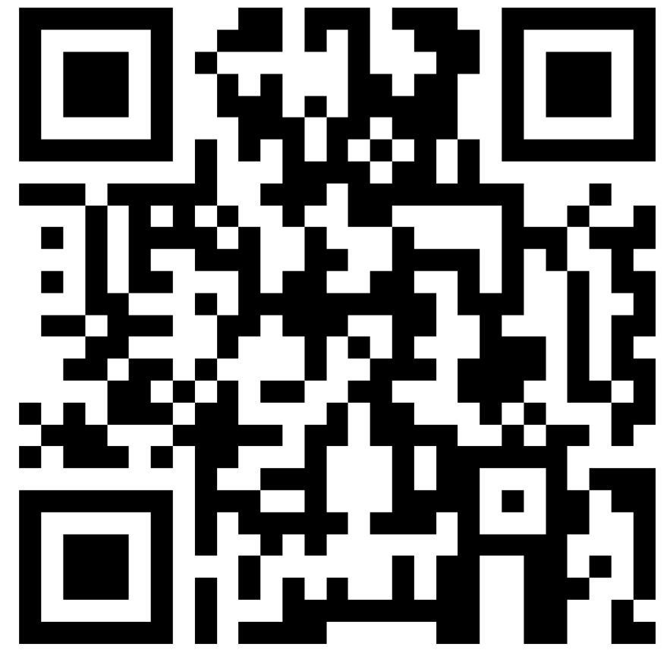
Welcome to Leading Labs at UO!
As you enter, please:
Make a name tent (use a marker, not a pen/pencil)
Pick up an information packet
Sign in with our QR code, or this link: https://forms.office.com/r/cGU76ACH6i
Richard
Richard he/him/his
Notes:
QR code and link needs updated for 2025

Slide 2


Leading Labs at UO
Richard Wagner
richardw@uoregon.edu
Anthropology
Architecture & Environment
Biology
Chemistry & Biochemistry
Computer Science
Earth Science
Geography
Marine Biology
Physics?
teaching.uoregon.edu
Notes:
Introduce me.
Call out of registrants departments
”Lab” is a big umbrella covering hands-on learning by students. Many folks are likely from natural sciences and STEM fields. Also have some art, architecture, and music folks who certainly lead students in learning physical techniques in arts. Social science and humanities – sociology, anthropology, disability studies – teaching students to design studies, analyze governmental data sets, examine artifacts.

Slide 3

Getting to Know You
Talk with a few neighbors (who you don’t already know)…
3 minutes
Name
What about UO appealed to you?
What teaching experience do you have, if any? Such as…
Tutoring
Learning assistant
Teaching assistant
Grader
Lead instructor
Teaching Technique
Toolbox
Icebreaker

Slide 4
Getting to Know Your Feelings
How do you feel about the prospect of teaching?
1
Paralyzed with nervousness and/or worry
4
Confident and eager to get started
Throat vote
Notes:
Possible discussion: Experience with teaching?

Slide 5
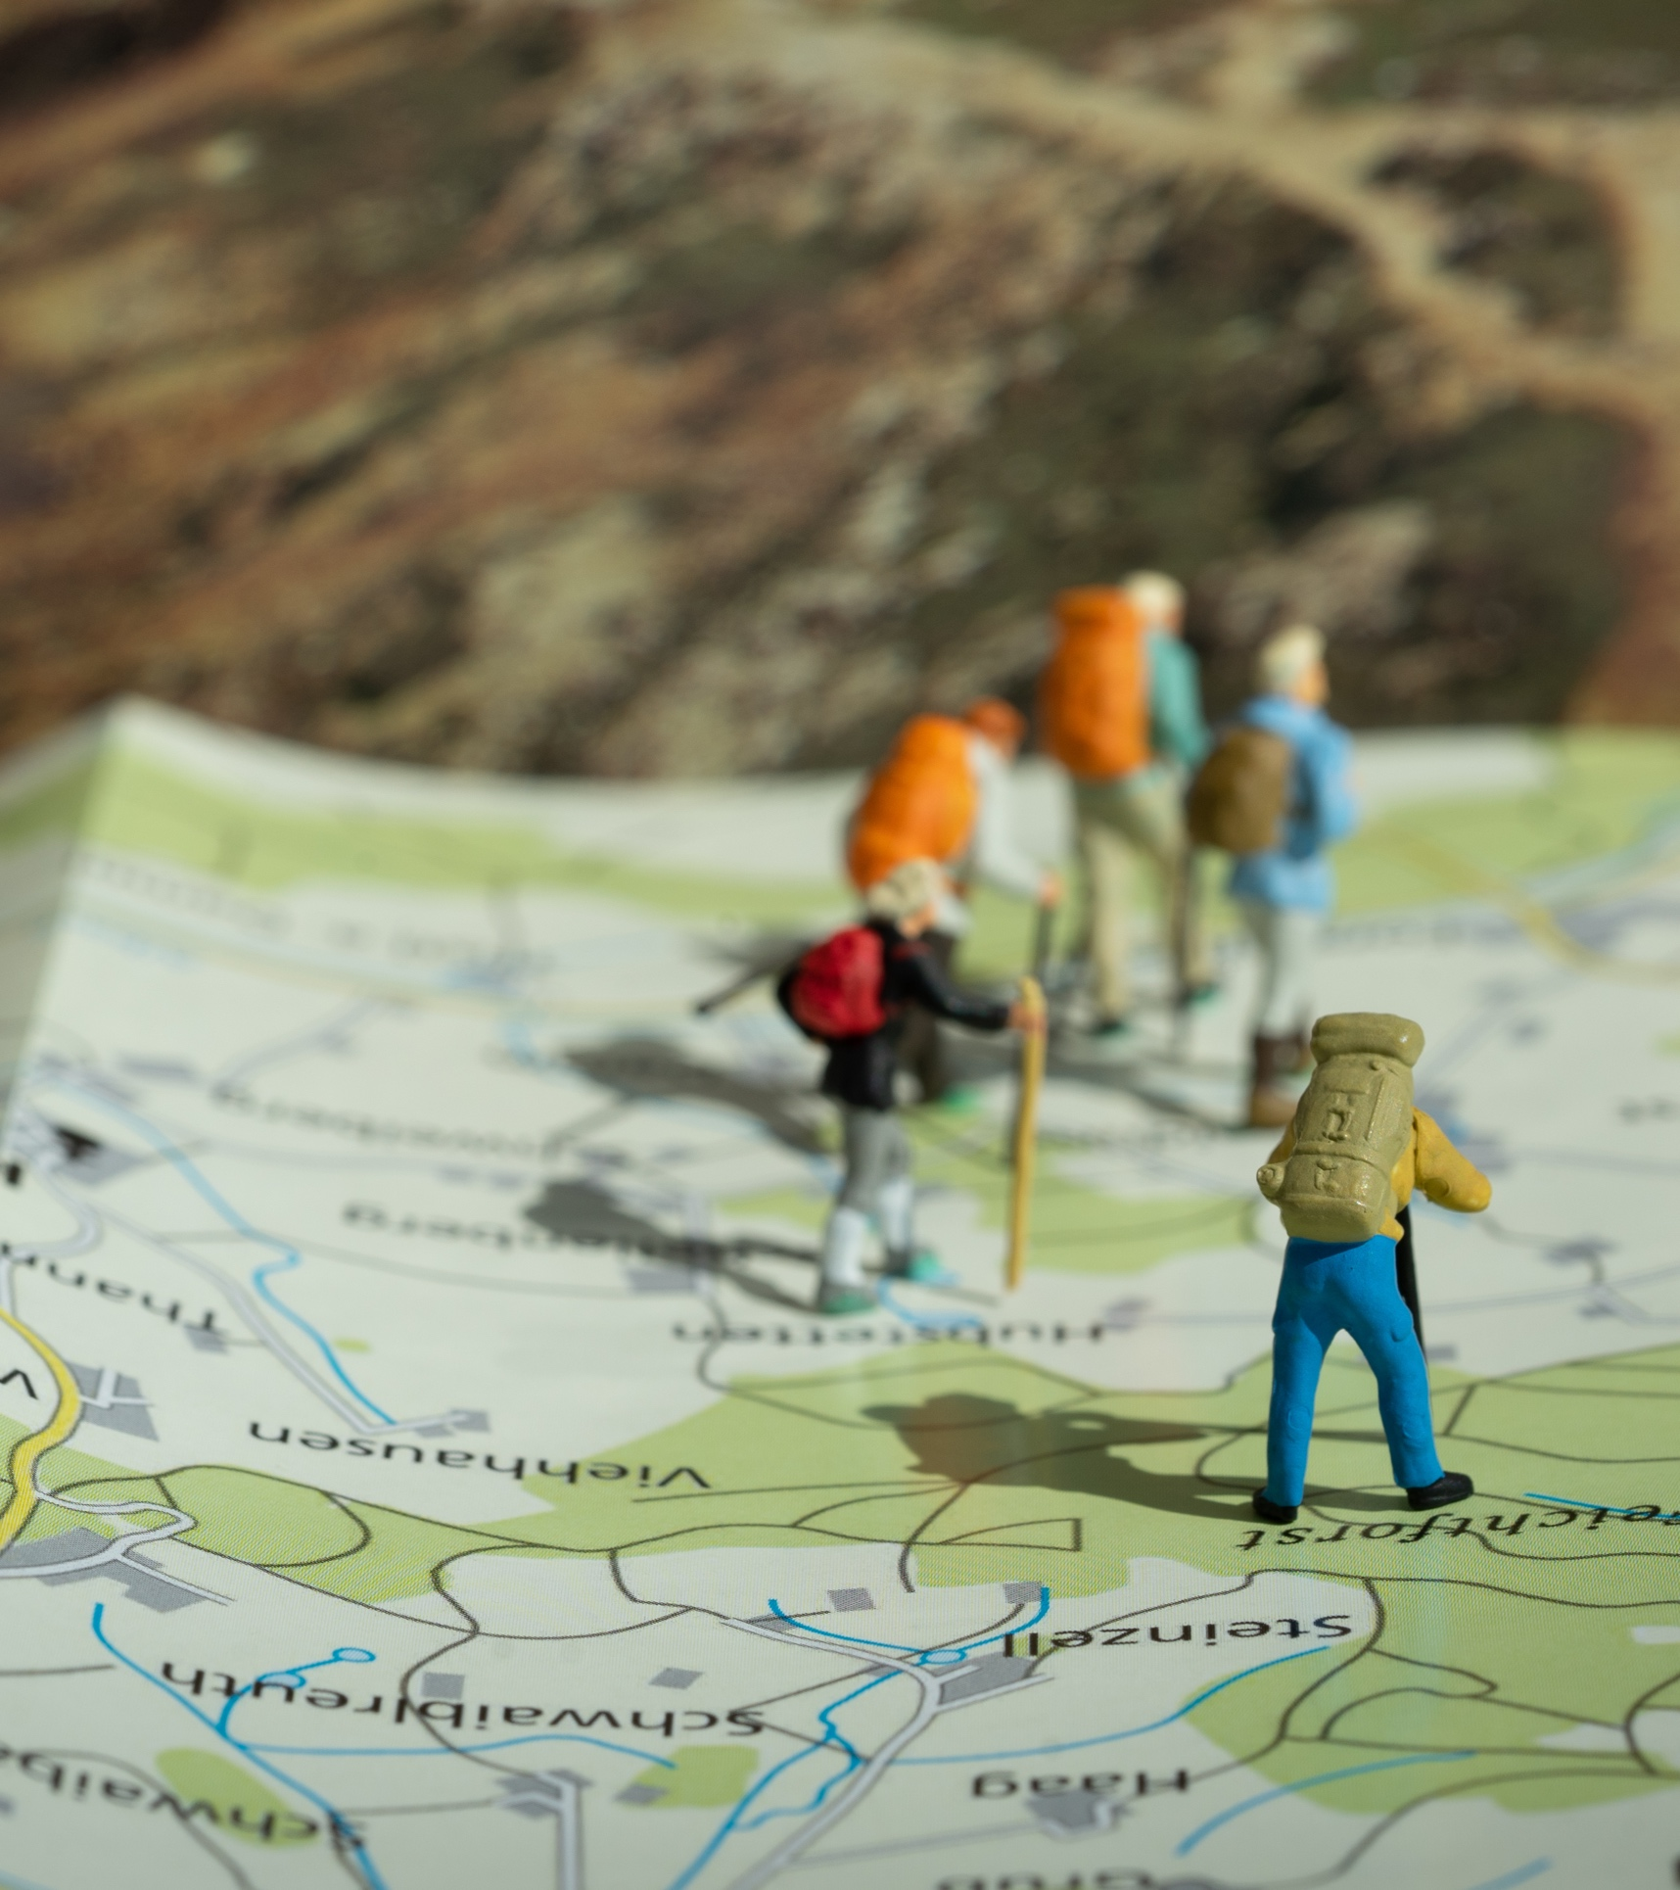
Today’s Agenda
Goal: Help you feel more prepared to teach
Defining good teaching​
Implement strategies for building community in your class​
Applying best practices for helping students learn in lab
Preparing for and wrapping up labs
Knowing where to go when you need help or to get support with teaching
Notes:
Your supervisor, lead TA, lab coordinator, or someone else will get into nitty-gritty of what to do on the first day, safety, grading, etc.

Slide 6
Defining Good Teaching​

Slide 7

What skills does an excellent instructor need?
Are these skills innate, or can they be developed?
Brainstorm
Notes:
Our ideas:
Enthusiastic
Organized
Fair
Responsive
An effective communicator
Perceptive
Skilled in guiding students to understanding
Prompt
Empathetic
Safe
Students feel they belong

Slide 8
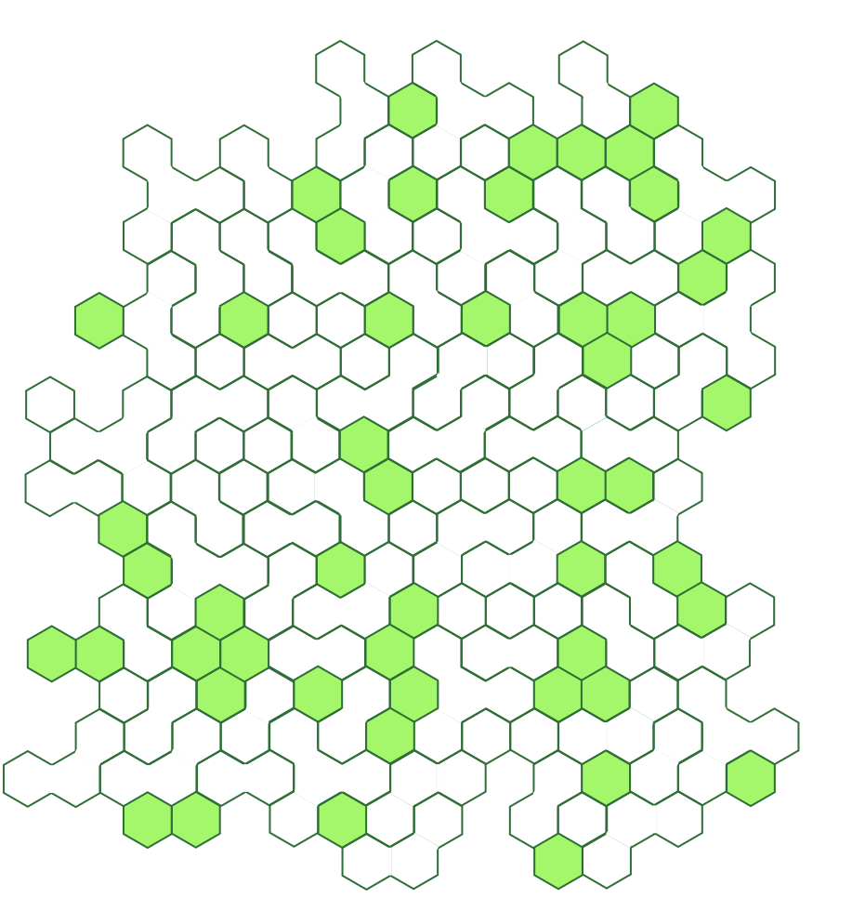




UO Defines Good Teaching As…
Professional: Basic practices necessary for a high-quality course.
Inclusive: Every student belongs and is valued. Materials are diverse and evolving.
Engaged: Instructors reflect on and revise their course and teaching strategies.
Research-informed:
Evidence-based teaching strategies
Models a process or culture of inquiry.
Learn more: https://teaching.uoregon.edu/PIERS
Notes:
Professional: Course is organized. Communication is timely and clear. Activities maximize student learning.
Note that these are not just internal TEP definitions. This is a definition the University created and are how faculty teaching is evaluated. Departments choose how GEs get evaluated, and hopefully would closely follow these.
Each of these have specific actions associated with them to guide instructors in how to be a good teacher. Learn more at link!

Slide 9
Building Community

Slide 10
Build A Community & A Sense of Belonging
Why?
How?
Discuss with someone you haven’t talked to yet and be prepared to share ideas
Easier to ask questions, take risks
More engaged
Work harder
Higher persistence
Harder to be dishonest
Builds trust (student-student and student-instructor)
Better matches real-world career experiences
Learn about your students
Let them know you
Facilitate student-student interaction
Show care, respect
Use names
Communicate that everyone brings unique and valuable experiences. Everyone has something to contribute.
Put content in context
Speak with everyone, everyday
Think-pair-share
Notes:
What benefits are there for student learning to building a community in our classes?

Slide 11
Applying Best Practices

Slide 12
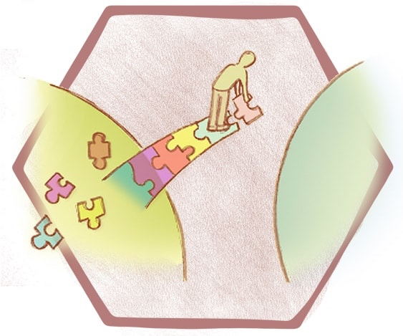
Constructivism
People learn by constructing their own knowledge
Prior knowledge affects learning
Research shows active learning helps most people along that path
Active Learning Methods!
Image courtesy Bridging Positions
Notes:
Learn better if you grapple with problems on your own rather than just being told about them.
Our teaching toolbox are demonstrations of active learning techniques!

Slide 13

When Asking Questions
Try to be specific
Rather than:
Did everybody get that?
Ask:
How do we know if the sample is acidic?
How much water should you add if your clay feels too dry?
Use adequate wait time
How long should we wait for answers?
How long do people wait?
Wait 7-10 seconds for replies, not 0.5-3 seconds.
Get input from multiple voices.
Probe further to confirm understanding.
Prediction
Notes:
More specific questions force folks to retrieve information instead of just having them agree that things make sense.
How long do people wait – not unusual for folks to wait for less than a second (0.5-3 seconds is common)
Try actually counting on your fingers behind your pack

Slide 14

When Answering Questions
Answer Directly
Course policies and procedures: When is this assignment due?
Safety: Where is the fire extinguisher?
Answer indirectly
Foster independence: it’s okay to refer students to lab manual or their group mates.
Lead students through the critical thinking process: How does an expert in your field approach a problem?
Aim to spur critical thinking, not to accept sage wisdom
Notes:
Your job is not to make sure students have right answer. It’s to help them understand concepts, think for themselves.
Model the way a scientist/expert approaches solving a problem. What kinds of questions do you ask to help you figure things out? Is there a routine you can demonstrate?

Slide 15

Spur Deeper Thinking in Your Students
What could you do to get students to think deeper about the content or methodology rather than accept black boxes?
Review the Deeper Thinking Questions handout
Which can I imagine using?
How can I modify some for my discipline?
When/how would I use them?
5 minutes
Document Analysis
Notes:
Black box – question goes in, box goes brrrr, answer comes out. Want students to put together what is going in INSIDE the box.
GEs from non-mathematical fields may way to focus on the middle question. What are some similar questions that you could ask for your discipline?

Slide 16
Challenging Situations
Scenarios are on walls around the room
Visit different scenarios, discuss:
What are the issues involved?
What are some appropriate courses of action?
What are the implications of these actions?
How could the situation have been prevented or muted?
Write your ideas on the sheets
There is usually no single right answer!
15 minutes
Gallery Walk
Notes:
Debrief by asking about situations that stood out to you. Courses of actions that others wrote or said to about that were interesting to you.

Slide 17
Preparing and Wrapping Up

Slide 18
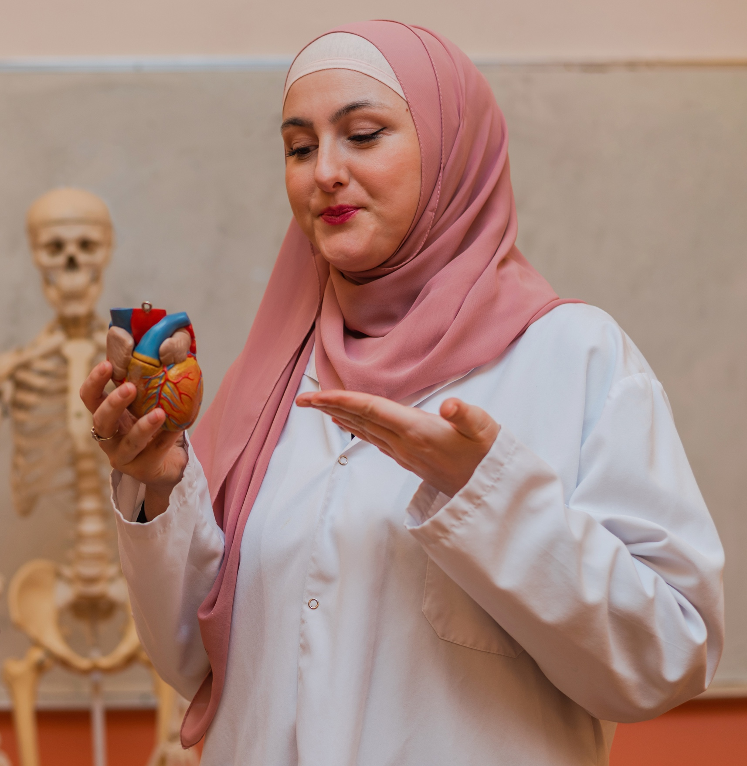
Getting Ready
Tips for GEs Teaching For the First Time
Which tips seem particularly well suited for labs or for your discipline?
Working with a Teaching Team
Know your responsibilities, what to expect
Be professional
Don’t be afraid to admit uncertainty, ask questions
Review (on your own) the document on Setting Expectations
Document Analysis

Slide 19

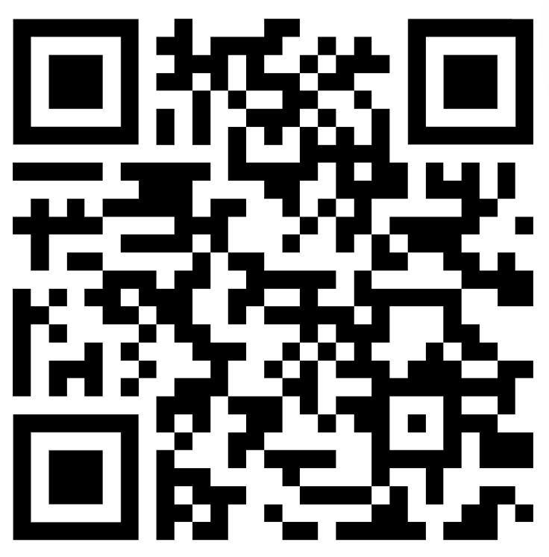
Grading & Feedback
3 minutes
Why do we do it?
What do we strive for?
What practices are helpful? What is not helpful?
+ 4 minutes
Please share your group’s thoughts on the last questions
https://padlet.com/richardw19/grading
Padlet

Slide 20
Our Quick Grading Tips
Canvas Features and Tools Today @ 3pm
Pacific Hall, 123
Use rubrics that are clear (for you and students) and focused on learning objectives.
Align scoring and grading expectations with others (fellow lab leaders or lead instructors)
Teach students where to find feedback and how to use it to further their learning.
Set a timer for yourself for each submission.
Choose several areas to provide targeted feedback on (you can't do it all, and students can’t read it all)
If assessments are question-based, grade one question at a time rather than one student at a time.
Give feedback close to submission date, so it can be applied.
Use Speedgrader in Canvas
Grading with Canvas
Wednesday, Oct 8
11am
LOCATION
Grading 601: Efficient Grading
Wed, Oct 15
10am on Zoom

Slide 21
Getting Support

Slide 22
Teaching: You Are Not Alone
Teaching Knowledge & Practice
Campus Resources
TEP and UO Online
Student Support
Tutoring & Academic Engagement Center
Accessible Education Center
Counseling Center
Safety
UO Police (911)
Safety & Risk Services
Workshops
Consultations
Class Observations
Reading Groups
Teaching Courses
Podcasts, Journals, Blogs
Science Teaching Journal Club
Tues 9am, LISB 217
Specifics of Course and Discipline
Lead Instructor
Head TA
Other GEs on team
Your Peers
Support Staff
Courses/Seminars

Slide 23
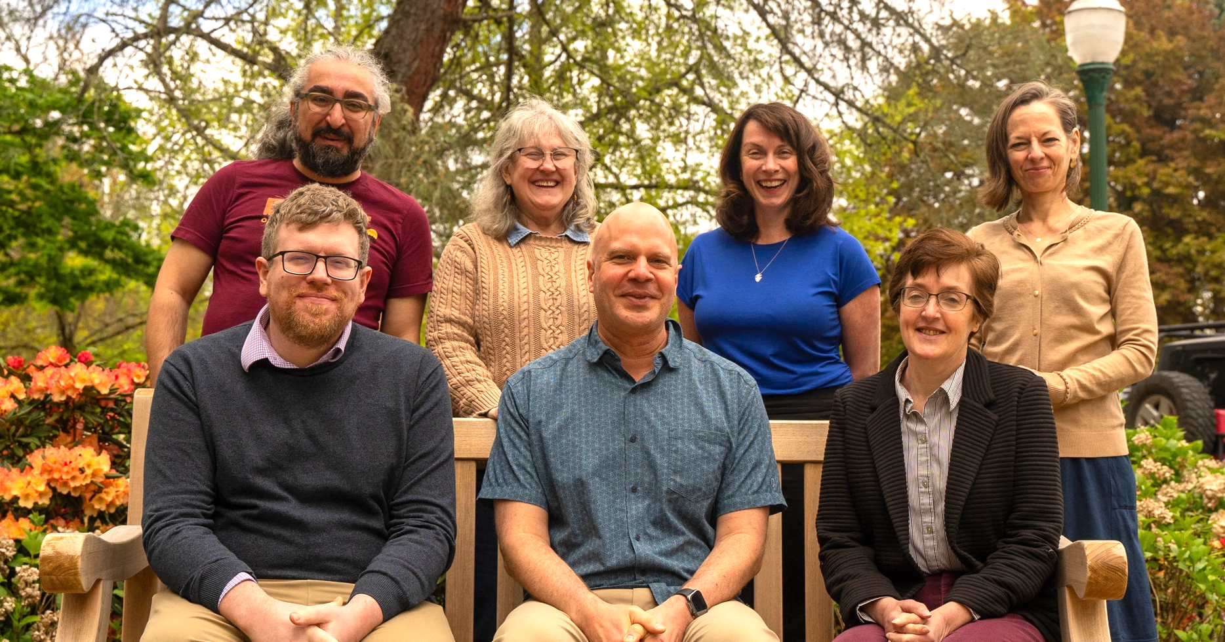
Getting Help from TEP
Me - Richard (richardw@uoregon.edu)
TEP website (teaching.uoregon.edu)
General Questions: tep@uoregon.edu
Upcoming GE-focused TEP Events
Workshop | Description | Time & Location
GTI Meet & Greet | Meet other GEs and learn about our teaching certificate program: the Graduate Teaching Initiative. | Mon Oct 6, 10:00am Knight Lib Dream Lab
Grading with Canvas | Learn more about Canvas’s SpeedGrader. Practice using it in our closed Grading Practice Sandbox. | Wed Oct 8, 11am Knight Lib Dream Lab
International GE Success: Thriving in the U.S. Classroom | Build community and share ways to navigate teaching challenges in the US with confidence and care. | Thurs Oct 9, 11am EMU Diamond Lake Rm
Efficient Grading | Discuss tips for getting through that stack of exams, homework, lab reports, or assignments quickly. | Wed Oct 15, 10am Zoom!

Slide 24

Next Steps
Supporting Your Professional Teaching Development
Attend a TEP teaching workshop or request a consultation - teaching.uoregon.edu
Join the TEP Graduate Teaching Initiative
Participate in the Science Teaching Journal Club
9:00 am Thursdays, LISB 217 or via Zoom ID 369 256 082
Aim for the Kimble First-Year Teaching Award

Slide 25
Wrapping Up
Please sign in if you haven’t already:
Please complete our feedback survey:
https://forms.office.com/r/cGU76ACH6i
On the last page of your packet, please tear off the bottom half, complete it, and turn it in before you leave!
Exit Ticket

Slide 26
Closing Slide with the University of Oregon Logo

