Slide 1
Leading Labs
Richard Wagner
richardw@uoregon.edu
teaching.uoregon.edu
Notes:
Tell about self, introduce Julie
”Lab” is a big umbrella covering hands-on learning by students. Many folks are likely from natural sciences and STEM fields. Also have some art, architecture, and music folks who certainly lead students in learning physical techniques in arts. Social science and humanities – sociology, anthropology, disability studies – teaching students to design studies, analyze governmental data sets, examine artifacts.
Icebreaker. Move to a side/corner of the room according to:
Where did you do your undergrad: East of Mississippi, east of Mississippi, university outside the US
Undergraduate degree in chemistry, biochemistry, or other
Physical, organic, inorganic, biochem, analytical
Solid, liquid, or gas
Theory or experiment

Slide 2
Talk with a few neighbors
Name
Department/field
What about UO appealed to you?
What teaching experience do you have, if any?
Tutoring
Learning assistant
Teaching assistant
Grader
Lead instructor
3 minutes
Teaching Toolbox
Technique
Ice breaker

Slide 3
How do you feel about the prospect of teaching?
1
4
Paralyzed with nervousness and/or worry
Confident and eager to get started
Throat vote
Notes:
Discussions : Experience with teaching?

Slide 4
Today’s mission: Help you feel more prepared to teach
Good teaching defined
Implement strategies for building community in class
Best practices for helping students learn in lab
Preparing for and Wrapping Up Labs
Know where to go when you need help or to refine pedagogy
Notes:
Your supervisor, lead TA, lab coordinator, or someone else will get into nitty-gritty of what to do on the first day, safety, grading, etc.

Slide 5
What skills does an excellent instructor need?
Your brainstormed list
Patience
Confidence
Empathy
Openness
Flexibility
Knowledge, experience
Humor
Excited about material
Variety of activities
Simplicity & Clarity
Pedagogical Knowledge
Enthusiastic
Organized
Fair
Responsive
An effective communicator
Perceptive
Safe
Skilled in guiding students to understanding
Prompt
Empathetic
Students feel they belong
Are these skills innate or can they be developed?
Brainstorm
Notes:
Write on worksheet

Slide 6
UO defines good teaching as…
Professional
Engaged
Research-informed
Every student belongs and is valued
Instructors always work to improve
Evidence-based teaching strategies
Bring research methods and content into class
Inclusive
Basic practices necessary for a high-quality course
Notes:
Note that these are not just internal TEP definitions. This is a definition the University created and are gu how faculty teaching is evaluated. Departments choose how GEs get evaluated, and hopefully would closely follow these.

Slide 7
SWOT your teaching!
Strengths
Weaknesses
Opportunities
Threats
What aspects of your personality/nature/skills will help you teach well?
What aspects of your personality/nature/skills will you need to be conscious of and develop to teach well?
What knowledge and professional skills will you develop through your GE assignment?
What outside events or requirements might make it difficult to do your job well?
Worksheet
Notes:
Weakness example – Richard is naturally shy. Have to consciously push myself to interrupt and interact with students who are working.
Debrief just opportunities and threats.

Slide 8
Build community & Sense of belonging

Slide 9
Why?
Building Community & Sense of Belonging
Discuss with someone you haven’t talked to yet.
Be prepared to share ideas
Your brainstormed list
Easier to ask questions, take risks
More engaged
Work harder
Higher persistence
Harder to be dishonest
Give space to ask questions and to ask “dumb” questions
Identify knowledge gaps
Avoid stereotype threat
Helps students with life transitions (first-year students, for example)
Think-pair-share
Notes:
What benefits are there for student learning to building a community in our classes?

Slide 10
How?
Building Community & Sense of Belonging
Discuss with someone you haven’t talked to yet.
Be prepared to share ideas
Your brainstormed list
Learn about your students
Let them know you
Facilitate student-student interaction
Show care, respect
Use names
Communicate that everyone brings unique and valuable experiences. Has something to contribute.
Put content in context
Learn names
Use creative interactions and ice breakers
Discipline specific practices
Be a human and share your struggles with content
Share major / tailor content to students
Encourage students to use study groups
Set community expectations
Think-pair-share

Slide 11
What aspects of identity affect how students engage with your class?
Attitude toward learning
Job?
Kids?
All these attributes affect the student’s point of view!
Major
Residency
New
events
Year
in
school
Income
level
First
generation
in
college?
Ethnicity
Age
Brainstorm
Image courtesy Polo And Tweed
Notes:
What aspects of students’ backgrounds might affect their attitude, how they view chemistry and the work you’re asking them to do?
New events – example is freshman living away from parents for first time, have to figure out laundry, navigate social things.

Slide 12
Your students may not be like you!
How else can you learn about your students, promote sense of belonging?
Notes:
How else to learn about students - Survey, talk to them, etc.

Slide 13
Learning in Lab

Slide 14
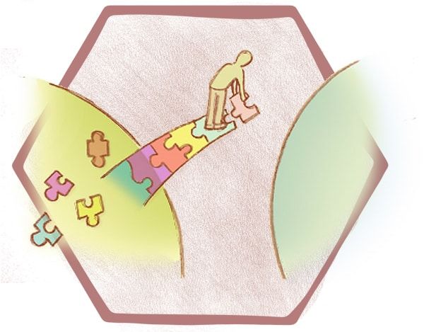
Constructivism
People learn by constructing their own knowledge
Prior knowledge affects learning
Research shows active learning helps most people along that path
Image courtesy Bridging Positions
Notes:
Learn better if you grapple with problems on your own rather than just being told about them.
Our teaching toolbox are demonstrations of active learning techniques!

Slide 15
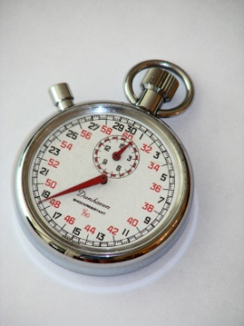
When Asking Questions
Try to be specific
Wait 7-10 seconds for replies.
Get input from multiple voices.
Probe further to confirm understanding.
Rather than:
Did everybody get that?
Ask:
How do we know if the sample is acidic?
How long should we wait for answers?
How long do people wait?
Prediction
Image courtesy The Write Direction
Notes:
More specific questions force folks to retrieve information instead of just having them agree that things make sense.
How long do people wait – not unusual for folks to wait for less than a second (0.5-3 seconds is common)
Try actually counting on your fingers behind your pack

Slide 16
Spur Critical Thinking in Your Students
What could you do to get students to think critically about the content rather than accept black boxes?
Look at 100 Questions handout
Think individually:
Which can I imagine using?
How can I modify some for my discipline.
When/how would I use them?
Document Analysis
Image courtesy Greenlane SEO
Notes:
Black box – question goes in, box goes brrrr, answer comes out. Want students to put together what is going in INSIDE the box.
GEs from non-mathematical fields may way to focus on the middle question. What are some similar questions that you could ask for your discipline?

Slide 17
Help students grow content knowledge in lab
101
What principles from class underpin that reaction/result?
Do you units (for a value) make sense?
How could we combine this with another lab we’ve done?
What future directions could you take with these results?
Can you derive how this result from basic principles?
Is there another way to solve this problem?
What pieces of the instructions are confusing to people?
What is the primary safety concern for today?
Ask about specific techniques from the lab today.
How do results change if you change setup or why is the setup that way?
Do the results follow any specific patterns?
How does this make you feel?
Can you explain this using a metaphor.
102
103
104
105
Think-pair-share
Notes:
What are some general questions you could ask to help students develop the skill to see lab activities an application of content learned in lecture?

Slide 18
Answering questions
Answer directly
Where is the fire extinguisher?
Answer indirectly
Foster independence: Okay to refer students to lab manual or their partner.
Lead students through the critical thinking process: How does an expert in your field approach a problem?
Draw on questions from the 100-questions document.
Image courtesy Adobe
Notes:
Your job is not to make sure students have right answer. It’s to help them understand concepts, think for themselves.
Model the way a scientist/expert approaches solving a problem. What kinds of questions do you ask to help you figure things out? Is there a routine you can demonstrate?

Slide 19
Challenging Situations
Scenarios are on walls around the room
Visit different scenarios, discuss:
What are the issues involved?
What are some appropriate courses of action?
What are the implications of these actions?
How could the situation have been prevented or muted?
Write ideas on the sheets
15 minutes
There is usually no single right answer!
Gallery Walk
Notes:
Debrief by asking about situations that stood out to you. Courses of actions that others wrote or said to about that were interesting to you.

Slide 20
Scenario E
A student in your class, Naledi, has a chronic health condition that sometimes limits her mobility, which is documented with the Accessible Education Center. You get an email from Naledi the morning you’re scheduled to leave on a field trip saying that it is a bad pain flare up day and she won’t be able to do much walking in class today. The field trip was supposed to have a lot of hiking. The notification letter you got from AEC at the beginning of the term tells you to either give Naledi an alternative assignment or find a way for her to participate without walking much. You don’t have an alternative assignment prepared.

Slide 21
Preparing FOR and Wrapping Up Labs

Slide 22
Getting Ready
Which tips seem particularly well suited for labs?
Document: Tips for GEs Teaching for the First Time
Document Analysis
Notes:
22

Slide 23
Getting ready: Working in a teaching team
Know your responsibilities, what to expect
Be professional
Don’t be afraid to admit uncertainty, ask questions
Notes:
23

Slide 24
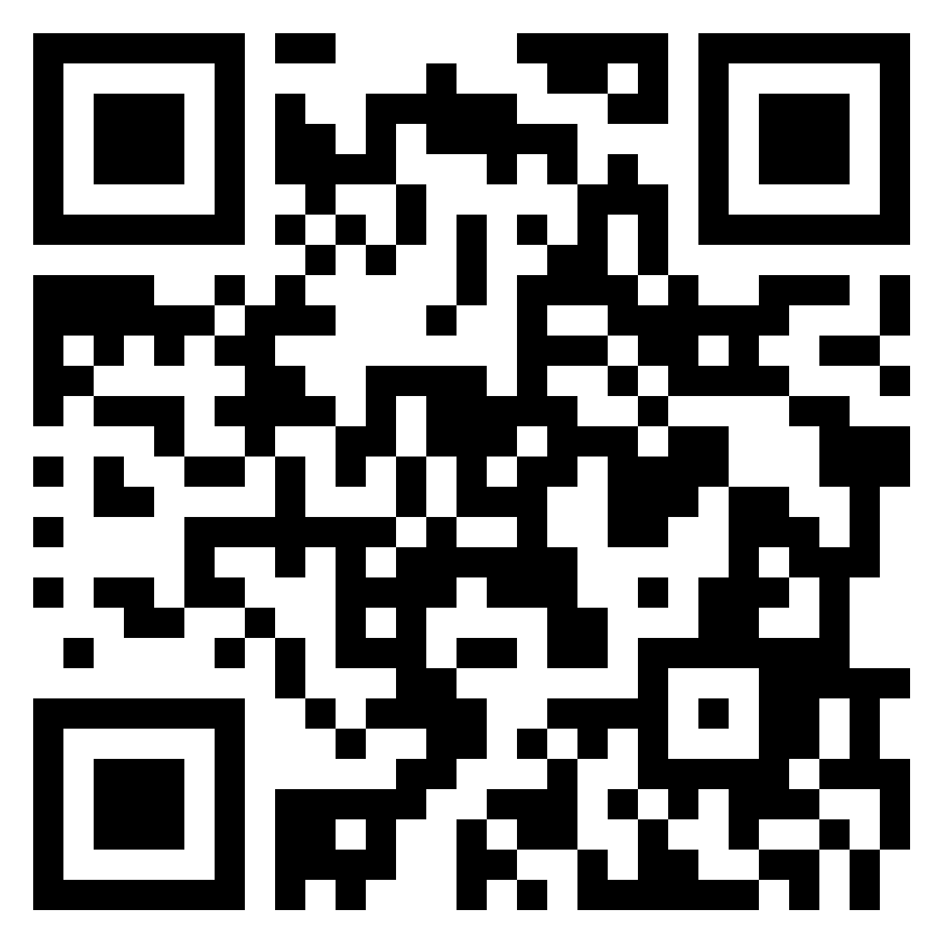
Grading & Feedback
Share your team’s thoughts:
Why do we do it?
https://padlet.com/jmueller93/grading
What do we strive for?
What practices are helpful? What is not helpful?
Padlet
Notes:
24

Slide 25
Teaching support resources

Slide 26
Teaching : You are not alone!
Consultations
Class observations
Lead instructor
Head TA
Workshops
TEP/UO Online
Courses
GEs on team
Content/
class specific
Science Teaching Journal Club
Peers
Teaching Knowledge
Support staff
You
Podcasts,
Journals
Safety
TAEC
Student assistance
Safety and Risk Services
AEC
Counseling Center
UO Police (911)
Notes:
TAEC - Tutoring and Academic Engagement Center
AEC - Accessible Education Center

Slide 27
On the Shoulders of Giants
Teaching Engagement Program
Me! Richard (richardw@uoregon.edu)
TEP website (teaching.uoregon.edu)
Workshops
General Questions: tep@uoregon.edu
Science Teaching Journal Club
9:00 am Thursdays, LISB 217 or Zoom ID 369 256 082
Get help button
Image courtesy TimeBank Mahoning Watershed

Slide 28
What can you do next to support your professional teaching development?
Attend a TEP teaching workshop or consultation teaching.uoregon.edu
Enroll in a course on university teaching
Join the TEP Graduate Teaching Initiative (GTI)
Participate in the Science Teaching Journal Club
9:00 am Thursdays, Zoom ID 369 256 082
Aim for the Kimble First-Year Teaching Award

Slide 29
Wrapping Up
Write inside your name tent, then hand in: What other teaching-related questions do you have?
Please sign in if you haven’t already:
https://forms.office.com/r/WgH4vh6YxH
Please complete our feedback survey:
https://forms.office.com/r/sPHb3fnxjh
Exit Ticket

