Slide 1
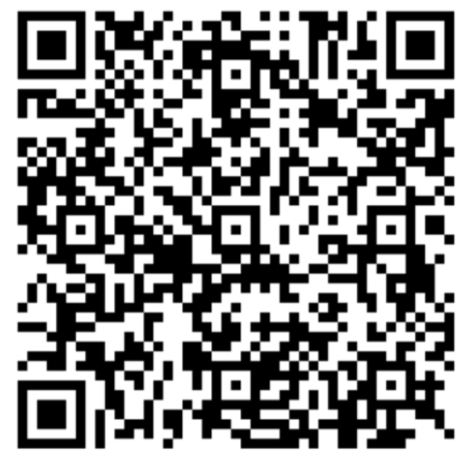
GE Day of Teaching Canvas Features and Tools
Please sign in with QR code
or add your info to the sign-in sheet

Slide 2
GE Day of Teaching Canvas Features and Tools
Tim Sorg | tsorg@uoregon.edu
September 25, 2024

Slide 3
Canvas should never get in the way of you having fun with your teaching
1
Notes:
Premise 1 (a negative statement)

Slide 4
Canvas should do work for us so we can focus on what really matters
2
Notes:
Premise 1 (a negative statement)

Slide 5
It takes a village to teach. And we are here to help! uoonline@uoregon.edu PLC 68 | (541) 346-1942
3
Notes:
Premise 1 (a negative statement)

Slide 6
Canvas helps you focus on what’s important
The key is to understand why before we ask how
Notes:
What I won’t be doing in this session: going over every detail and button click in Canvas
Not only would this be subjecting you all to a rather unpleasant firehouse of boring information, but it also wouldn’t be modeling good teaching
Rather, we have tons of resources, how-to guides, and support services to help you whenever you need.

Slide 7
Canvas Tools & Features
1. Gradebook
2. SpeedGrader
3. Discussions
4. Group Sets
Notes:
These are going to be your bread and butter

Slide 8
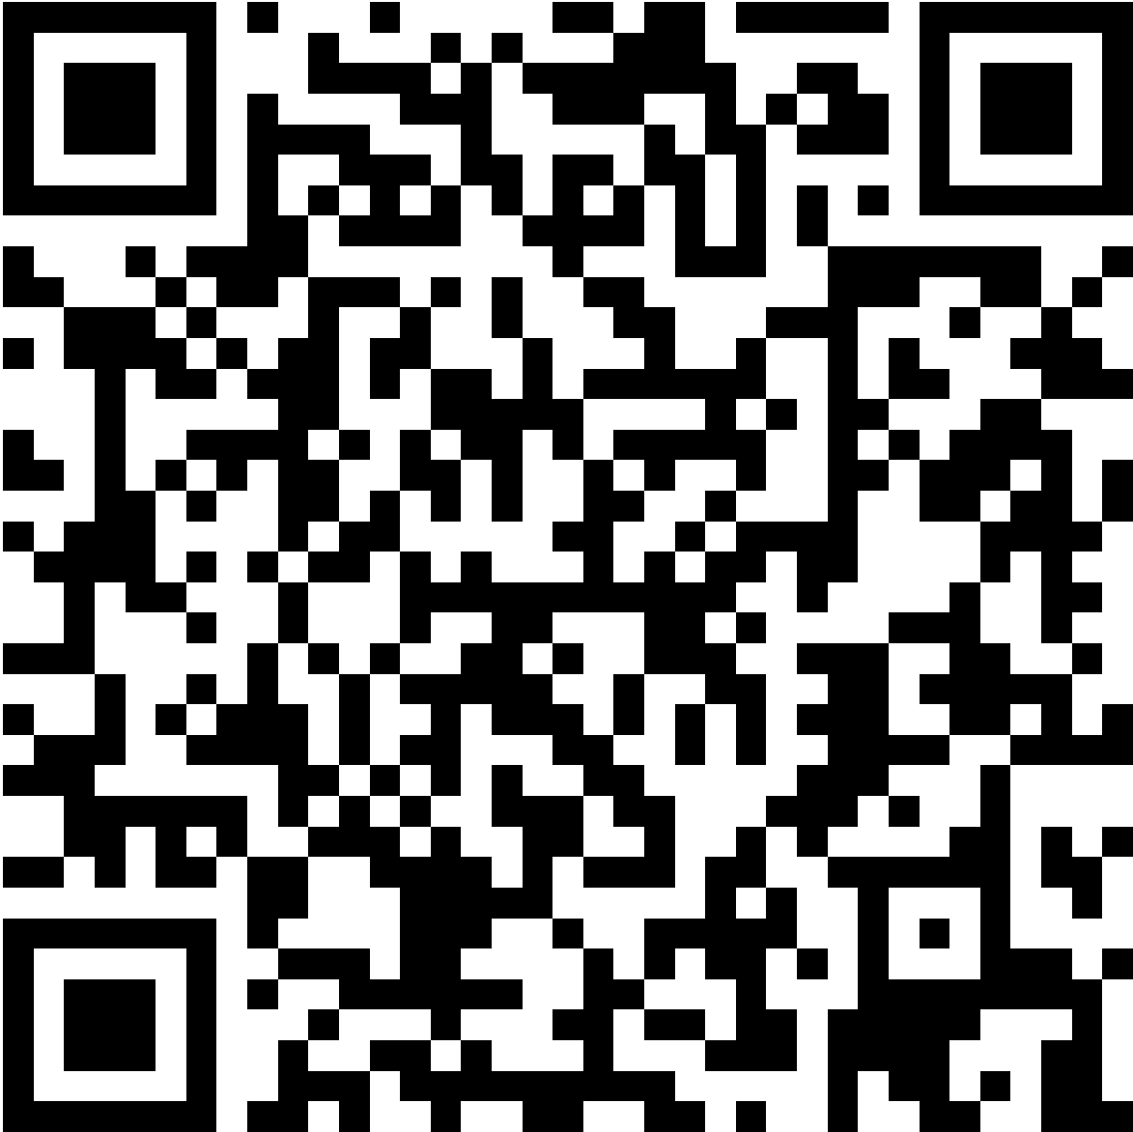
UO Online Canvas How-to-Guides
teaching.uoregon.edu/resources/browse-canvas-how-topics
Announcements & Email | Assignments | Discussions
Navigation | Files, Modules, & Pages | Gradebook
Groups & People | Panopto Videos | Quizzes | Zoom

Slide 9
UO Online Support Services
Instructional Design
| uoonline@uoregon.edu
Team up with an Instructional Designer for help planning and designing your online course.
Media Services
| jkemp@uoregon.edu
Work with Jack Kemp, our Online Education Media Producer, to create unique and professional learning videos using state-of-the-art recording equipment.
Canvas Support
| PLC 68 | (541) 346-1942
Contact our technology support team for help using Canvas, guidance for advanced features, or ideas for addressing teaching challenges.

Slide 10
Thank you!
Tim Sorg | tsorg@uoregon.edu
September 25, 2024

Slide 11
GE Day of Teaching Canvas Features and Tools
Please sign in with QR code
or add your info to the sign-in sheet

