Slide 1
Teaching as the Sole Instructor
Please scan to sign in
Jason Schreiner
(he/they)
Associate Director
Teaching Engagement Program
NOTE: These slides have been modified to reduce the file size. Several images and transition slides have been removed.
GE Day of Teaching
University of Oregon
2023

Slide 2
Who are we?
What do we care about teaching?
In pairs or trios, please introduce yourselves.
Then share your thoughts about:
What are you most concerned about teaching your own class?
What are you excited about helping your students learn to know, do, experience, or feel?

Slide 3
What can we accomplish today?
GE Day of Teaching
University of Oregon
2023
Begin to situate ourselves in relationships of teaching and learning
Consider a research-based framework for student engagement
Use aligned design to sketch a learning sequence
Brainstorm active learning strategies
Enhance transparency in the assessment of learning
Discuss how to get to know students
Remember some important course policies

Slide 4

What does ‘excellent’ teaching at UO mean?
https://teaching.uoregon.edu/resources/teaching-excellence

Slide 5
What is “inclusive teaching”?
Think: What does inclusive teaching mean to you?
Pair: What do you and your discussion partner agree about? What is different in your thinking?
Share: Who has insights to share with us?

Slide 6
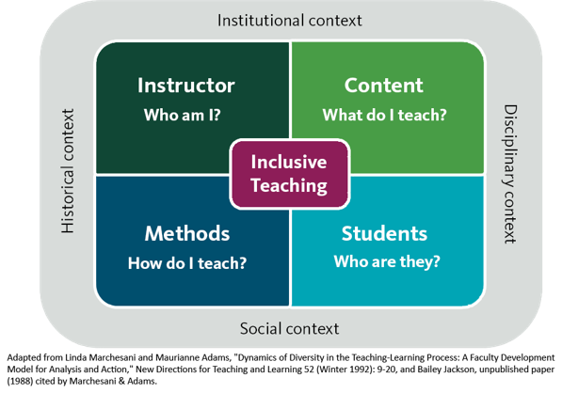
TEP - Jason Schreiner, 2019

Slide 7
Educator Reflection Questions:
Who am I? What assumptions do I make about teaching and learning?
Who are my students? What strengths, anxieties, identities, etc. do they bring?
What content will I convey? Does my course reflect the diversity of the field, discipline, etc.?
What teaching methods will I employ? Am I using a range of strategies to engage students?
How are relevant contexts shaping my course? How should I bring such contexts into the class?
What do I know and believe about power, inequality, and equity in education?
Notes:
Julie

Slide 8
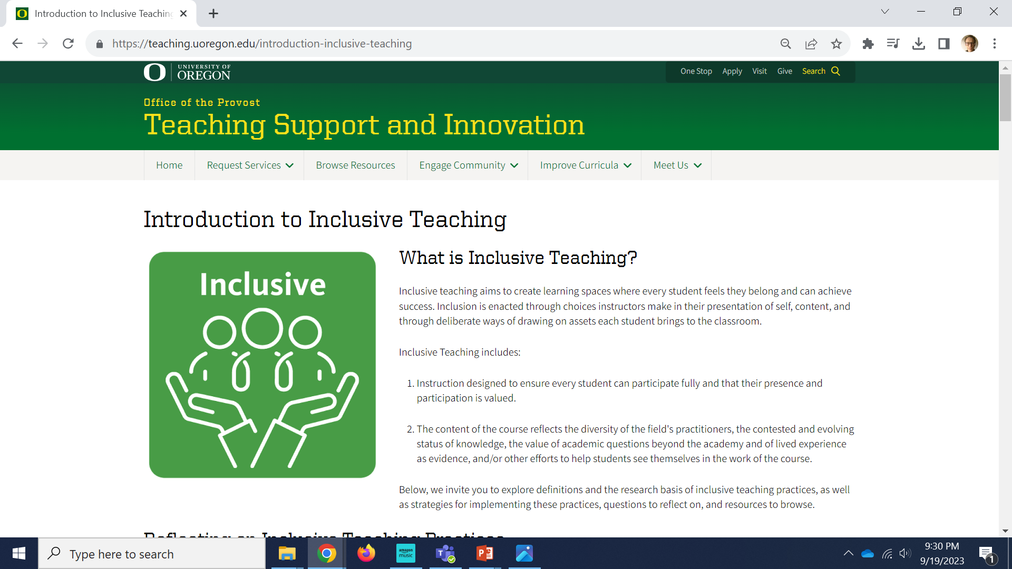
GE Day of Teaching
University of Oregon
https://teaching.uoregon.edu/introduction-inclusive-teaching
2022

Slide 9
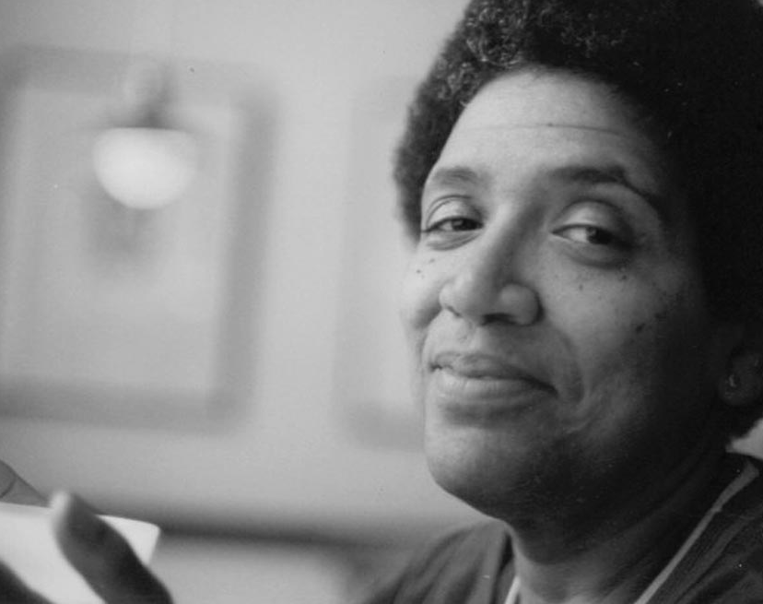
Audre Lorde
To those of you who sit here a little bemused and I hope very proud, I speak to you as a poet whose role is always to encourage the intimacy of scrutiny. For I believe that as each one of us learns to bear that intimacy, those worse fears which rule our lives and shape our silences begin to lose their power over us.
The quality of light by which we scrutinize our lives has direct bearing upon the product which we live, upon the changes which we hope to bring about through those lives. It is within this light that we form those ideas by which we pursue our magic and make it realized.
Lorde, A. (2009). “Difference and survival: An address at Hunter College.” In I Am Your Sister: Collected and Unpublished Writings of Audre Lorde. R. P. Byrd, J.B. Cole, and B. Guy-Sheftall (eds.). Oxford University Press, 201-204.
Lorde, A. (1985). “Poetry is not a luxury.” In Sister Outsider: Essay and Speeches. Crossing Press, 36-39

Slide 10
“Learning is not a spectator sport. Students do not learn much just be sitting in classes listening to teachers, memorizing prepackaged assignments, and spitting out answers. They must talk about what they are learning, write about it, relate it to past experiences and apply it to their daily lives. They must make what they learn part of themselves.”
- Chickering and Gamson, 1987
Chickering, A. W., and Gamson, Z. F. (1987). “Seven principles for good practice in undergraduate education.” AAHE Bulletin, 39, 3-7.

Slide 11









What factors shape student engagement?
Information & Ideas
Environment
Value
Student Engagement
Ambrose, S.A., Bridges, M.W., DiPietro, M., Lovett, M.C., and Norman, M.K. (2010). How learning works: Seven research-based principles for smart teaching. San Francisco: Jossey-Bass.
Fink, L.D. (2003). Creating significant learning experiences: An integrated approach to designing college courses. San Francisco: Jossey-Bass.
Barkley, E.F. (2010). Student Engagement Techniques: A handbook for college faculty. San Francisco: Jossey-Bass.
Reflection
Experiences
Self-Efficacy

Slide 12
Checklist for Planning
Active Learning
Information and Ideas: How are students engaging content? [lecture, reading, research, discussion, etc.]
Experiences: What are students “doing” or “observing” to bring content to life and make it “theirs”? [activities, exercises, assignments, etc.]
Reflection: How are students being asked to determine, for themselves, the meaning and significance of their learning experiences? [debriefs, journals, portfolios, metacognitive exercises, etc.]

Slide 13
Checklist for Planning
Motivation
Value: How has the value of the course, and particular aspects of it, been articulated? [goals, purpose, relevance, interest, significance, etc.]
Efficacy: How do students develop a realistic sense of agency, confidence, and progress about their performance in the course? [expectations, rigor, feedback, strategies for success, etc.]
Environment: How has a supportive learning environment been cultivated? [communications, approachability, organization, check-ins, etc.]

Slide 14
Goals
What will students learn?
Learning Outcomes
What should students know or be able to do?
Summative Assessment
What evidence will demonstrate student learning?
Formative Assessment
How can students get feedback about their learning?
Activities
How will you help students meet goals?
Aligned “Backward” Design
Wiggins, G. P., & McTighe, J. (2005). Understanding by design. Ascd.
Notes:
Sierra
Backward design is an approach to course design that focuses on student learning rather than on teacher performance. It is called “backward” because it starts with what students should know, understand or be able to do by the end of the unit/course/degree and works backward from there to inform development of course materials that specifically target successful achievement of the learning goals.
-The first step is to identify the learning goals/outcomes. Next, determine what evidence will convince you that students achieved the desire goals which become the course assessments. And, finally, with the achievement target clearly defined, create learning activities that will help students achieve the desired goals.

Slide 15
Key Questions to Ask
What should students know or be able to do? [What is the learning outcome?]
How do students demonstrate what they know or can do? [What kind of assessment?]
How do students prepare for demonstrating their knowledge or skills? [What kinds of experiences – activities, interactions, etc.?]
How do students engage the content they’ll be using? [How exposed to – retrieve or receive – the content?]

Slide 16
An Example
What should students know or be able to do? [Connect key concepts and theories of the critical social sciences to relevant local issues]
How do students demonstrate what they know or can do? [They can write a research-based, rhetorically-effective Op-Ed]
How do students prepare for demonstrating their knowledge or skills? [observe model demonstrations by instructor; read and assess sample Op-Eds; discuss and debate ideas; practice writing – including creative flare; engage in research] [not to mention: identify problems; appraise-critique-propose potential solutions]
How do students engage the content they’ll be using? [Readings, lectures, videos, database searches]

Slide 17
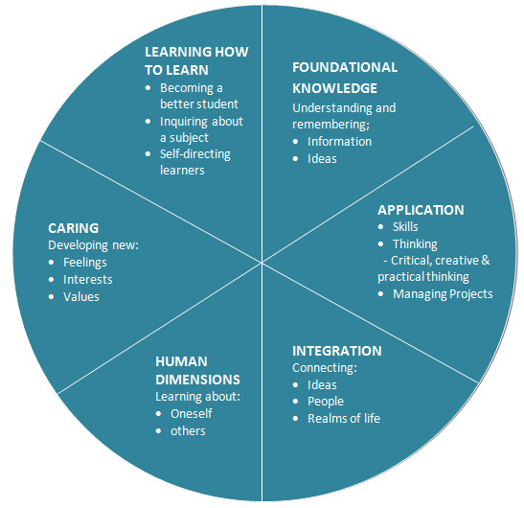
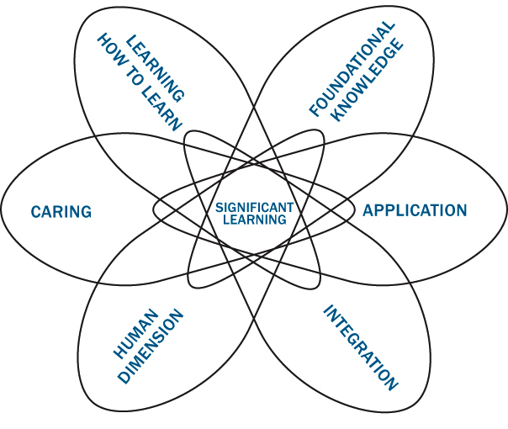
What kinds of learning goals?
(Fink)
Fink, L.D. (2003). Creating significant learning experiences: An integrated approach to designing college courses. San Francisco: Jossey-Bass.

Slide 18
Instructor Planning Steps
What should students know or be able to do?
(i.e. What is the learning outcome?)
1
4
How do students demonstrate what they know or can do?
(i.e. What kind of assessment?)
2
3
How do students prepare for demonstrating their knowledge or skills?
(i.e. What kinds of experiences – activities, interactions, etc.?)
3
2
How do students engage the content they’ll be using?
(i.e. How exposed to – retrieve or receive – the content?)
1
4
Student Learning Experience

Slide 19
What does Active Learning involve?
Information and Ideas
Primary / secondary
Accessing them in-class, out-of-class, online
Fink, L.D. (2003). Creating significant learning experiences: An integrated approach to designing college courses. San Francisco: Jossey-Bass.
Reflection
On what one is learning and how one is learning
Alone and with others
Experiences
Doing, observing
Actual, simulated
“Rich learning experiences”

Slide 20




Example: Quick Engagements
What Do You Think?
Believing and Doubting
Idea on Trial
Directed Paraphrasing
Notes:
Jason

Slide 21


Example: Contribution Journals
Daily (or weekly) in-class writing reflections
1-2 content-based questions that "warm up" thinking for discussion, e.g.:
    How would you describe settler colonialism to a friend?
    What do you think Pulido means when saying certain communities in Flint are "disposable"?
1-2 learning reflection questions that "wrap up" the class, e.g.:
    What did you find most interesting or significant or challenging today?
    What might you do to come more prepared for the next class?
Notes:
Jason

Slide 22
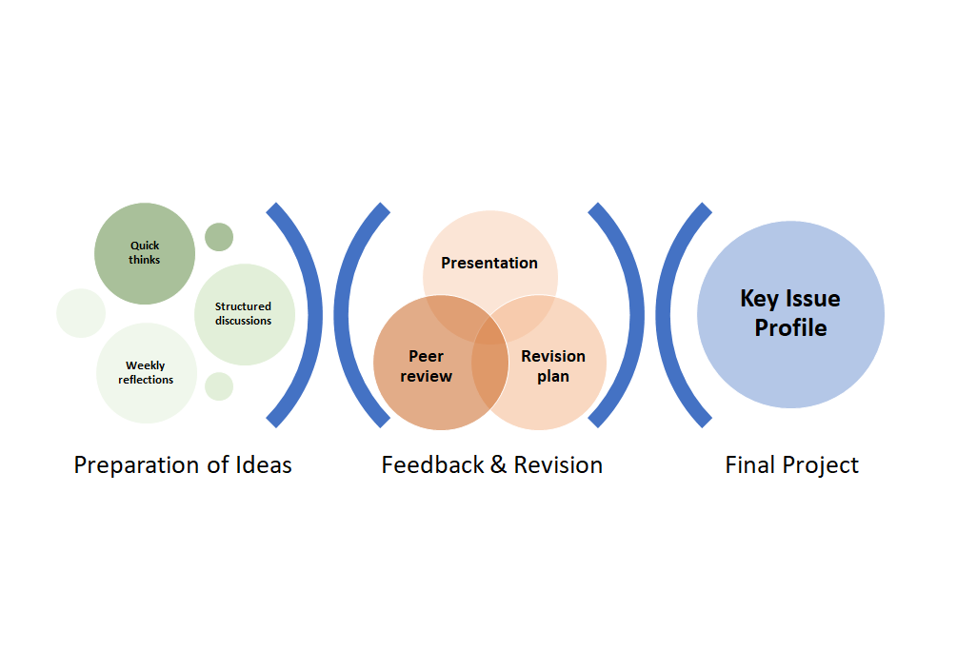
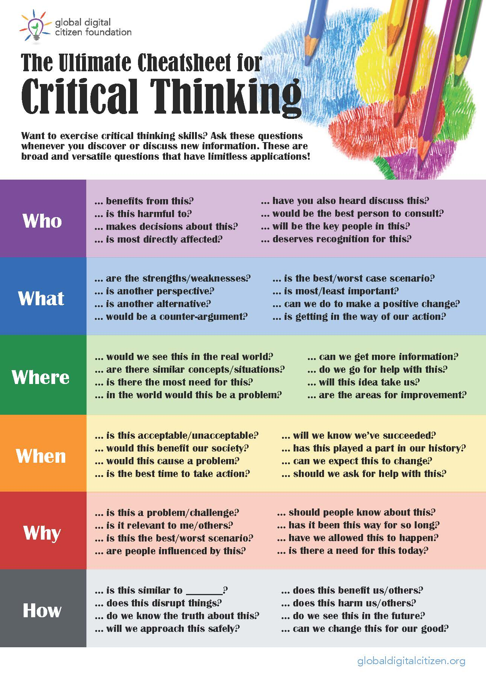
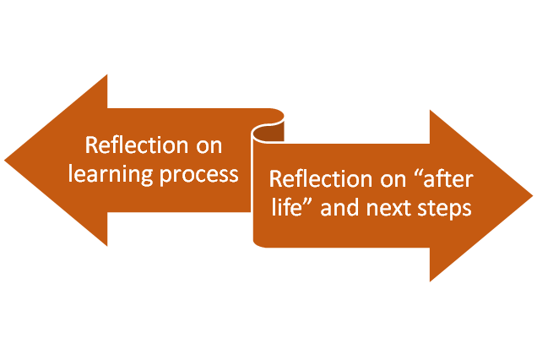
Example: Key Issue Profiles
Notes:
Jason

Slide 23
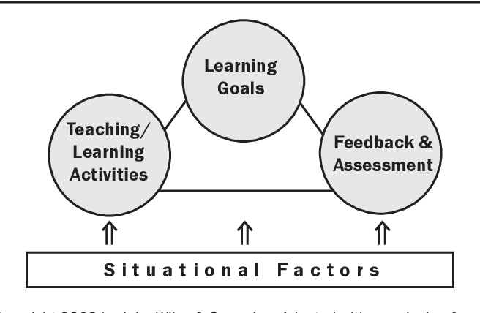
What is the context of learning assessment?
What is the learning goal(s) of the assignment you are grading?
What activities have helped students prepare for the assignment?
What factors might be influencing the quality of students’ work?
What criteria and standards are you assessing and giving feedback on?

Slide 24
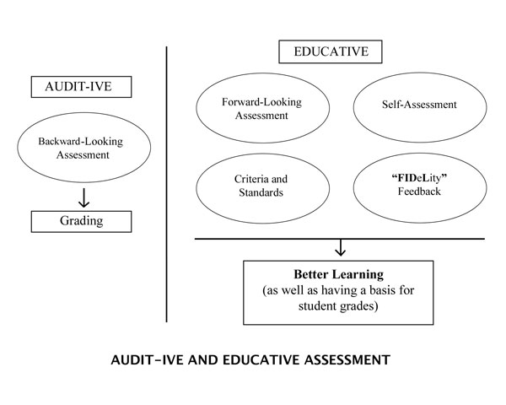
What kind of assessment am I doing?
Audit-ive Assessment: determining whether students learned correctly
Backward-Looking: focuses on whether students “got” the material they studied
Less feedback needed

Slide 25
What kind of assessment am I doing?
Educative Assessment: determining how students can learn better
Forward-Looking: focuses on whether students are ready for some future activity after current period of learning is over
Criteria and Standards: identifies the traits that count and describes the quality differences for each trait
Self-Assessment: provides opportunities for students to self-assess their work
Feedback: offers feedback as frequently and immediately as possible, based on criteria/standards, and supportively
More feedback needed

Slide 26
How transparent are the expectations?
“What am I supposed to do, and how am I supposed to do it?”
“How am I being graded?”
“When is it due and where?”
“Why are we doing this?”
(aka “Why should I care?”)

Slide 27

What is transparency?
Over 25,000 students…
…in hundreds of courses…
…at more than 40 institutions…
…in seven countries.
A change to assignment design:
Purpose, Task (or Process), Criteria

Slide 28
How transparent are the expectations?
“What am I supposed to do, and how am I supposed to do it?”
“How am I being graded?”
“When is it due and where?”
“Why are we doing this?”
(aka “Why should I care?”)
Task
Criteria for success
Logistics
Purpose or Goal

Slide 29
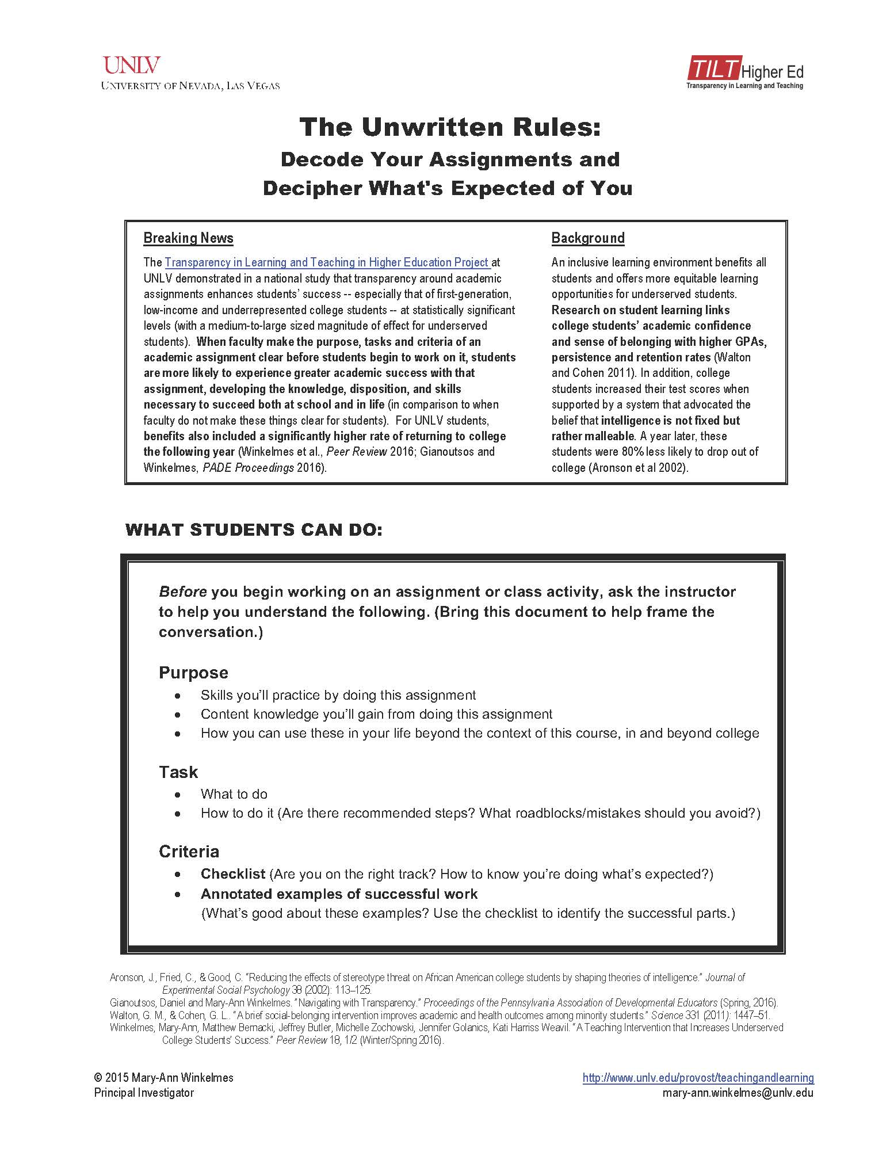
Notes:
20-30 minutes for working with 1-2 sample assignments?

Slide 30
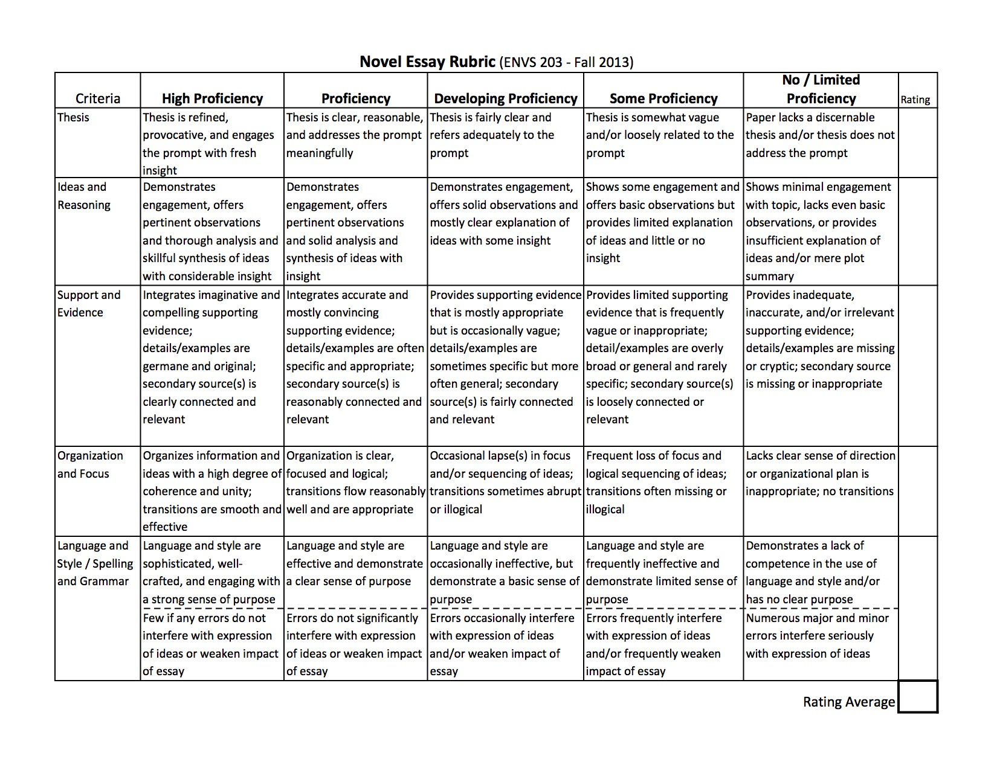

Slide 31
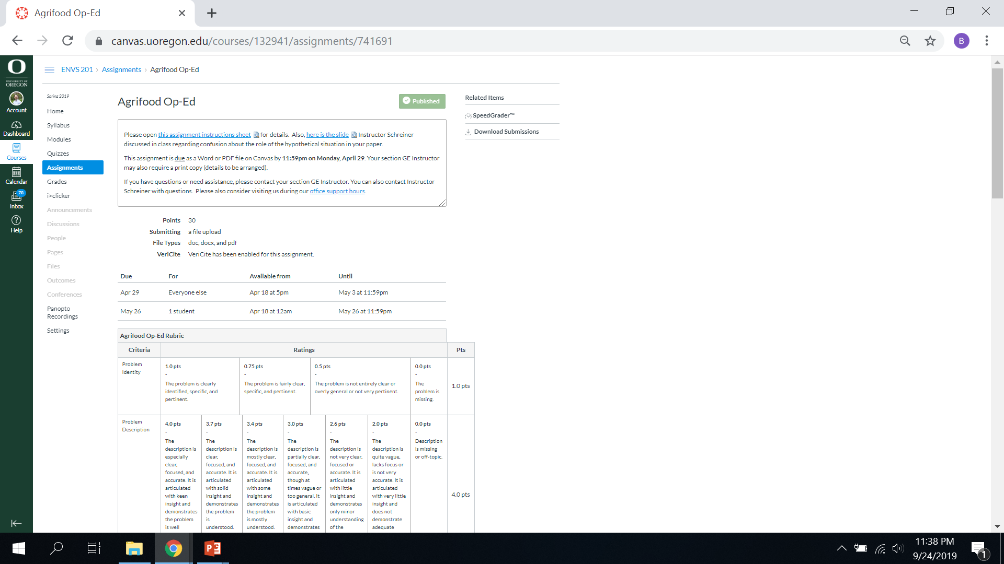

Slide 32
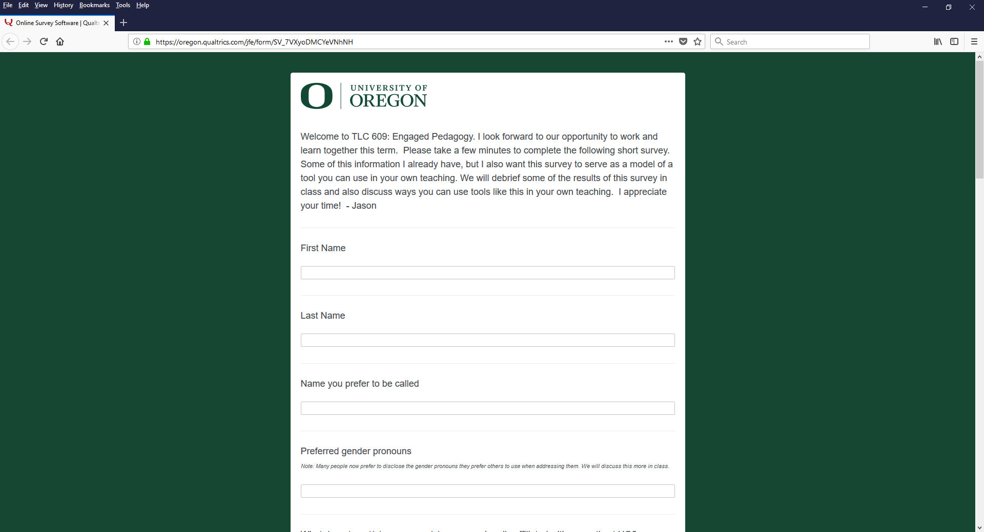
Who are my students?
What are their goals and concerns?
Sample question: “What three words most characterize the best teachers you've ever had at any level of your learning?”

Slide 33
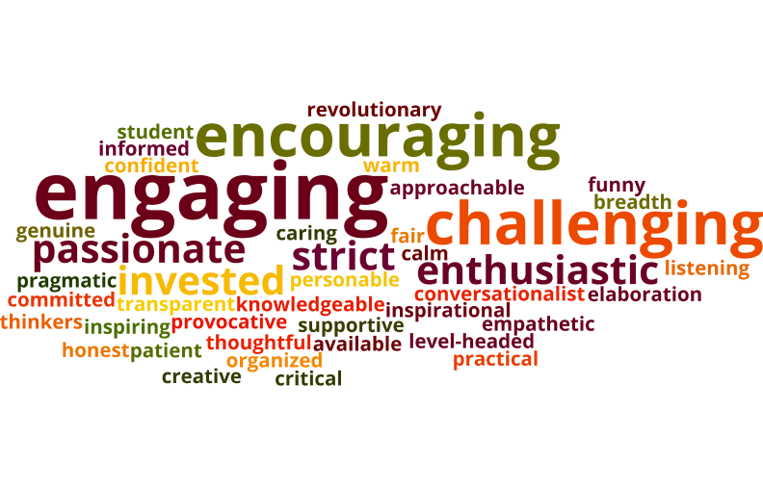
Who are my students?
What are their goals and concerns?
Sample question: “What three words most characterize the best teachers you've ever had at any level of your learning?”

Slide 34
Who are my students?
What are their goals and concerns?
Other sample questions:
What aspect(s) of your teaching are you currently most focused on changing, improving, enhancing, etc.?
Given your own experience as a student, and your current understanding of your discipline or field, what three intellectual skills do you feel are most essential for students to learn in order to be successful in courses within your discipline or field?
Notes:
Here I include two more survey questions from my pedagogy course, which are more specific to my graduate students’ concerns and goals.

Slide 35
How do we get to know students?
Surveys
Student feedback
Check-ins
Office support hours
Other ideas?

Slide 36
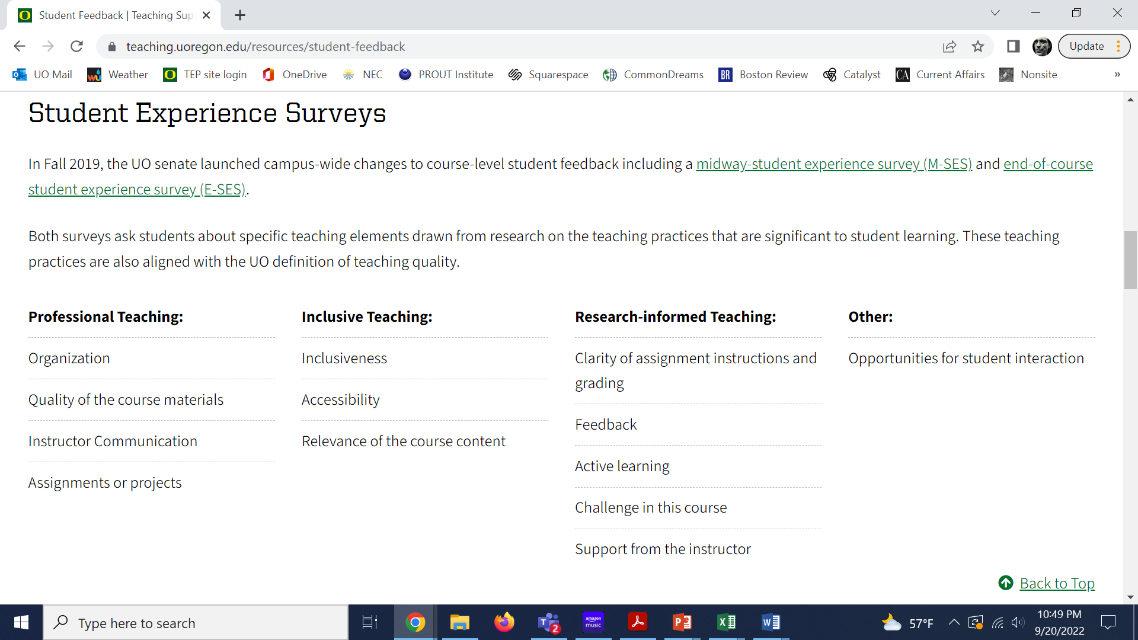

Slide 37

And Course Policies?

Slide 38
Two helpful resources to visit:
https://teaching.uoregon.edu/term-resources-page
https://teaching.uoregon.edu/teaching-and-generative-ai

Slide 39
GE Day of Teaching
University of Oregon
2023
Please scan to sign in
tep@uoregon.edu
teaching.uoregon.edu

