Slide 1
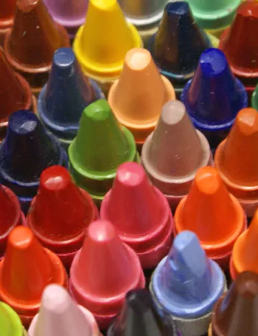
ACTIVITY: DRAW YOUR CREATIVE PROCESS
z
PLAY WITH PAPER AND CRAYONS. (10 minutes)
TRADE DRAWINGS WITH YOUR SMALL GROUP AND DISCUSS. (10 minutes)
FULL CLASS HARVEST: SIMILARITIES AND DIFFERENCES
(I participate too!)

Slide 2
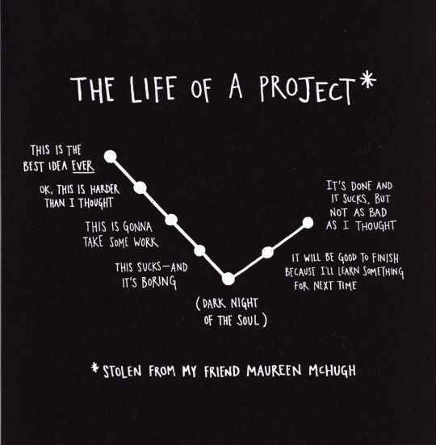
AUSTIN KLEON: LIFE OF A PROJECT
z

Slide 3
WRITING PROCESS
CONCEIVE
COLLECT
FOCUS (students and journalists tend to skip this)
Rehearse
Select
ORGANIZE (again, often skipped)
DRAFT
REVISE
-- adapted from Jacqui Banaszynski, editor, Nieman Storyboard

Slide 4
INSTANT REPLAY
What were your biggest successes this weekend? Be specific, and explain how you improved from previous meets.
What are the next steps you need to take to keep improving as a track and field journalist? Where do you need more improvement? Why?
What ideas do you have for how we can use our Pac-12 experience at NCAAs? I want your suggestions!
What do you need from me to keep improving?
How are you going to downshift during this non-meet week to make sure you're fresh for the big and busy Pre Classic week?

