Slide 1
Deepening Dialogue
July 13, 2023
Jason Schreiner
Associate Director, TEP
Notes:
√

Slide 2
Reflection Question
Thinking back, has there ever been a moment of classroom discussion when you felt really engaged as a student?
What made that discussion “work” for you to learn?
- What did your teacher do to help create it?
- What did you and your fellow students do to help make it happen?

Slide 3

Session Gifts, er, Goals
Discuss the purpose and value of discussion and dialogue and salient challenges to engaging them
Share ideas for how to deepen dialogue
Sketch plans for more discussion and dialogue in our classes

Slide 4

What do we mean by discussion and dialogue?

Slide 5
What do we mean by discussion and dialogue?
Brookfield and Presskill define discussion as “an alternately serious and playful effort by a group of two or more to share views and engage in mutual and reciprocal critique,” with four key purposes:
To help participants reach a more critically informed understanding about the topic or topics under consideration
To enhance participants’ self-awareness and capacity for self-critique
To foster appreciation among participants for the diversity of opinion that invariably emerges when viewpoints are exchanged openly and honestly
To act as a catalyst to help people take informed action in the world

Slide 6

What do we value in discussion and dialogue?
Why engage students in discussion and dialogue?
In what ways does it help students learn?
What are the benefits?

Slide 7
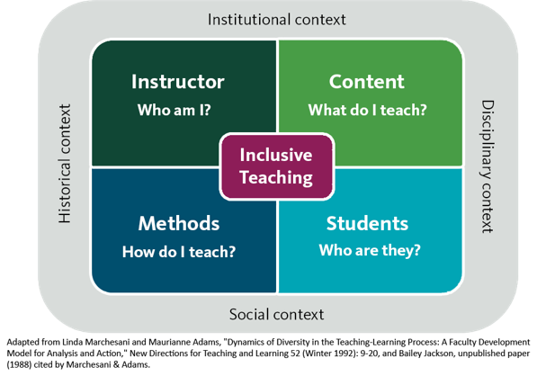
What is impacting classroom dialogue?
Academic freedom & political (multi)polarization
Cancel culture
Existential crisis
Career readiness concerns
Artificial Intelligence
Attendance & engagement
Relevance & alignment

Slide 8
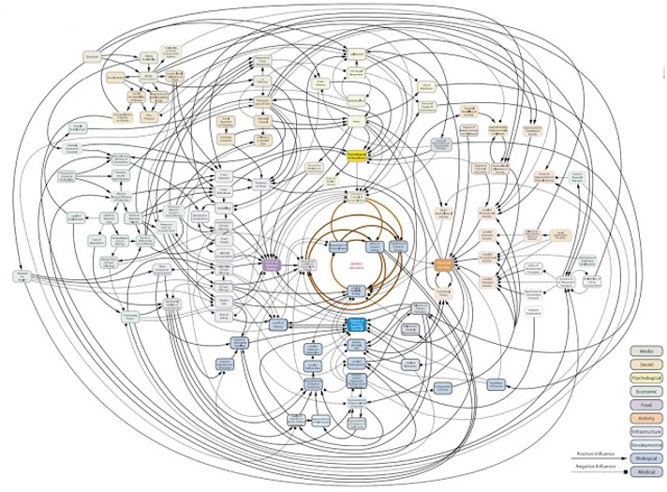
Key Factors for Organizing Discussion and Dialogue
Purpose or Goal
Structure, Process, Protocol
Content Focus
Student Preparation
Agreements for Interaction
Role Clarifications
Artifacts and Assessment
Accessibility and Alternates
What else?

Slide 9
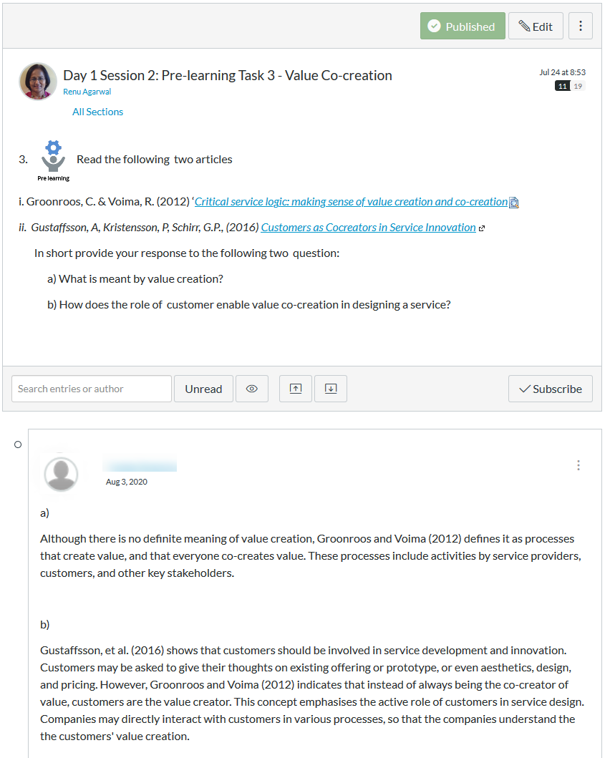
Example: Canvas Discussion
What are some ways you have used Canvas Discussion?

Slide 10
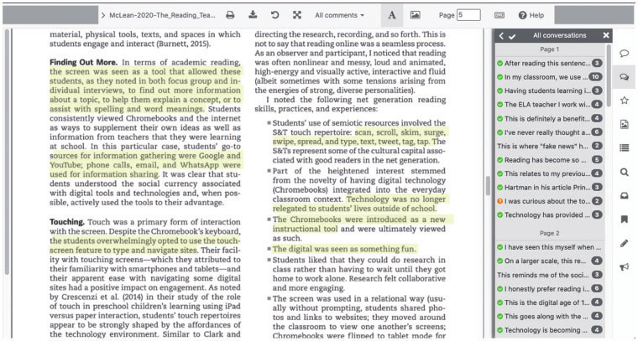
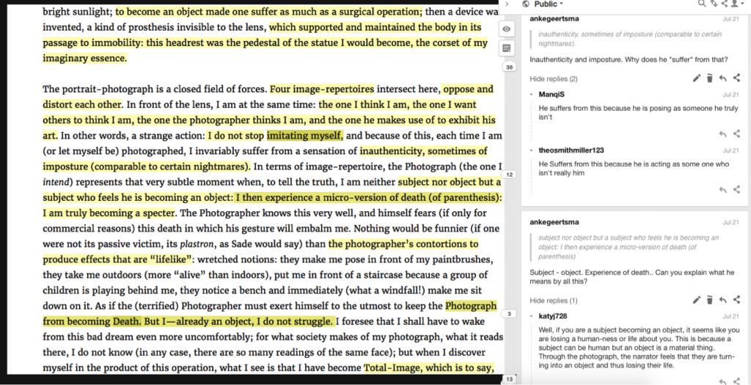
Example: Perusall and Hypothesis
Facilitate group discussion via annotation and comments
Support in-person and asynchronous engagement
Create an artifact for revisiting
Integrate with Canvas

Slide 11



Example: Online Collaborate Spaces
Microsoft Whiteboard

Slide 12
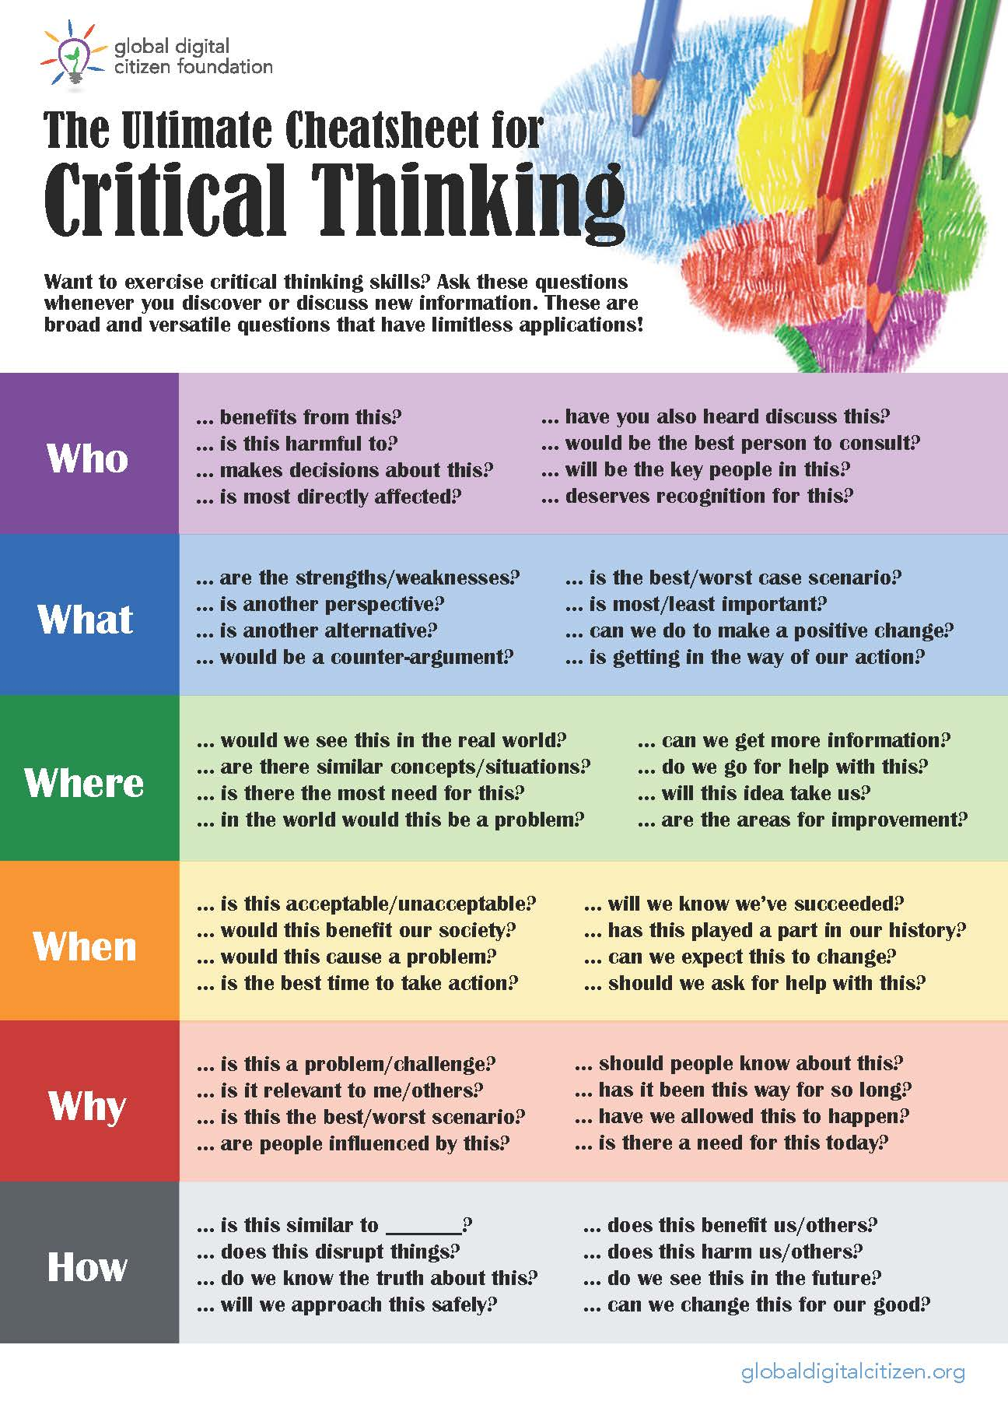

Example: Inquiry Templates
“In simpler terms, critical thinking involves first discovering the who, what, when, where, and how of things – finding the answers to those eternal questions of the inquisitive child – and then utilizing that knowledge in a manner that enables you to determine what matters most.”
Teaching Critical Thinking (2009)

Slide 13
Example: Strategic Questioning
Getting CLOSE-UP
Clarity: What do you mean by that? Can you put that another way?
Linking: How is that similar to the other reading? How does your view connect with X’s?
Open-ended: What interests you about __? What’s happening here?
Synthesis: What stands out from the discussion? What question do we still have?
Evidence: How do you know this? What experience is the analysis based on?
Understanding: Why is this happening? How do you explain the situation?
Priority: What matters to you most about this? What’s the most important value to consider?
Brookfield and Presskill, Discussion as a Way of Teaching (1999)

Slide 14
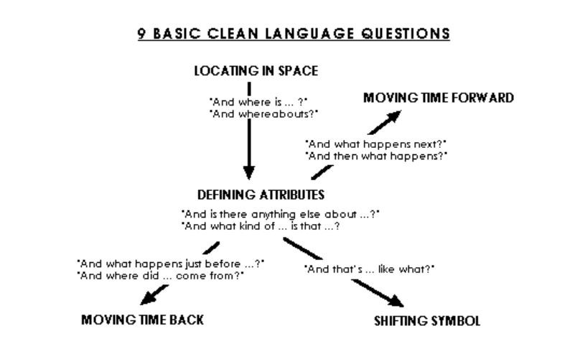
Example: Clean Language
For more details, see Brookfield and James, Engaging Imagination: Helping Students Become Creative and Reflective Thinkers (2014)
See also
Caitlin Walker’s TED Talk (2012)

Slide 15
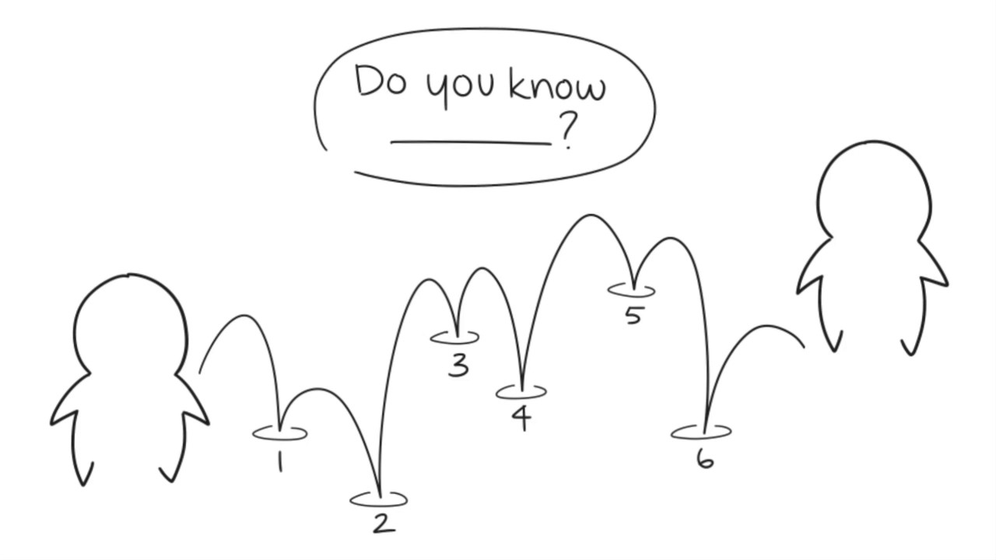
Example: Six Degrees of Separation
Trace six steps that connect any two things:
Higgs Boson particle and the World Series
Four-color theorem and Chris Rock
Georg Simmel’s big lie theory and a Douglas Fir tree
Etc.
For more details, see Brookfield and James, Engaging Imagination: Helping Students Become Creative and Reflective Thinkers (2014)

Slide 16
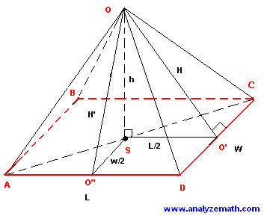
Example: Pyramiding
How do we know or how do we understand something is good, sound, useful, etc.?
What would that be like?
What would that not be like?
How do you know when…?
How would you recognize…?
What work is X doing? How? Why?
For more details, see Brookfield and James, Engaging Imagination: Helping Students Become Creative and Reflective Thinkers (2014)

Slide 17

Example: LSD
Look back through your work
Select the most interesting things you learned
Deepen by indicating how you’ll use what you learned to inform where you go next
For more details, see Brookfield and James, Engaging Imagination: Helping Students Become Creative and Reflective Thinkers (2014)

Slide 18
Practical Ideas
Think about your course and identify at least one way you could deepen student engagement through discussion or dialogue.
Some factors to consider:
What is the purpose or goal?
Which content is the focus?
What kinds of preparation do students need?
How will you assess learning?
Feel free to work individually or with others.

