Slide 1
Core Ed – Written Communication Assessment
Core Education
Methods of Inquiry
Composition
Arts & Letters
Social Science
Natural Science
Majors’ Writing Outcomes
WR 121
Written Communication
113 of 300 courses submitted
99 of 282 courses submitted
33 of 118 courses submitted
WR 122 or 123
72%
65%
12%
All UO students must complete writing program requirements
One of the most common Core Ed methods of inquiry
>70% of
UO majors have a communication outcome
Notes:
Austin
SHARED responsibility across curriculum
Most sought skill by employers in career surveys (Probably similar with faculty)

Slide 2
Writing Assessment Project (CAIT) teaching.uoregon.edu/writing-assessment
Composition
Revise the learning objectives of the Composition Program,
Begin to develop a shared understanding of these goals for Writing faculty, students, and other UO colleagues,
Articulate how the composition program objectives align with core education goals for written communication and state-wide writing objectives.
WR 121
WR 122 or 123
Notes:
Austin/Nick
Could ask audience to jot down 2-3 of their own goals for students as writers… then bring back in thru facilitatoion.

Slide 3
WR Student Perceptions
Core Education
Methods of Inquiry
Composition
Arts & Letters
Social Science
Natural Science
Majors’ Writing Outcomes
WR 121
WR 122 or 123
Written Communication
Spring 2022 survey
1,802 students enrolled in composition courses
815 respondents (45.2%)
Most valuable about their learning about writing
Writing Self-Efficacy
Future Writing Goals

Slide 4
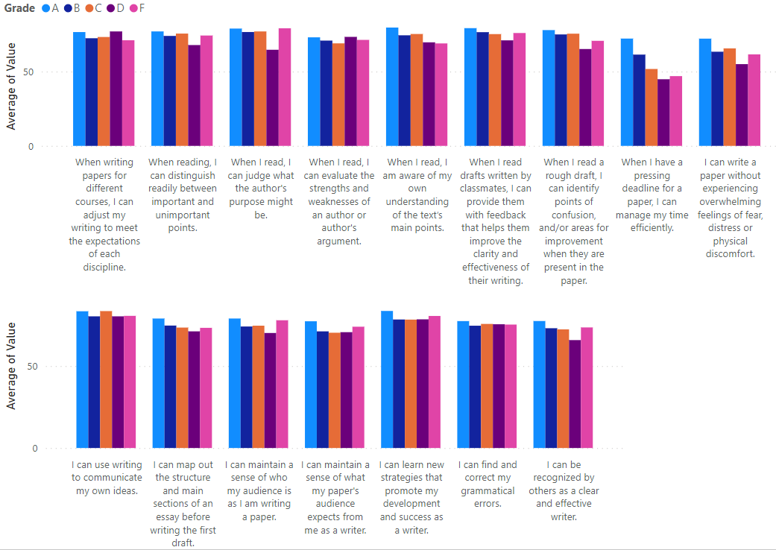
Student Perceptions
Writing Self-Efficacy
Notes:
Austin
Stuidents across the board are least confident in these skills.
Student who struggle are aware of their lack of confidence in these tasks – different from other domains of writing!

Slide 5
Student Perceptions
Writing Self-Efficacy
Lowest Confidence:
When I have a pressing deadline for a paper, I can manage my time efficiently.
I can write a paper without experiencing overwhelming feelings of fear, distress or physical discomfort.
Notes:
Austin
Stuidents across the board are least confident in these skills.
Student who struggle are aware of their lack of confidence in these tasks – different from other domains of writing!

Slide 6
Student Perceptions
Future Writing Goals
14.4% - developing more cohesion and concision in their academic writing,
14.2% - transferring skills to new writing contexts,
13.1% - building their self-efficacy as writers,
10.1% - becoming more efficient writers,
7.9% - creating stronger arguments,
6.8% - improving time management with written assignments,
6.3% - increasing their facility with grammar, syntax, and vocabulary
Notes:
Austin

Slide 7
Coming out of WR courses… Many students struggle with time management & writing anxiety. Most students have goals for improving their writing that match many instructor’s goals.

Slide 8
Writing in Context - Develop arguments in multiple genres that are relevant to students and to the audiences to which they’re addressed.
Research and Inquiry - Engage with primary, scholarly, and public sources to enrich a process of inquiry and inform students’ writing.
Analysis - Analyze how writers reflect, challenge, and transform their discourse communities, including in their relationship to formal and stylistic conventions.
Agency and Positionality - Recognize lived experience as a source of authority in writing, reading, and discourse.
Feedback and Revision - Give and receive constructive feedback; revise based on feedback, further research, and reflection.
Transferring Skills - Apply the processes and strategies of writing to engage with new contexts and communities in the University of Oregon and beyond it.
https://teaching.uoregon.edu/writing-assessment
Notes:
Nick

Slide 9
Student Perceptions
Most valuable about their learning about writing
>90% of respondents align to program outcomes
“how to be able to truly collaborate with others and be open to writing revisions.”
“how to write in a different way than what was taught to me in high school”
“understanding your audience and the things they might think is very important.”
“most valuable thing I learned was analyzing articles, this was very beneficial throughout the class and was something I used in other classes.”
“how to find scholarly sources and what made a source scholarly”
Notes:
Austin

