Slide 1
Teaching in
a Neurodiverse Context
Notes:
Laurel (HIT RECORD). Welcome! We are so glad you have joined us! As we start today, we want to note that we are recording and will be posting the recording afterwards ,but that the recording will stay on slides and presenters. Please feel free to have your camera on or off, and to step away any time you need to. We will use slides during this session; if you don’t yet have a copy and want to refer to them, I will put a link in the chat. We will send out an email after the session with a recap of the slides and other resources we’ve shared, as well as a redacted copy of the chat, so you can reference the questions, practices, and expertise your colleagues share. Alex, would you read our Land Acknolwedgement?

Slide 2
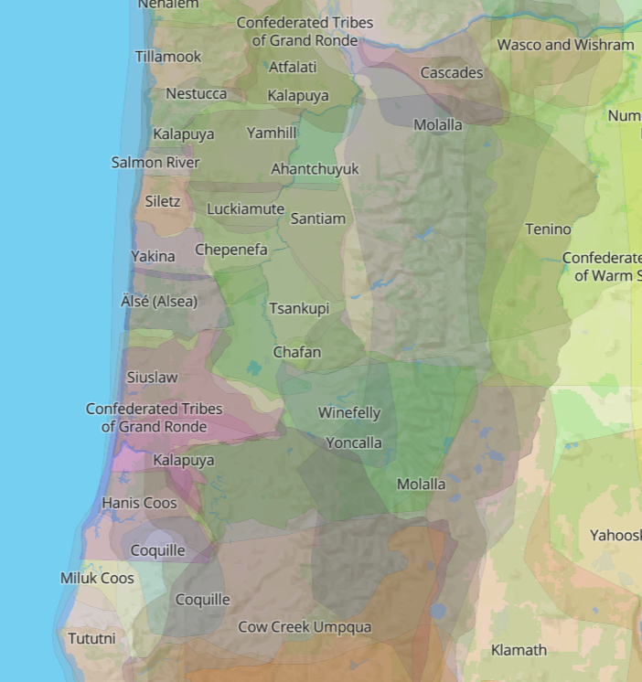
Land Acknowledgement
The University of Oregon is located on Kalapuya Ilihi, the traditional indigenous homeland of the Kalapuya people. Following treaties between 1851 and 1855, Kalapuya people were dispossessed of their indigenous homeland by the United States government and forcibly removed to the Coast Reservation in Western Oregon. Today, descendants are citizens of the Confederated Tribes of Grand Ronde Community of Oregon and the Confederated Tribes of the Siletz Indians of Oregon, and continue to make important contributions in their communities, at UO, and across the land we now refer to as Oregon.
Learn more about:
Confederated Tribes of Grand Ronde
Confederated Tribes of Siletz Indians
Programs & Services / Chifin Native Youth Center
Notes:
Alex

Slide 3
Welcome!
Please introduce yourself in the chat
(in whatever way you wish–name, pronouns, role, mood, what you had for breakfast, etc.)!
Notes:
Alex and Laurel. We will introduce ourselves, but before we do, we invite you to take a moment and identify how you’d like to introduce yourself in the chat, so we can get a sense together of who we are sharing this virtual room with! (take at least 15 seconds of silence). Alex, Spencer, and I are going to share a bit about ourselves, but feel free to turn your volume down and keep writing what you’d like to share or keep your focus on the chat if you wish.

Slide 4
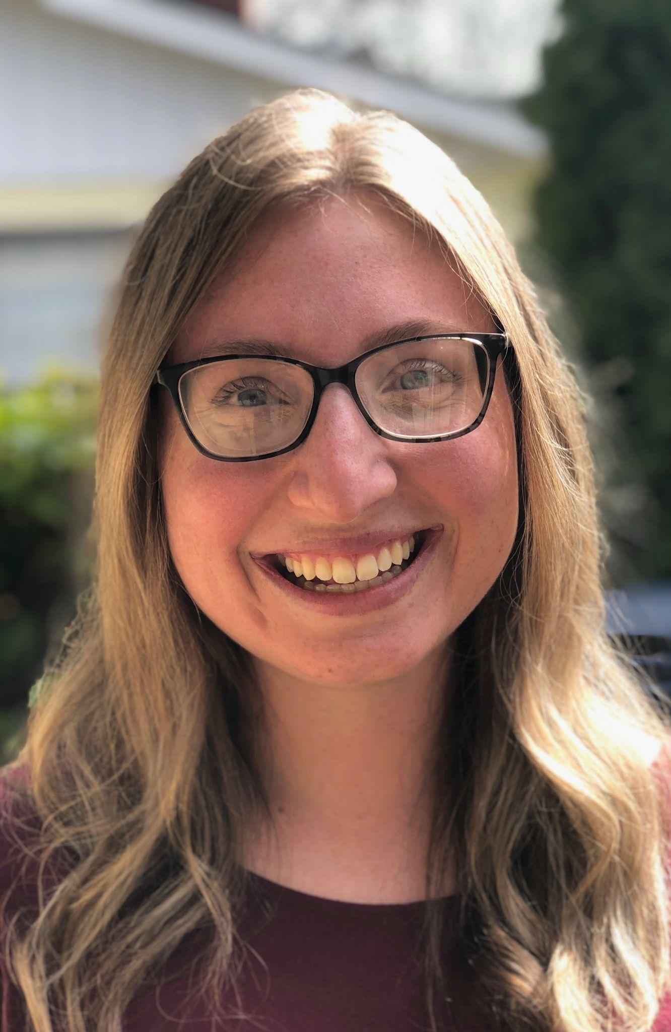
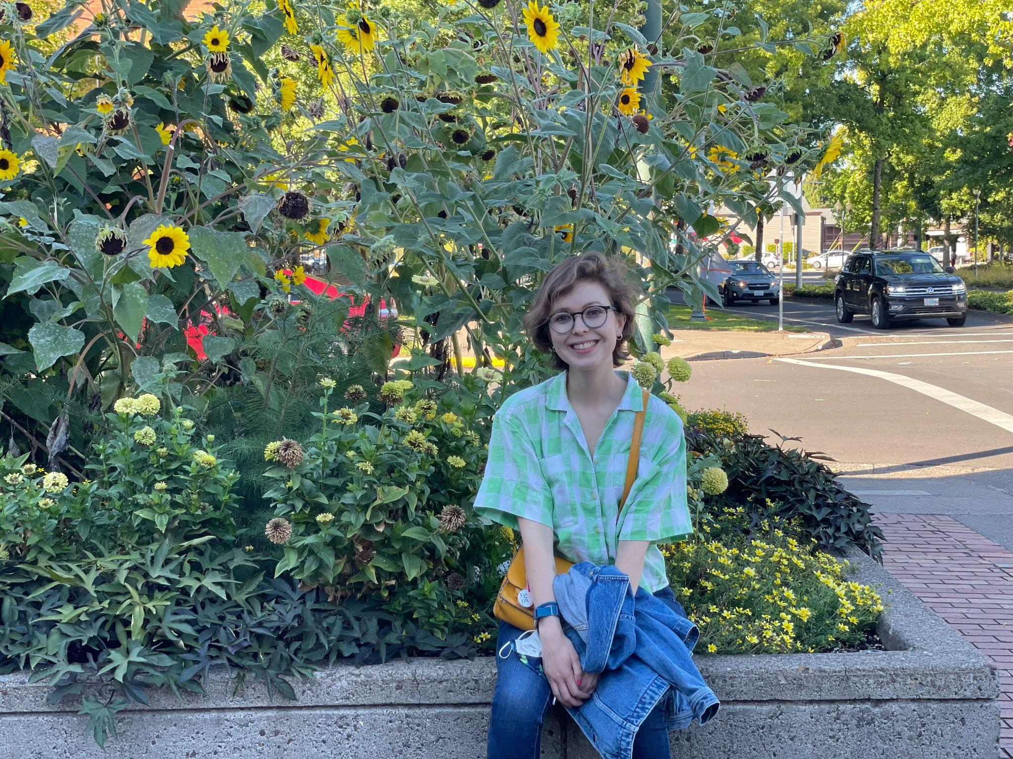
Alex Newson (she/her)
Spencer Brower (she/her)
Laurel Bastian (she/her)
Autistic doctoral student in Special Education Department
Educator at heart
Focus on neuroinclusive research methods, equitable trauma-responsive teacher training, and mental health and wellbeing for autistic students and staff
AuAdhd doctoral student in School Psychology
Former educator
Focus on identity development (disabled, LGBTQ youth) and mental health work, affirming practice, and neurodivergent-informed consultation.
Faculty Consultant with TEP; was faculty @ UW-Madison for decade
Focus on accessibility in course design & teaching; wellbeing; trauma-responsive pedagogy
Disabled ADHDer
Notes:
Go in a line

Slide 5
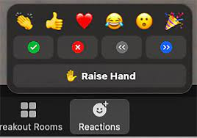
Invitation to participation
You are coming in with important knowledge, experience, and goals! While this session will not involve substantive discussion, we hope you will still participate in ways that feel right to you, such as:
using chat
using the reactions
stopping us or raising your hand
staying for the post-session chat
emailing us after the session
There will also be a survey near the end of this session with an opportunity to 1) set yourself a goal, 2) give us feedback, so we can improve!, and 3) let us know what future sessions would be most useful to you, so we can offer them.
Notes:
Spencer

Slide 6
Only “rule” for today: be open to new possibilities!
You may already be familiar with or use the terms or ideas we will discuss today.
That's okay!
Please be open to hearing new ideas that drive you to question your current practice. We are here to learn together.
Notes:
Spencer

Slide 7
Agenda
(5 min) Welcome & session overview (we are here!)
(15 min) Key terms and concepts
(7 min) Why does Neurodiversity matter in teaching and learning?
(25 min) How might we think about designing for neurodiversity?
(5) What options exist for next steps in learning & practice together?
Post session chat/Q & A (optional & available!)
Notes:
Laurel–read each. “while this session is geared towards instructors, we think the concepts and strategies apply to many, many contexts, and we invite you to find the overlap for your own, regardless of your role.”

Slide 8
Building capacity together:
Introductory Information
Information and application
Reflection & Discussion
Today’s session!
1-2 winter sessions that match your needs/goals; 3 fall/winter UDL sessions
1-2 discussion-based sessions: pose big ?s & dialogue with colleagues
Notes:
Laurel: Today’s invitation is both to this session AND to continuing to build our capacity at UO to ask together “what does a neurodiverse and neurodivergent-affirming climate look like in our work and in our learning?” We want to share a glimpse of future offerings so you can see that bigger invite if you are interested. (1st text) We are starting with an introductory session to examine some key terms and concepts. (2nd text) We plan to offer at least 1- 2 sessions this winter term addressing the needs you hopefully tell us about in the survey we share with you today, as well as 3 fall and winter sessions on UDL. All of these sessions will focus on application. (3rd text block). We also plan to have 1-2 discussion-based sessions in winter where we can pose big questions you might be grappling with around designing for neurodiversity, access, and inclusion. CONSIDER THIS INVITE TO BUILD CAPACITY TOGETHER, and please contact any of us directly at any time if you/d like to think together or partner around this.

Slide 9
Key Terms & Concepts
Neurodiverse, neurodiversity paradigm, neurodivergent, & neurotypical
Notes:
Laurel - transition slide. Alex and Spencer and going to lead us through key terms and concepts. Some of you have a lot of expertise in this area. Some are newer to these terms and concepts. If questions come up for you while Alex and Spencer are sharing, please feel free to put those questions in the chat, and we will make sure we address them in the chat during or after our session. to Alex!

Slide 10
Defining Neurodiversity
Neurodiversity is:
The natural variation in behavior and mental processes. We are all encapsulated within neurodiversity.
The concept that there is natural diversity in ALL human minds that makes us unique and individual
Notes:
***Alex
“ND is not a classificatory term dividing us from them. We are all Neurodiverse. We live on a Neurodiverse planet in which amoral nature generates endless genetic diversity, while we humans have evolved the capacity to make judgments about nature’s bounty. What Neurodiversity brings us is a challenge to find a place for everyone and to distribute the bounty fairly.” Singer: Neurodiversity: its politics, not science!

Slide 11
Defining Neurodivergent and Neurotypical
Neurodivergent (ND) is:
A descriptive term for individuals who have cognitive profiles that fall outside the dominant discourse of neurocognitive functioning.
A person whose mind works significantly differently than "normative" social expectations and neurotypical minds. Can be innate or acquired
Neurotypical (NT) is:
Referring to those whose neurocognitive functioning fits within the dominant societal standards.
A person whose mind works similarly to "normative" social expectations and the majority
Notes:
***Alex Touch on neurodiverse means a GROUP of mixed neurodivergent and neurotypical individuals
Neurodivergent note: Can include Autism, OCD, Tourettes, ADHD, etc. There is a difference between acquired (Traumatic brain injury, PTSD, Dementia, Depression) and neurodivergences which are present at birth (ones described originally)

Slide 12
“Neurodivergent” as term for range of conditions & experiences
Tic disorders
Bipolar
Schitzophrenia
ADHD
Autism
OCD
Dysgraphia
Epilepsy
Dyslexia
Dyscalculia
Down Syndrome
Sensory Processing
Dyspraxia
OSDD
CPTSD
Misophonia
Notes:
***Spencer and Alex
Many people who are ND are in more than one way
Each ND identity and/or diagnosis has wide (and internally divergent!) constellation of experiences or traits associated with it, so impossible to assume what someone who is X or has Y is experiencing
Intersectionality always matters, including here

Slide 13
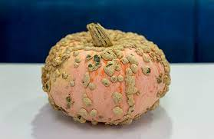
Defining the Neurodiversity Paradigm
The Neurodiversity Paradigm says:
Naturally occurring variation within and between groups and individuals
Our variations and differences hold equal value
As with other identities there is majority or minority status:
Outcome dictated by environment
Diversity as a property of the environment
Our diversity creates a rich and varied ecosystem and is a collective strength
Based on example from Dr. Sue Fletcher-Watson
Notes:
Alex to go over the list, Spencer to elaborate about the expectation of the “orange pumpkin”

Slide 14
Ableism
From Center for Disability Rights:
“Ableism is a set of beliefs or practices that devalue and discriminate against people with physical, intellectual, or psychiatric disabilities and often rests on the assumption that disabled people need to be ‘fixed’ in one form or the other.
Ableism is intertwined in our culture, due to many limiting beliefs about what disability does or does not mean, how able-bodied people learn to treat people with disabilities and how we are often not included at the table for key decisions.”
Notes:
***Spencer: “These terms acknowledge the innate biological characteristics of individuals and the strengths and challenges they bring, as well as the idea that many challenges are exacerbated because of societal norms and expectations.”

Slide 15
Assume Neurodiverse Groups
Do not ask students to disclose disability, diagnosis, or neurodivergence to receive support (this is not necessary, and can be harmful and exclusionary).
Do assume that students are experts in what they need to be ready for and engaged in learning, and that needs for people with similar identities may differ.
Do ask all students about their needs at the beginning/throughout the term (through initial survey and multiple modes like office hours, email, etc.). This both elicits information to consider in your course design and teaching and can increase students' sense of belonging.
Notes:
Alex to through points, Spencer to say text at bottom about invitation
Neurodiverse spaces means that we assume different neurotypes - neurotypical and neurodivergent.
Many of us teach in the way that worked best for us or those similar to us. An invitation, as we continue our time together, to notice where you might experience resistance to some of the practices that we share and whether that resistance is around what works for you as an individual and what works for the group. This is an invitation to be curious. Observe if this is uncomfortable because it is unfamiliar and new. It can be easier to brush away differences but remember we can provide support throughout this process. See difference as opportunity, an opportunity to lean in.

Slide 16
Why Neurodiversity Matters in Teaching & Learning
Notes:
Spencer

Slide 17
Because students say so!
Asking and including disabled and neurodivergent student voices can create spaces of increased accessibility and inclusion while better understanding barriers and current needs (Barkas et al. 2021; Clouder et al. 2020; Karousou, 2017).
Student voices can counter our assumptions about learning in necessary ways!
Notes:
Alex and Spencer

Slide 18
From 2022 Student Experience Survey:
“Please be mindful of how you frame things to your students, as the things you say can make students feel unwelcome in the learning environment. Calling students out saying they are not paying attention when they are twirling their hair or doodling is not accurate, as students actually pay better attention when they can doodle things relevant to the picture books. Many students in our cohort have autism, adhd, etc, and need to do these things to self-soothe and focus.”
Notes:
Alex and Spencer
READ ONLY BOLDED SECTION

Slide 19
From 2022 Student Experience Survey:
“I personally would have greatly benefited from easily accessible resources like the slides from class being uploaded to canvas or access to my laptop/tablet to take more efficient notes. I understand the need for control over the classroom, however I frequently find myself missing out on important lecture content because I am so focused on forcing my brain to focus on writing down notes quickly enough to keep up with the rest of the class.”
Notes:
Alex and Spencer
READ ONLY BOLDED SECTION

Slide 20
From 2022 Student Experience Survey:
“I am severely dyslexic, and no one knows what that’s like, so everyone does slides too fast. But for this course the slides were posted after which was my saving grace.”*
*A course design side note: while there can be pedagogical reasons to post slides or notes after the class, we also encourage posting them beforehand (or posting a draft version of them) if possible.
Notes:
Alex and Spencer

Slide 21
Because Assumptions Rely on NT Generalizations
Assuming how students learn best can be based on neurotypical ways of knowing, learning, and being.
Assumptions may not make room for the varied strengths and needs of neurodivergent students nor students with intersecting identities that we do not share.
https://www.insperity.com/blog/how-to-stop-making-assumptions/
Notes:
Alex and Spencer

Slide 22
Designing for Neurodiversity
Notes:
Laurel : now that we have some shared terms and concepts and a shared sense of why centering neurodiversity matters, how do we design for all of us?

Slide 23
Revisit learning objectives & revise for clarity
Work with individual accommodations while proactively designing for all students.
Consider principles: of transparency, consistency, voice and choice, and flexibility.
Important places to start:
Notes:
Laurel: we’ll highlight three places to start, with an emphasis on “START.” We look forward to a deeper dive in future sessions. [read each, note that for first one they go in tandem and both still needed]

Slide 24
Revisit Learning Objectives
(& How They Align with Assessment):
Revising learning objectives (at the course and modular level) to ensure they are clear and appropriately focused is one of the most supportive things we can do for accessibility.
Find out more about learning objectives at the Learning Objectives and Backward Design webpage.
Notes:
Laurel *** Sheen Hua, UO’s Accessiblility Technology Manager, repeatedly stresses this point–if we don’t get to the core of the learning objective, it falsely constraints how it can be achieved. For example, In my business communication course, one of the dept learning objectives was to be able to analyze an audience and tailor information to them, and we did this through presentations.

Slide 25
Revisit Learning Objectives
(& How They Align with Assessment):
Our learning objectives, and how we reach them, can be embedded with cultural assumptions.
“Marking points off a presentation for being visibly nervous and not making enough eye contact with the audience… I have autism, and because of the way my brain works, I cannot make eye contact. I should not have to get AEC accommodations to not get marked down for something that is a part of my disability.”
Student response from 2022 SES
Notes:
Laurel: But we assessed these using a detailed rubric that included things we did not teach, and that were not actually necessary to meet the outcome–eye contact, pacing, verbal variation, etc. I am certain in retrospect I had many students for whom this was a barrier to their learning or an additional tax that did not support learning. like this student [show comment

Slide 26
Work with Individual Accommodations:
These are necessary modifications that students obtain through the AEC; honoring these is crucial, and each applies to one individual.
“Academic accommodations are legally-mandated modifications, adjustments, auxiliary aids, and/or services that give a student with a disability an equal opportunity to benefit from the educational process. It is useful to think of accommodations as adjustments to how things are normally done.”
From Stanford’s Office of Accessible Education
Notes:
Laurel: while this session is not about accommodations, we want to highlight how important they are, and how necessary it is to honor them and to be in conversation with AEC if we see any challenges to enacting them. So [read} accomodations are…

Slide 27
Proactively Design for All Students:
We do not have to know details about individual students’ disability and neurodivergence to design for and teach all.
Frameworks like Universal Design for Learning, Trauma-Informed Pedagogy, and others offer guidelines and principles we can think with and structure in to our courses.
Notes:
BUT–while accommodations important, they need to be paired with proactive design strategies–strategies we can use to create an accessible learning experience for students even when they don’t have a formal accommodation or a specific diagnosis. SO we want to re-examine our learning objectives, work with individual accommodations, and use approaches like those in universal design to benefit all students

Slide 28
Consider principles
Of transparency, consistency, voice & choice, and flexibility.
Notes:
Laurel: We are using these not as a formal framework, but as descriptive categories that will help us ask questions of our own teaching or facilitation practices. There could be additional categories here, or they could be differently grouped, but we consistently hear these categories in student feedback and in frameworks like Universal Design for Learning, Trauma-Informed or Trauma-Responsive Pedagogy, and several other theories and descriptors that have surfaced since the pandemic.

Slide 29
TRANSPARENCY
CONSISTENCY
In the goals we have; in the purpose of and instructions for the process & tasks we are asking them to engage in; in our expectations (including assessment practices)
In course structure (online & in person); communication patterns; preparation needs; deadlines, opportunities for engagement.
VOICE & CHOICE
FLEXIBILITY
In opportunities to connect their
interests, values, & culture to goals
& content; agency to care for their bodies & minds while learning; choice in engagement.
In options students have for accessing course content and demonstrating knowledge. In deadlines, when part of course structure & transparent.
Notes:
Laurel: ** just speak these out, then note we are going to go through each, and share again our characterization of them, a short list of practices, and an illustration

Slide 30
Transparency
In the goals we have; in the purpose of and instructions for the process & tasks we are asking them to engage in; in our expectations of them (including assessment practices); and in what they can expect of us.
Notes:
Laurel: so here we are with transparency. [read text] This is one of THE MOST IMPORTANT things we can provide for students and for colleagues. When we are transparent about where we are going and any requirements to getting there others can make decisions for themselves that take in to account their own learning preferences and needs, and can put the effort they may have used on trying to translate something that feels opaque into learning.

Slide 31
Transparency
“I have ADHD and without clear instructions I get stressed out about assignments very quickly.”
“As a person with ADHD, sometimes reading-heavy courses can be very difficult. I think that, maybe, providing some guided note sheets or something similar as an option to accompany readings would help those of us who struggle with focusing to truly nail down the key points of a reading and not get lost in the process.”
Student response from 2022 SES
Notes:
Laurel: what happens for students when we are not transparent?

Slide 32
Transparency
Practices that support transparency:
Sharing an agenda or outline of class (if reasonable, with time estimates)
Using the Transparency in Teaching and Learning framework on assignments
Giving explicit instructions (including purpose and steps) or structure for activities, even ones that feel more social or organic (like small group disc.)
Using content warnings (and stating the purpose of engaging with content)
Sharing processes, policies, and timing for feedback and grading
Posting preparatory materials (slides, notes, discussion ?s) prior to class
Notes:
Laurel will list, expand on necessity of goals & transparent instructions, then read back some of the things people put into chat (question on next slide)

Slide 33
Transparency
What is one practice you have, or one you would like to try, that would be an example of transparency? Please share in the chat!
Ex: “A practice I use ____” or “I’d like to try ___.”
Notes:
Laurel– take 30 seconds. count in head. One of us share brief summary of what seeing in chat.

Slide 34
Consistency
Consistency in course structure (online & in person); communication patterns; preparation needs; deadlines, opportunities for engagement. Consistency also includes predictability: students know important dates at start of/early in term, know when breaks during a class will occur, etc.
Notes:
Laurel

Slide 35
Consistency
“I struggle with anxiety and minor dyslexia. It is ready hard for me to learn when I'm scared of getting called on. I will certainly volunteer, but getting called on can be nerve-racking for those with anxiety and learning difficulties.”
Student response from 2022 SES
Notes:
Laurel

Slide 36
Consistency
Practices that support consistency:
Minimizing surprises, such as cold calling
Having a rhythm to the class in the form of repeated elements–in the arc of the class, or in their working process–that students can anticipate
Offering low-risk, repeatable opportunities to demonstrate knowledge; ensuring that conditions around graded course assessments (such as medium, genre, timing) are ones they’ve already experienced within the course.
Creating “base groups” of 4-5 students that will frequently work together
Having predictable deadlines that students are aware of as early as possible
Notes:
Laurel list; note that an interesting question might be “if you were not there, would students be able to self-organize and continue their work? Alex, would you be willing to add to our thinking here?

Slide 37
Consistency
What is one practice you have, or one you would like to try, that would be an example of consistency? Please share in the chat!
Ex: “A practice I use ____” or “I’d like to try ___.”
Notes:
Laurel summarize what’s coming up in chat

Slide 38
Voice & Choice
In opportunities to connect their interests, values, & culture to course goals & content; in agency to care for their bodies & minds while learning (without feeling like they have to mask, perform, or hide); in having multiple options for how they contribute to class and engage with each other and instructors.

Slide 39
Voice & Choice
Practices that support voice & choice:
Offering different options for participation, including solo or group work
Encouraging students to do what they need physically to support learning
Normalize variety of participation and co-working behaviors as positive contributions
Designing choice into assignments and in-class activities (in topical focus, or in goal, or in process of task)
Notes:
Laurel verbalize list

Slide 40
Voice & Choice
What would you want to add as either a practice you appreciate, or as something else that’s important to you about voice and choice?
Feel free to add this to the chat!
Notes:
One of us summarize what we see in chat. Let’s give people a little more time here and focus on what they say.

Slide 41
Flexibility
In options students have for accessing course content and demonstrating knowledge. Possible flexibility in deadlines, which can be used as primarily supportive, instead of primarily punitive.
While all of these are interdependent, flexibility that supports learning needs transparency. Both students and instructors ideally know what students must do to succeed, and flexibility is designed in to course structure.
Notes:
Laurel

Slide 42
Flexibility
“In the future it would be helpful to be able to use text to speech on pdf texts (or all texts that are required) because I haven't been able to get a diagnosis of dyslexia, but it's still difficult to keep up with the readings. So if all texts could be accessible, even if students don't have school provided accommodations, it would be helpful.”
Student response from 2022 SES
Notes:
Laurel

Slide 43
Flexibility
Practices that support flexibility:
For deadlines, using:
set number of exemptions (or “oops” tokens) to submit late work
“best by” deadlines to create a window of time instead of one deadline
Around activities or assignment, allowing students:
to work in groups or solo
to show knowledge through verbal presentation, in writing, etc.
Around attendance, creating options for in person, remote, or asynchronous learning (such as with Hyflex or Hybrid teaching)
Notes:
Laurel paraphrase list

Slide 44
Flexibility
What strategies for flexibility have you used or seen in the last several years that feel like they work–for students and for you?
Notes:
If time, do this slide; if not, omit and note future opportunities to discuss flexibility in depth

Slide 45
Next Steps: Opportunities for Learning & Practice

Slide 46
Identifying Your Goals & Interests
Let’s take 2-3 minutes to pause & re-center on your goals.
What one or two practices or concepts from today do you want to keep in mind and apply within your work?
What workshops would you like to see offered next term that relates to neurodiversity, disability and inclusion, or accessibility?
Please reflect within this Qualtrics survey, which includes both these questions and two questions around feedback for your co-facilitators. Your response will be emailed to you so you can return to it.

Slide 47
Upcoming learning opportunities:
Stanford Neurodiversity Summit 2022; Virtual; $20
2 sessions in Winter in response to your asks from survey
3 UDL workshops (one on each guideline), the 1st on Nov. 17
Please contact us to share your practices and for one-on-one co-thinking, consultation, or idea generation any time!

Slide 48
Thank you!
Please feel free to stay to finish your survey response & to talk.

Slide 49
Resources
Please contact us with any questions, ideas for resources, or collaborations!

