Slide 1
Welcome
What are your goals for today's workshop? Please share in the chat!
Notes:
Add "Pre-Session Survey" link to chat for those who haven't completed it. https://forms.office.com/Pages/ResponsePage.aspx?id=jxkLj0f0_ky6A1JrRsZh-EJ2TG73IFtGkQBY9zhsfM9URDdFTjJYRVRRUTdDVFVJNEFFWFlQTTlTTS4u

Slide 2
Using Open Educational Resources
Accessible & Inclusive Design Workshop Series
April 27, 2022
Rayne Vieger, Laurel Bastian
Using Open Educational Resources presentation by Rayne Vieger is licensed under a Creative Commons Attribution 4.0 International License except where otherwise noted.
Notes:
Open Educational Resources (or OER) are free and openly licensed teaching materials, such as open textbooks, that ensure that all students have access to your course materials at no cost. The open licensing of OER is much more flexible than traditional copyrighted course materials, and allows faculty to adapt, remix, improve, and share materials widely.
A significant number of UO students said that using low or no-cost OER increased their educational access; textbook costs, for example, can be prohibitively expensive for students. Using “freely accessed” OER can mean all students can access the materials they need to learn. Because OER can be freely “used, re-mixed, improved, and shared,” this also means they can be more web-accessible to students, which is an important consideration.
But how do instructors find high-quality OER to use in their courses, and what key tips should instructors know about making OERs more digitally accessible? Find out in this workshop and leave with a clearer plan for high quality and digitally accessible resources for your students!

Slide 3
Session Learning Objectives
By the end of this session, participants should be able to:
Define Open Educational Resources (OER)
Describe the benefits of OER for students and faculty
Identify common places to search for high-quality OER
Identify support for finding, creating, or adapting OER
Notes:
“free and affordable course texts among the most common student comments about inclusive and accessible teaching”.
Students also indicate the value of affordable materials, especially expensive, textbooks, and free materials.

Slide 4
Agenda
Opening Question
Student Voices
Defining OER – Why is this a potential solution?
Finding OER
Short research activity – find an OER for your discipline
Tips for adapting accessible OER
Questions & identifying your next steps
Notes:
( ) Welcome and opening “big question”:
( ) Definitions (if needed)
( ) Learn why
( ) Learn what
( ) Learn how
( ) Identify where you can apply

Slide 5
How might the cost of textbooks be connected to accessibility?
Opening Question

Slide 6
Student Voices
The Practitioner Guide: Accessibility notes that “Students interpret accessibility both in terms of accessibility for students with disability-related barriers and in terms of access to course materials and course resources…Student comments indicate the benefits of making course content and course resources easily accessible and affordable for students"
For example:
“All of the materials we needed for this class were free. What was especially helpful was the free textbook we could reference.”
“I spent 100 dollars total on one class just on textbooks but this instructor made sure to not make us buy any and used pdfs instead so that was really amazing!”
Notes:
“All of the materials we needed for this class were free. What was especially helpful was the free textbook we could reference.”
“I spent 100 dollars total on one class just on textbooks but this instructor made sure to not make us buy any and used pdfs instead so that was really amazing!”
Students indicate providing affordable course materials is a way to make courses more accessible.
“The textbook is irrelevant and too expensive. It's time to end the tyrannical rule of textbooks.”
“The textbook and class materials are extremely expensive and off putting.”
“Although I am very privileged, I know that the course could very easily be too expensive for other students. The textbook and software are pricey, and may become inaccessible for some students. Aside from that, I have very few complaints.”
“The textbook is very expensive and I believe that the class would be more accessible if there was a cheaper textbook available.”
The themes represented above suggest different ways students describe teaching practices that support accessibility. Students interpret accessibility both in terms of accessibility for students with disability-related barriers and in terms of access to course materials and course resources. For example, students describe the importance of instructors ensuring access to accommodations or describe the ways instructors can provide flexibility in assignments, deadlines, attendance, and other course policies. Alternatively, student comments indicate the benefits of making course content and course resources easily accessible and affordable for students.
There is also clear overlap between the themes that emerge from the ways students talk about beneficial accessibility practices and those elements that need improvement. From student comments in response to both open-ended questions, four common themes emerge relating to 1) ensuring access to accommodations, 2) designing for flexibility, 3) Canvas organization and accessible course materials, and 4) affordability. These themes represent the most common themes in student responses, not an exhaustive list of the ways students interpret accessibility.

Slide 7
Student Voices
“The textbook is irrelevant and too expensive. It's time to end the tyrannical rule of textbooks.”
“The textbook and class materials are extremely expensive and off putting.”
“Although I am very privileged, I know that the course could very easily be too expensive for other students. The textbook and software are pricey, and may become inaccessible for some students. Aside from that, I have very few complaints.”
“The textbook is very expensive and I believe that the class would be more accessible if there was a cheaper textbook available.”
Notes:
“All of the materials we needed for this class were free. What was especially helpful was the free textbook we could reference.”
“I spent 100 dollars total on one class just on textbooks but this instructor made sure to not make us buy any and used pdfs instead so that was really amazing!”
Students indicate providing affordable course materials is a way to make courses more accessible.
“The textbook is irrelevant and too expensive. It's time to end the tyrannical rule of textbooks.”
“The textbook and class materials are extremely expensive and off putting.”
“Although I am very privileged, I know that the course could very easily be too expensive for other students. The textbook and software are pricey, and may become inaccessible for some students. Aside from that, I have very few complaints.”
“The textbook is very expensive and I believe that the class would be more accessible if there was a cheaper textbook available.”
The themes represented above suggest different ways students describe teaching practices that support accessibility. Students interpret accessibility both in terms of accessibility for students with disability-related barriers and in terms of access to course materials and course resources. For example, students describe the importance of instructors ensuring access to accommodations or describe the ways instructors can provide flexibility in assignments, deadlines, attendance, and other course policies. Alternatively, student comments indicate the benefits of making course content and course resources easily accessible and affordable for students.
There is also clear overlap between the themes that emerge from the ways students talk about beneficial accessibility practices and those elements that need improvement. From student comments in response to both open-ended questions, four common themes emerge relating to 1) ensuring access to accommodations, 2) designing for flexibility, 3) Canvas organization and accessible course materials, and 4) affordability. These themes represent the most common themes in student responses, not an exhaustive list of the ways students interpret accessibility.

Slide 8
One Solution: Open Educational Resources (OER)

Slide 9
OER are:
Free teaching and learning materials with creative commons licensing that provides faculty with the freedom to revise and reuse.
They can be entire textbooks, but also videos, quizzes, learning modules, and more.
Notes:
Open educational resources are “teaching, learning, and research resources that, through permissions granted by their creator, allow others to use, distribute, keep, or make changes to them"
(Lauri Aesoph, Self-Publishing Guide, BCcampus).
Open = Free with permissions
Open textbooks are free OER that can be read and redistributed in multiple formats including PDF, EPUB, and Word documents. Open textbooks can also be printed and sold at cost and distributed as physical books. Some of them can be used as is or adapted for a particular context.
Open courseware may include lesson plans, assignments, exams, or reading lists. "Courseware gives new teachers a set of educational blueprints they can use to build their own courses and to improve their pedagogy" (Creative Commons).
Learning objects are digital resources used for learning. "Examples of learning objects include a definition of a word or concept, an illustration, an interactive diagram, a simulation of a chemistry experiment and a wide array of other online tools and exercises that help students understand a particular point or principle" (Creative Commons).

Slide 10
Notes:
… the Creative Commons. CC is a nonprofit that created licenses to help people who want to share copyrightable intellectual property.

Slide 11
All Rights
Reserved
Some Rights
Reserved

Slide 12
With Creative Commons licenses, you are free to…
Copy | Mix
Share | Keep
Edit | Use
Notes:
The licenses allow for these things…

Slide 13
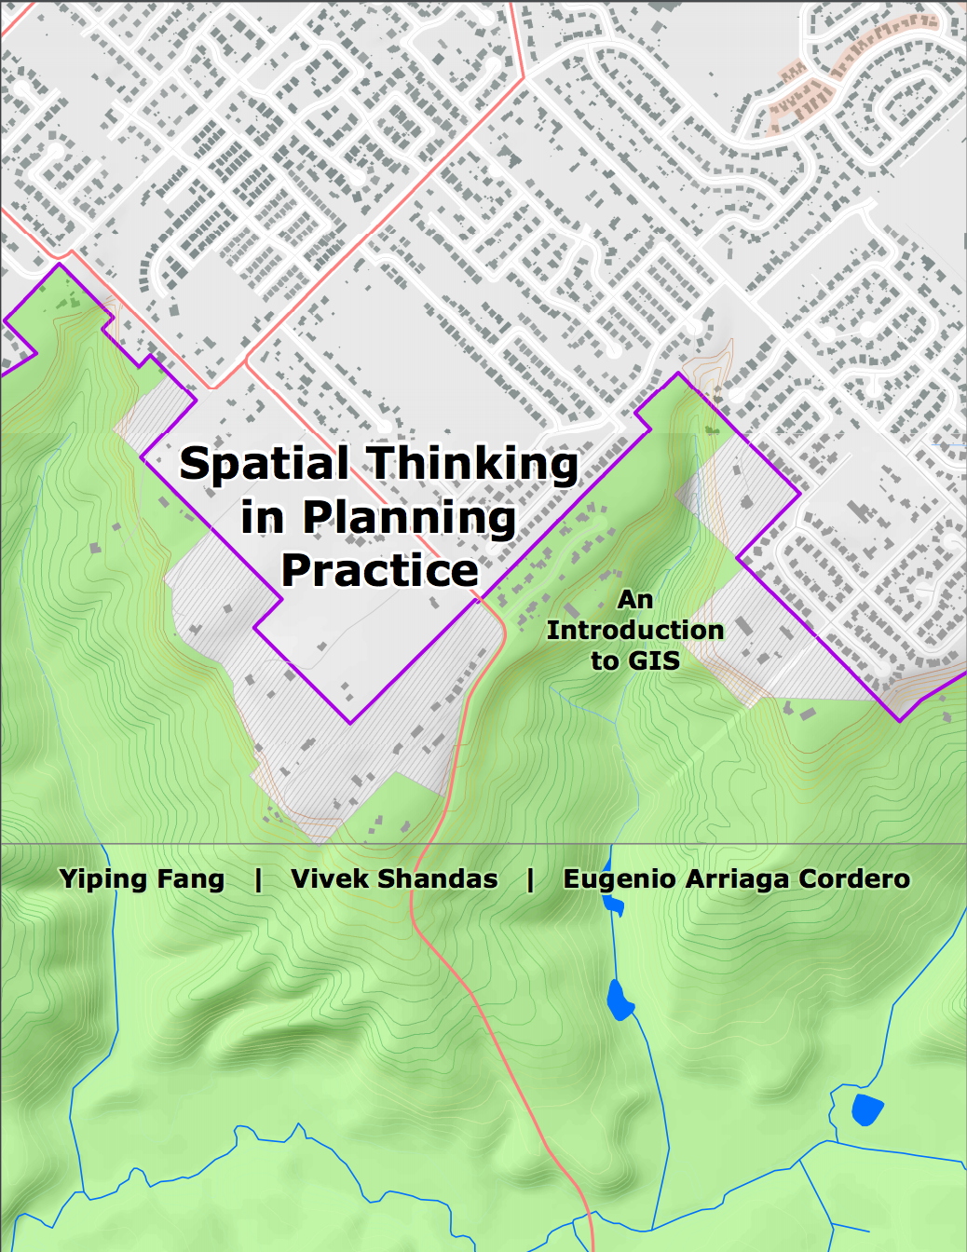
Notes:
Rayne
Some example books from (1) Portland State University, (2) SUNY and (3) Stanford University, funded by those institutions

Slide 14
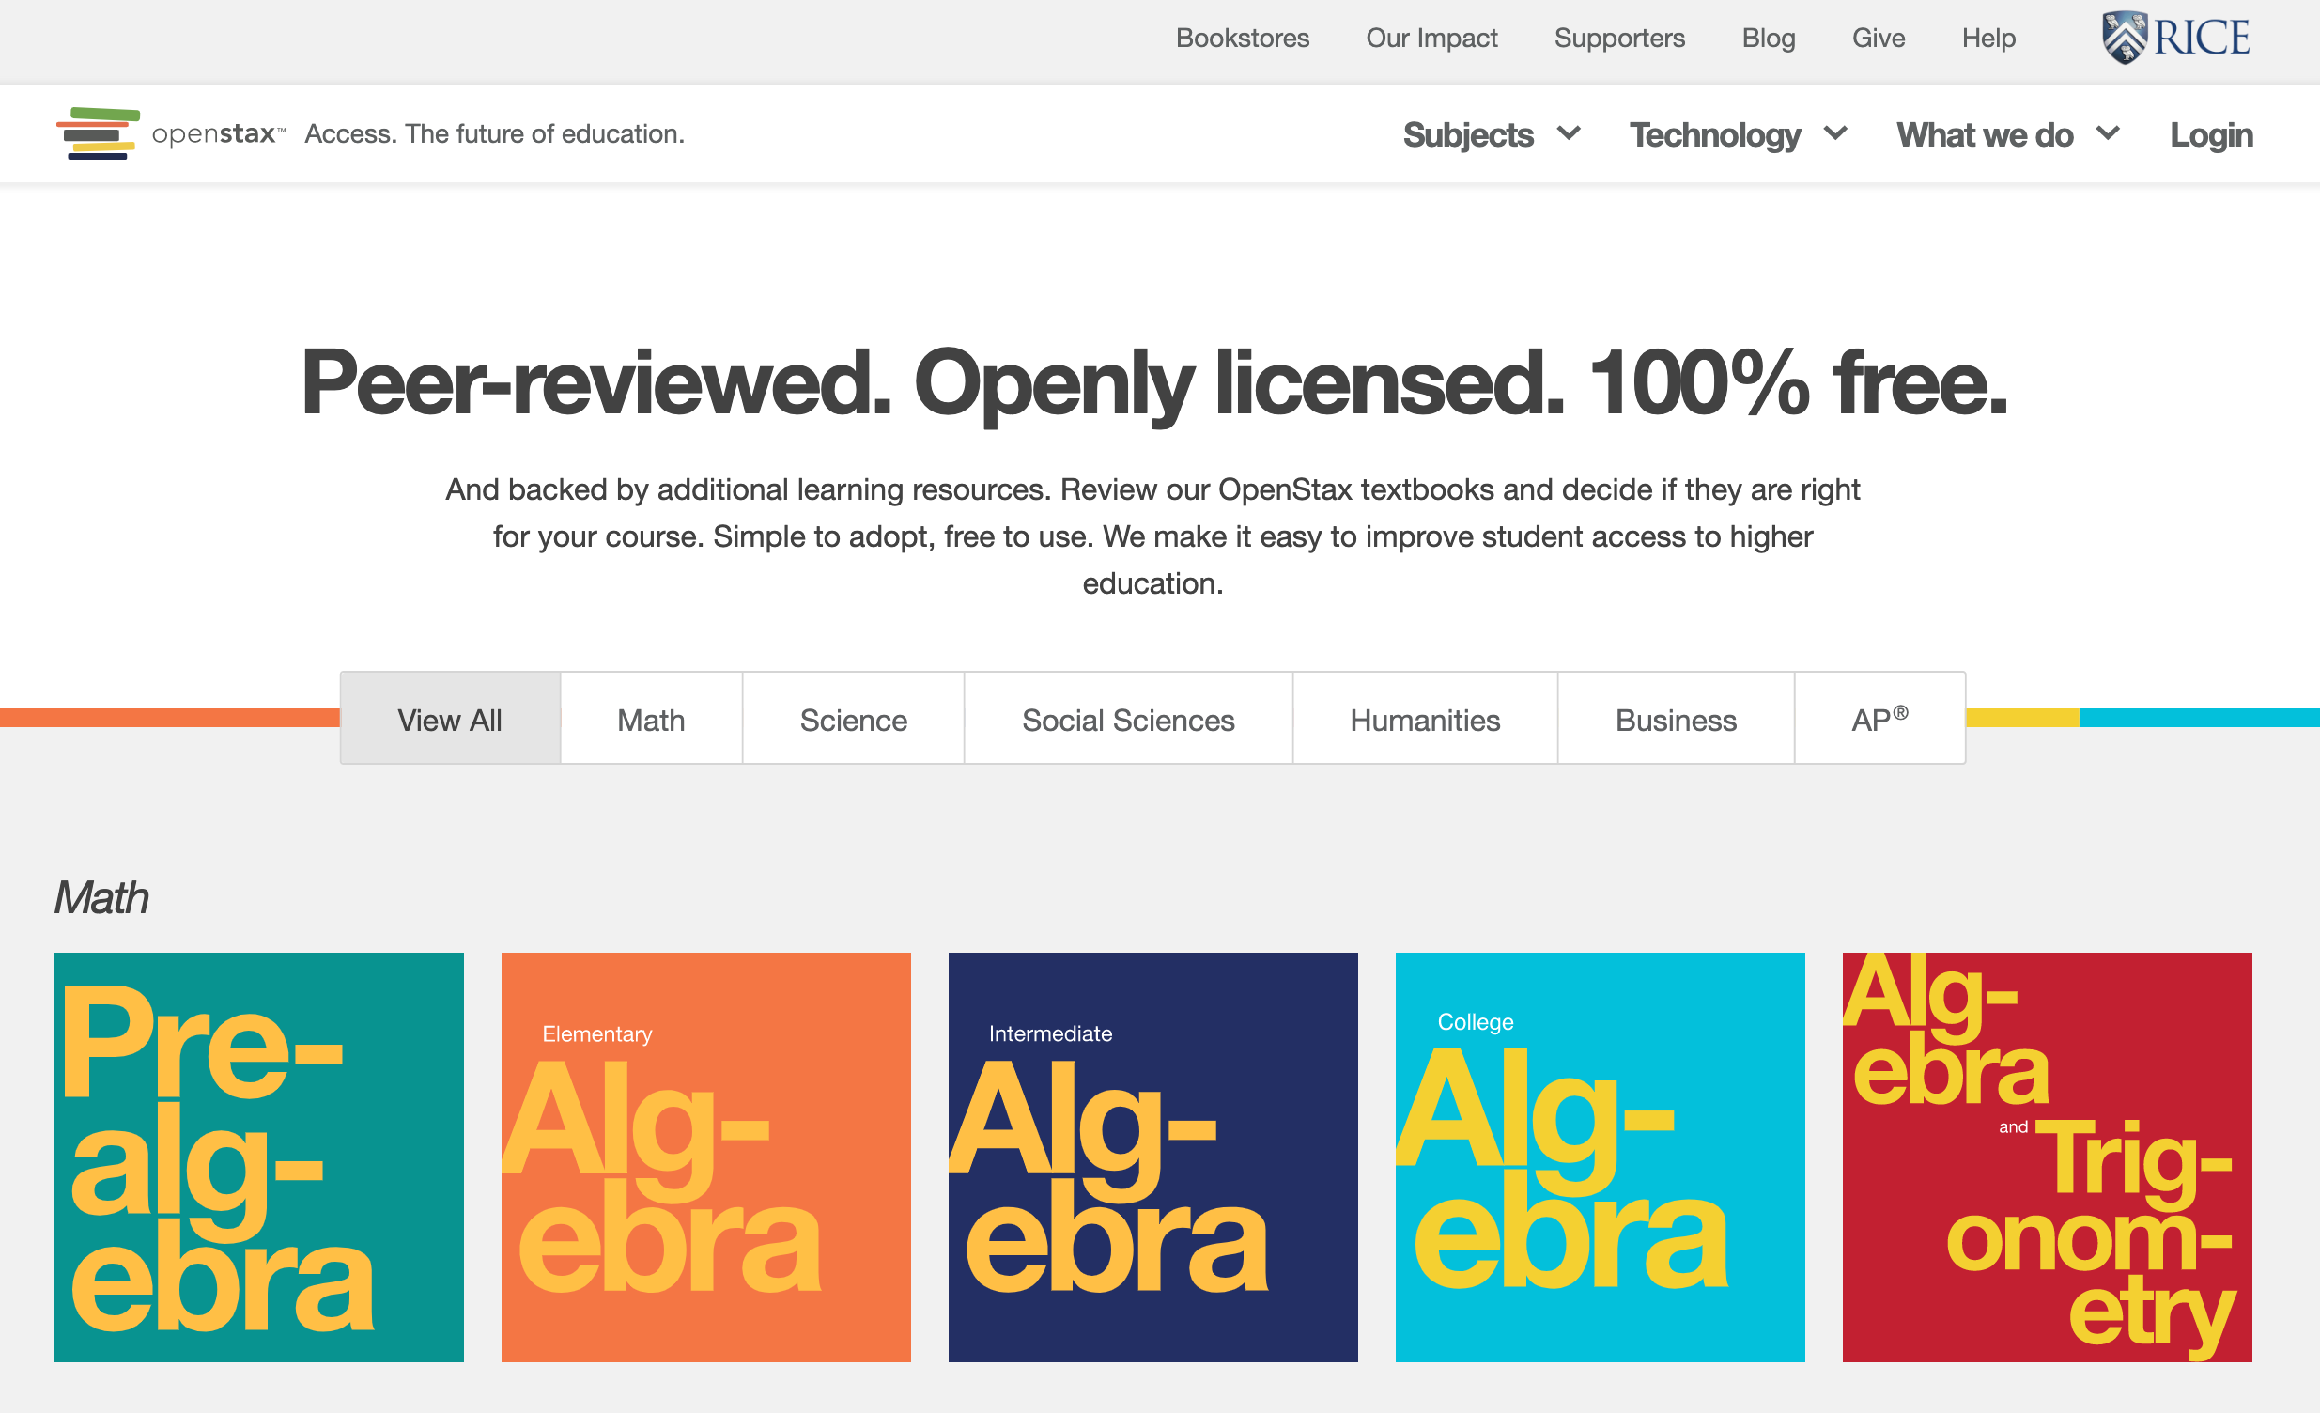
Notes:
OpenStax is the branding of the textbooks published by Rice University. They set out to publish textbooks for the top 25 enrolled courses in the US. They were initially funded by foundations, but they are now self-sustaining.

Slide 15
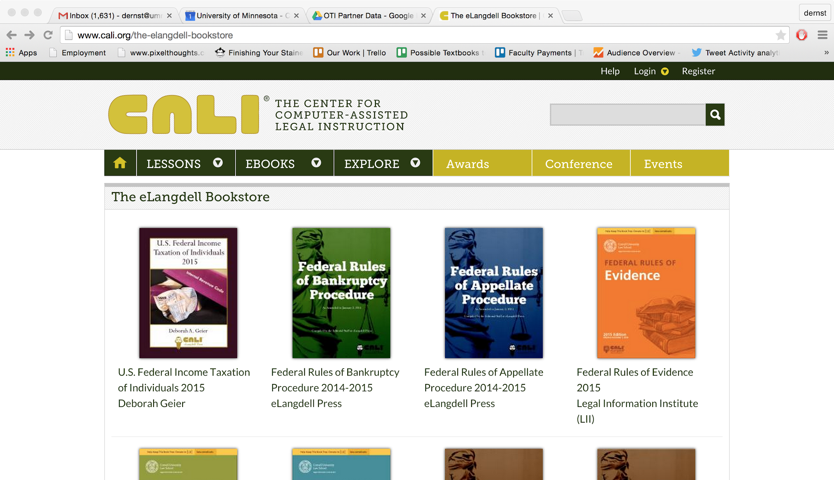
Notes:
CALI is a consortium of just about every law school in the country and they update these books annually. The consortium members pool their funding and Cornell University publishes the books.

Slide 16
Why should we use OER?
Notes:
OER can be adapted or modified for different formats making them potentially more accessible to students. Follow the BCcampus Open Textbook Accessibility Toolkit to make sure your OER are as accessible as possible.
OER can be accessed by anyone with a computer and an Internet connection. Students can access them even before their classes begin and access them long after.
Multiple formats
OER can save students money that they would otherwise spend on expensive textbooks and learning materials. OER makes education more affordable.

Slide 17
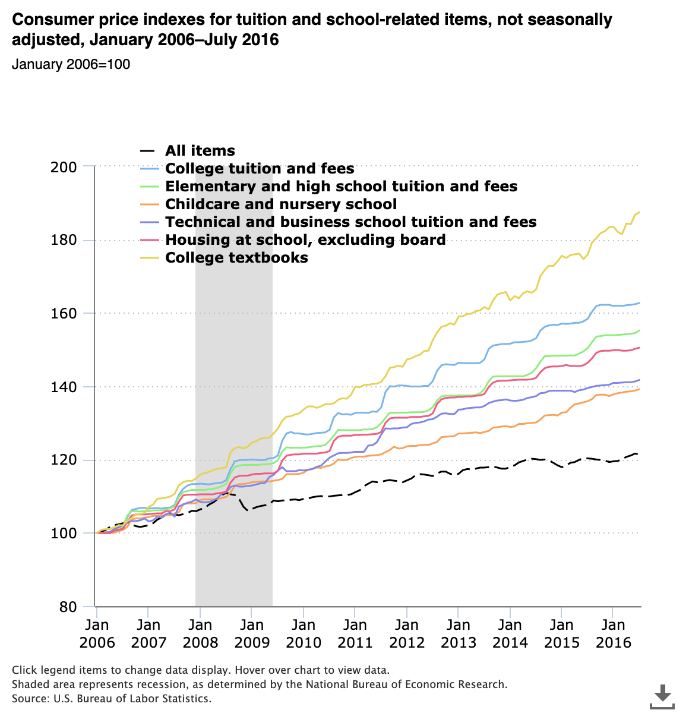
Textbook costs have increased 1,000%
since the 1970s
They increased 88% during 2006-2016 alone
Bureau of Labor Statistics, U.S. Department of Labor, The Economics Daily, College tuition and fees increase 63 percent since January 2006
Notes:
Nick
https://www.vox.com/the-goods/2019/3/6/18252322/college-textbooks-cost-expensive-pearson-cengage-mcgraw-hill

Slide 18
How does the high cost of course materials affect you?
 | UO | National
I've skipped meals in order to afford material | 15% | 11%
I've missed paying a bill in order to afford my materials | 5% | 9%
I've worked extra hours in order to afford my materials | 28% | 25%
I've chosen which classes to take based on cost | 18% | 19%
I've had to prioritize access codes over my other learning materials | 22% | 22%
I've dropped a class because I couldn't afford the materials | 5% | 7%
I've failed a class because I couldn't afford the materials | 3% | 3%
Fixing the Broken Textbook Market, US PIRG
Notes:
Nick
https://uspirg.org/sites/pirg/files/reports/Fixing-the-Broken-Textbook-Market_June-2020_v2.pdf

Slide 19
University of Oregon Student Snapshot
65%
of UO students reported skipping buying or renting a textbook
responded saying they were concerned that their grades would suffer
94%
Fixing the Broken Textbook Market, US PIRG
Notes:
Nick
Deleting the national slide, but maybe compare it to national data ?
https://uspirg.org/sites/pirg/files/reports/Fixing-the-Broken-Textbook-Market_June-2020_v2.pdf

Slide 20
Searching for OER
Notes:
Three sample searches
Open Textbook Library + show rubric/reviews
OER Commons - show education filter to tune out K-12 content
Open Oregon Resources - keyword or Control F

Slide 21
Places to Begin your OER Search
Narrow Search:
Open Textbook Library https://open.umn.edu/opentextbooks/
Pressbooks Directory https://pressbooks.directory/
Broad Search:
OER Commons https://www.oercommons.org/
Mason OER Metafinder (MOM) https://mom.gmu.edu/
OASIS https://oasis.geneseo.edu/

Slide 22
Find an OER Research Activity
Please take 5 minutes to do some research on your own.
Be ready to share what you’ve found in the chat when you come back from your independent research.

Slide 23
Providing Alternate Access to Content
Are there multiple, editable file formats? (Word, HTML, ODT, etc.)
Do images include alt text and/or descriptions that convey the purpose of the image based on its context?
Do videos have captions and/or transcripts?
Are tables used for information and not just layout?
Slide reused from Open for Everyone: Integrating Universal Design for Learning
in Open Education Practice by Dale Coleman and Jennifer Snoek-Brown, which is licensed is licensed under a CC BY 4.0 license
Notes:
JSB slide:
Editable file formats is a concern that both faculty and students have asked me about. ESL faculty asked about PDF conversions and didn’t know about ODT file format; student recently has asked about how to advocate to faculty about accessible PDFs.
If it’s only PDF, then make sure it’s an accessible PDF, because your eLearning staff can convert an accessible PDF into an editable format. If PDF, then a good rule-of-thumb is if you can highlight and copy-and-paste the text.
But it’s easier if there are multiple, editable file formats already on hand.
If HTML, then you can run it through an online screen reader/accessibility check and/or copy-and-paste it into a Canvas content page (in edit mode) and then do an Ally accessibility check.
ODT is the file extension for Open Office documents, similar to Word .docx file format, and these are compatible with Microsoft Word
Captions -- not just auto-generated ones

Slide 24
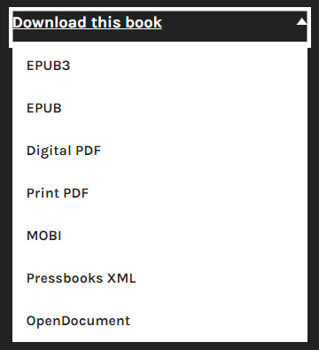
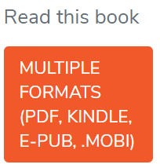
Providing Alternate Access to Content
VS.
Slide reused from Open for Everyone: Integrating Universal Design for Learning
in Open Education Practice by Dale Coleman and Jennifer Snoek-Brown, which is licensed is licensed under a CC BY 4.0 license
Notes:
JSB slide:
Example of noting available formats when I am looking for OER.
Comparison of something only available in PDF vs. something available in multiple formats.
This is an example of multiple formats via Pressbooks, you see increasing options via Pressbooks in OER.

Slide 25
Accessibility Checklists for Adapting & Creating OER
WAVE (Web Accessibility Evaluation Tool), https://wave.webaim.org/
BC Campus Open Ed’s Accessibility Checklist for Textbooks, https://opentextbc.ca/accessibilitytoolkit
Achieve’s Rubrics for Evaluating OER Objects, http://www.achieve.org/files/AchieveOERRubrics.pdf
Slide adapted from Open for Everyone: Integrating Universal Design for Learning
in Open Education Practice by Dale Coleman and Jennifer Snoek-Brown, which is licensed is licensed under a CC BY 4.0 license
Notes:
JSB slide:
I’ve highlighted a few “quick tips” for thinking about major UDL and accessibility issues, but there are more extensive and complete checklists out there.
Not on this list but also very important -- running your Word documents through Accessibility checker!

Slide 26
Identify what you want to apply:
How can you remove a cost barrier for your students?
Are there things that you have already created that you can openly license?
Talk to your colleagues about your experiences with OER
Gather student stories about their experience with OER (both financial impact & learning) to share with colleagues
Notes:
https://oregon.qualtrics.com/jfe/form/SV_egJEc6MFVdn0MAu

Slide 27
Questions? Need support?
Rayne Vieger: raynev@uoregon.edu
Laurel Bastian: lbastian@uoregon.edu
The Accessible Education Center is available at 541-346-1155 or uoaec@uoregon.edu
Canvas Support is available Monday – Friday, 8am – 5pm
In person: PLC 68
By phone: (541) 346-1942
By email: uoonline@uoregon.edu
By live chat: livehelp.uoregon.edu
Schedule a consultation with TEP or UO Online any time at teaching.uoregon.edu

Slide 28
Thank you, and feel free to stay and search for OER!
Using Open Educational Resources presentation by Rayne Vieger is licensed under a​ Creative Commons Attribution 4.0 International License except where otherwise noted. ​

