Slide 1
Designing and Organizing an Accessible Canvas Site
Accessible & Inclusive Design Workshop Series
March 30, 2022
Sheen Hua, Laurel Bastian, and Bailey Dobbs

Slide 2
Session Learning Objectives
By the end of this session, participants should be able to:
Identify wayfinding principles and where/how to apply them
Select and adhere to a labeling convention that works for themselves & students
Use modules to create a learning path in a Canvas course
Identify and implement high-impact accessibility design practices in Canvas

Slide 3
Agenda
Opening question
Wayfinding principles – what, why, and how?
Modules – what, why, and how?
Key accessibility practices – what, why, and how?
Questions & identifying your next steps
Post-session practice (optional)
Notes:
Here's a brief look at our agenda today. Of note, we will be sticking around after the session for anyone who wants to stay and ask questions, troubleshoot something in Canvas, and/or start applying these concepts to your Canvas site. We invite you to stay for that if you have the time and inclination. If not and you need help later, we'll provide several ways you can seek help at the end.

Slide 4
Opening Question
Think of one experience you had as an instructor in the last two years where you were trying to work with a tool that was totally new for you and not intuitive. How did this impact your workflow and focus?

Slide 5
Definitions: what do we mean by "accessible" and "inclusive"?

Slide 6
Definitions: Accessibility
“Accessible means a person with a disability is afforded the opportunity to acquire the same information, engage in the same interactions, and enjoy the same services as a person without a disability in an equally effective and equally integrated manner, with substantially equivalent ease of use (U.S. Department of Education’s Office for Civil Rights)
“... the ability of the design or system to match the requirements of the individual. It is not possible to determine whether something is accessible unless you know the user, the context and the goal.” (the Inclusive Design Research Center)

Slide 7
Definitions: Inclusive Design
The Inclusive Design Research Center (IDRC) defines it on their website as “design that considers the full range of human diversity with respect to ability, language, culture, gender, age and other forms of human difference.”
They identify “3 dimensions of inclusive design" which are:
recognizing diversity and uniqueness
using an inclusive process and tools
considering broader beneficial impacts of design processes.

Slide 8
Student Voices
The Practitioner Guide: Accessibility notes that "...comments about accessibility most frequently mention experiences about Canvas and online. In particular, students reference their ability to find, use, or have access to materials like slides and notes."
For example:
“The Canvas page was not very easy to navigate (AT FIRST). Once I received a walkthrough of the Canvas page, I understood it; however, until then, I struggled with finding all the assignments I needed to complete.”
“Everything on Canvas was easy to find and read! The instructor does a great job on uploading lectures and including written explanations of topic."

Slide 9
Wayfinding
"Navigation is about wayfinding. You can't treat it as separate because many other things run parallel with it. If you look at studies in wayfinding, everything from exhibit design to building the cathedrals, it's about creating a complete system. It's about looking at the whole."
- Clement Mok, graphic design expert & author

Slide 10
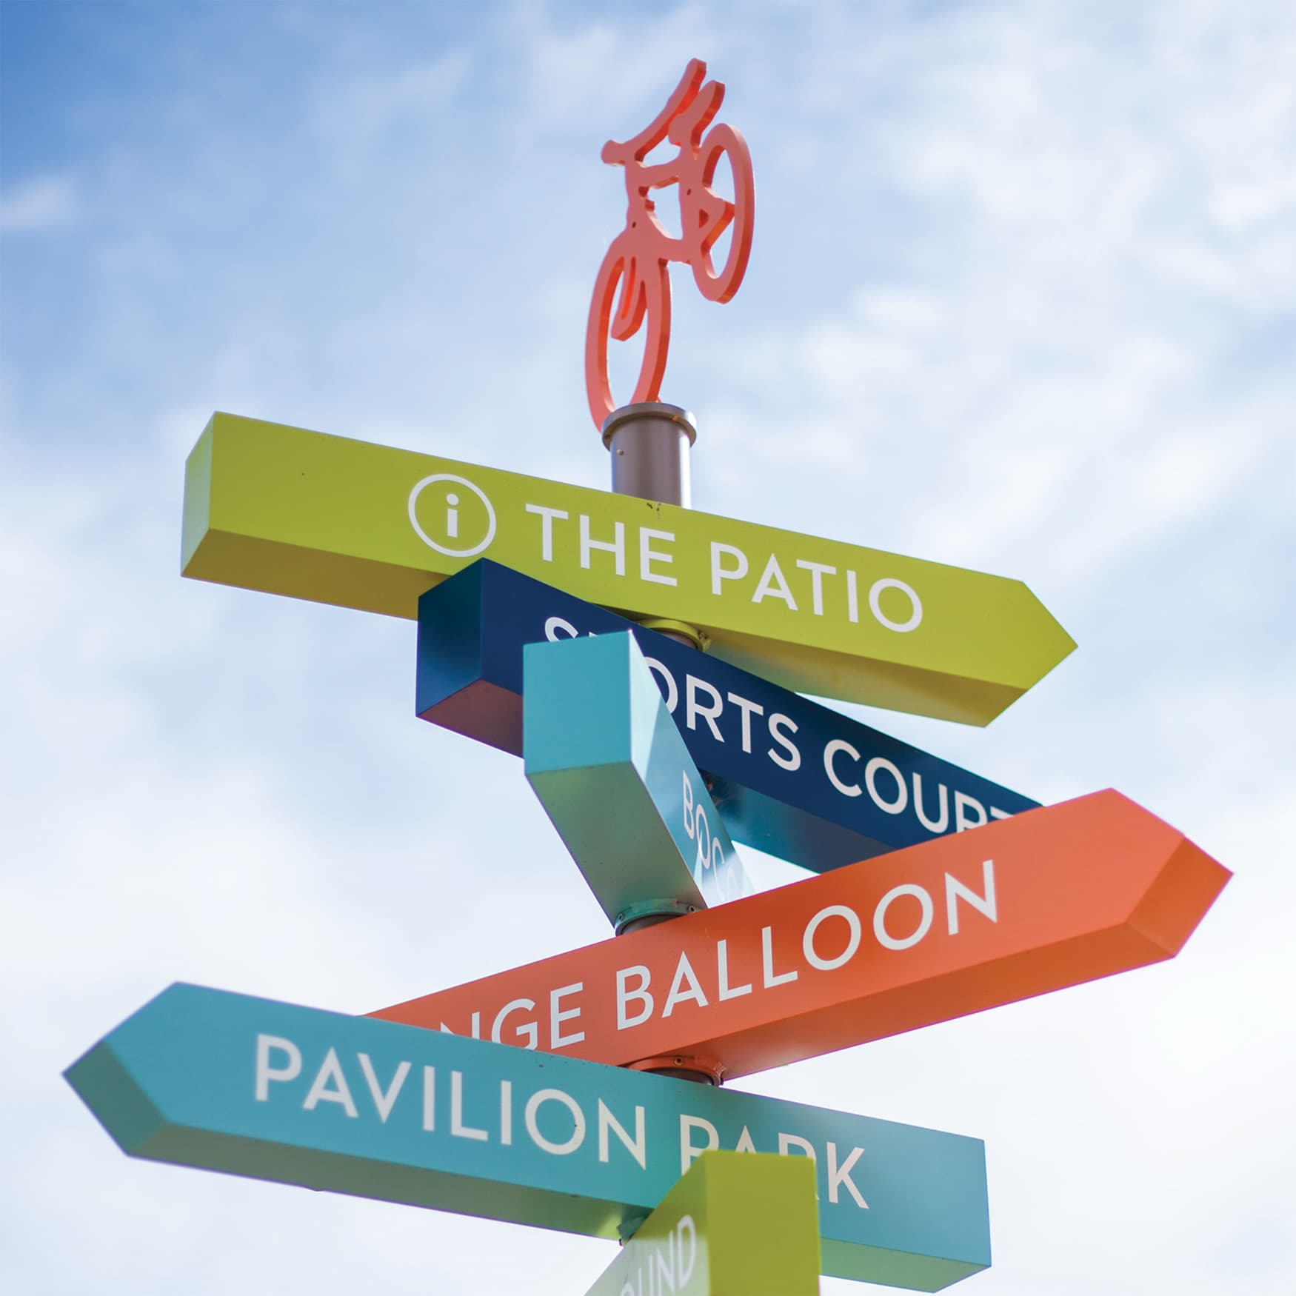
Wayfinding
What do we mean by wayfinding?
Information systems designed to guide a user through a space
Physical or digital
Signs, messages, arrows, maps, diagrams, etc.
Why do we utilize wayfinding practices online?
Users navigate digital spaces in the same way as physical spaces
Can get "lost" online

Slide 11
Wayfinding Tips
Create structured paths
Utilize navigational cues
Create and maintain a consistent labeling convention
Limit navigational choices

Slide 12
Wayfinding Tips
Create Structured Paths
Home Page with Navigational Links
Modules
Requirements & Prerequisites
Weekly Overview with Navigational Links
Visual Cues

Slide 13
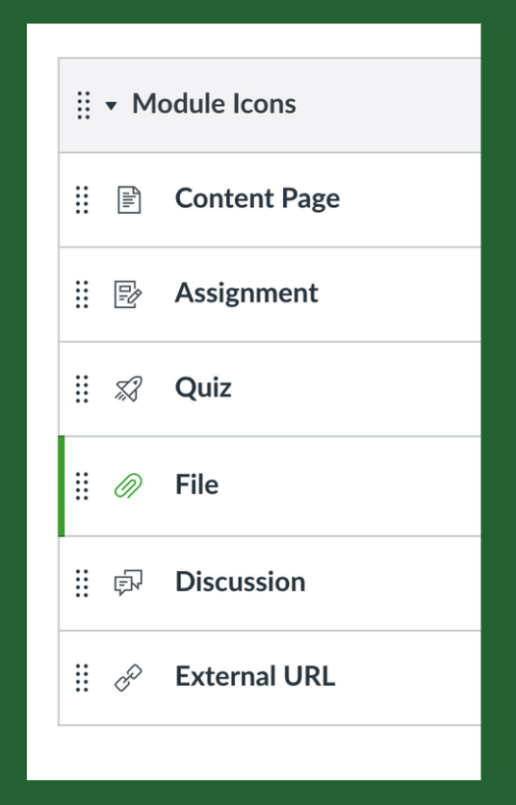
Wayfinding Tips
Utilize navigational cues
Symbols/Icons
Images or Font
Page layout, background, or color

Slide 14
Wayfinding Tips
Create and maintain a consistent identity and labeling convention
Pages, documents, etc. have similar look, structure, and headings
Modules should all shared a naming convention
Files names should be clear, descriptive, and consistent
Links should be descriptive

Slide 15
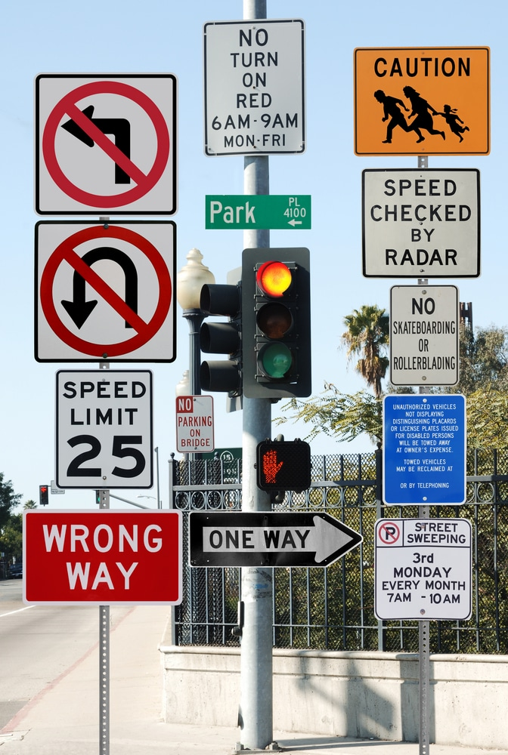
Wayfinding Tips
Don’t give too many navigational choices
Avoid "choice overload"
Streamline your Canvas Navigation in Settings
Remove extraneous menu items
Don't clutter pages with links
Check for conflicting cues

Slide 16
Modules
"For human beings, the only way to manage a complex system or solve a complex problem is to break it up. In the breaking apart, it is best to look for points of natural division..."
- Baldwin and Clark, in Design Rules: The Power of Modularity

Slide 17
What are modules?
Modularity is the degree to which a system's components can be separated and recombined, often with the benefit of flexibility in use.
Modules are individual components
In education, modules are units or lessons
In Canvas, modules are "containers" that house learning content and activities

Slide 18
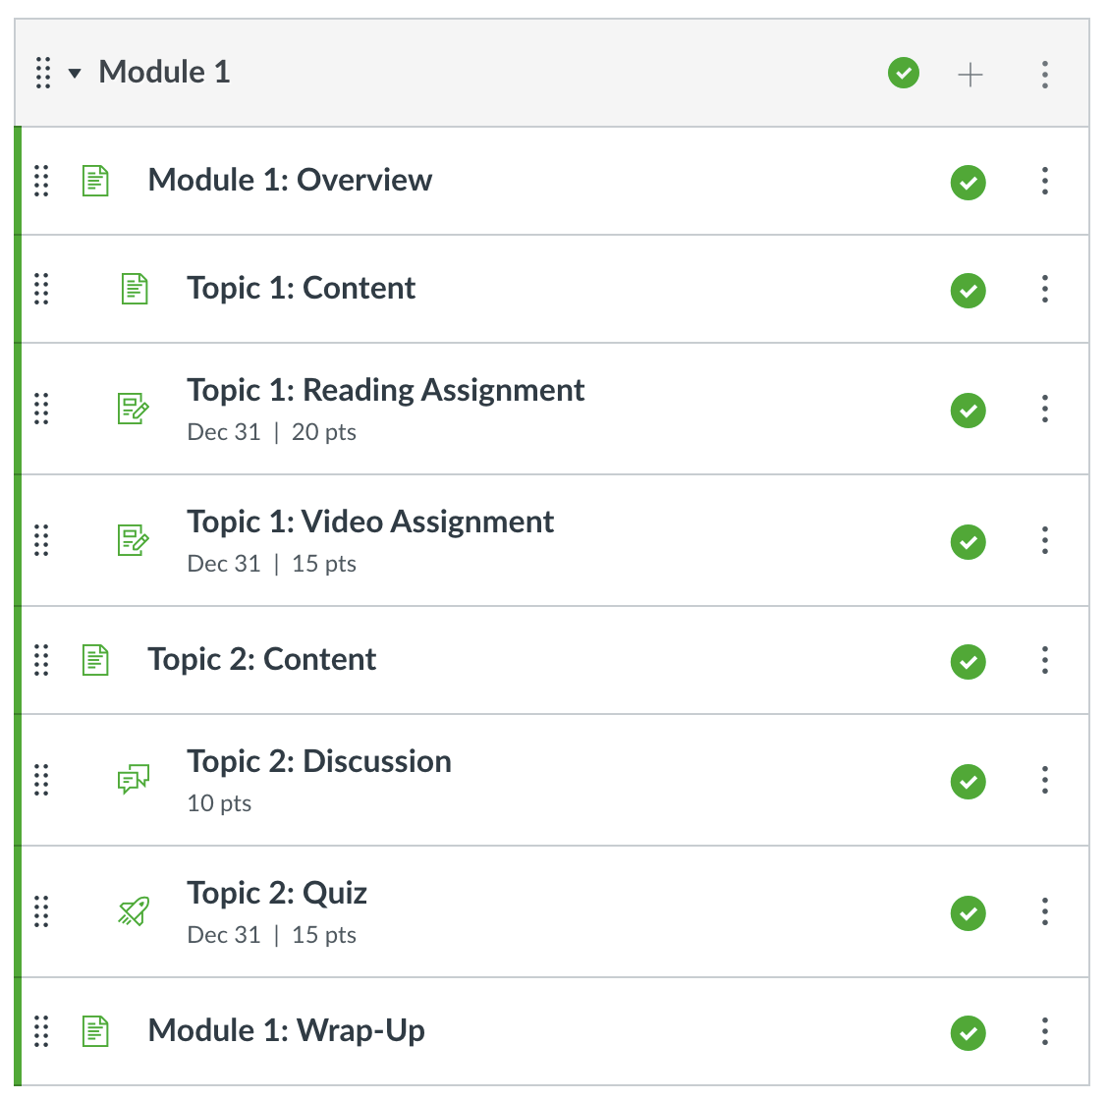
Why use modules?
More streamlined
Easier to navigate
More organized
More flexible
Easier to convert to other formats
Easier to reorganize

Slide 19
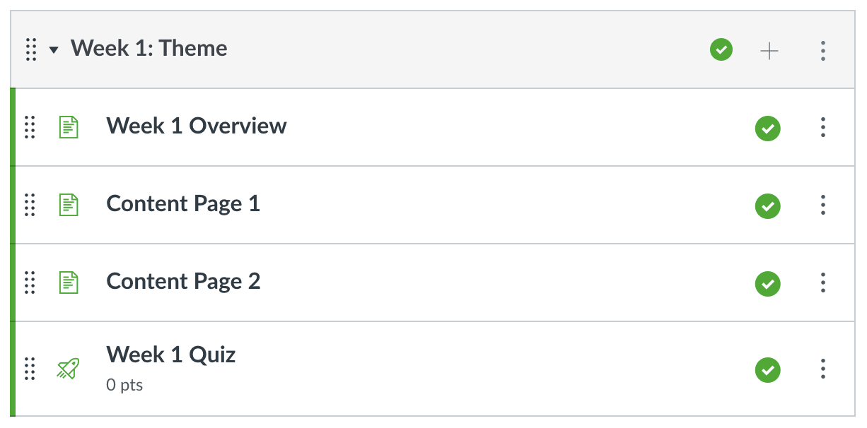
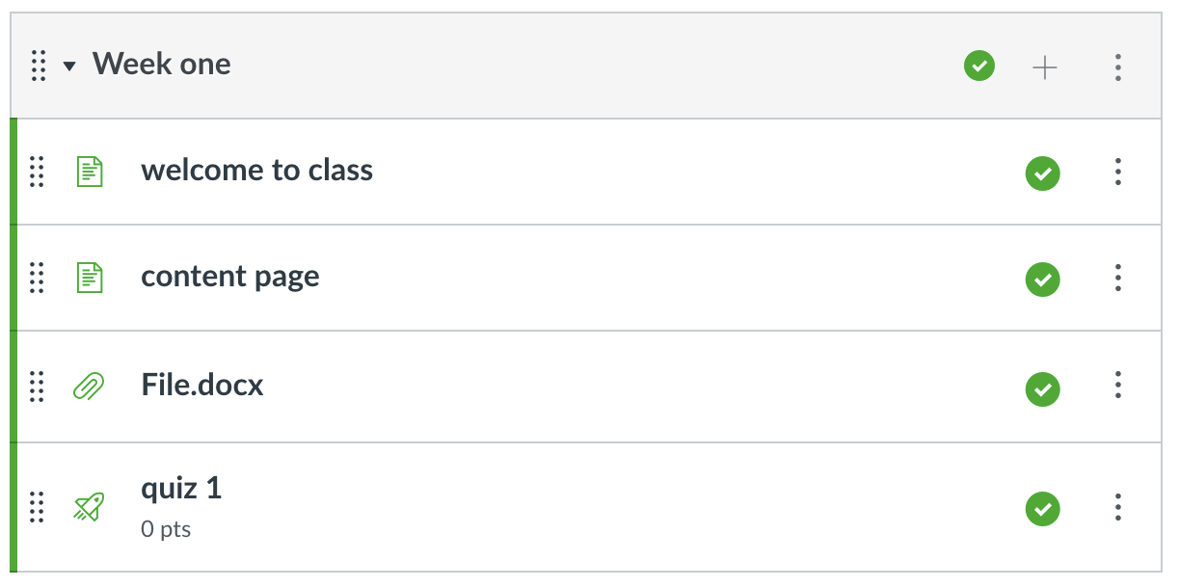
How to make modules
Identify key topic areas
Preferably using Backward Design
Modules should contain a unit or group of lessons
Label modules clearly and consistently
Create modules of consistent size and structure

Slide 20
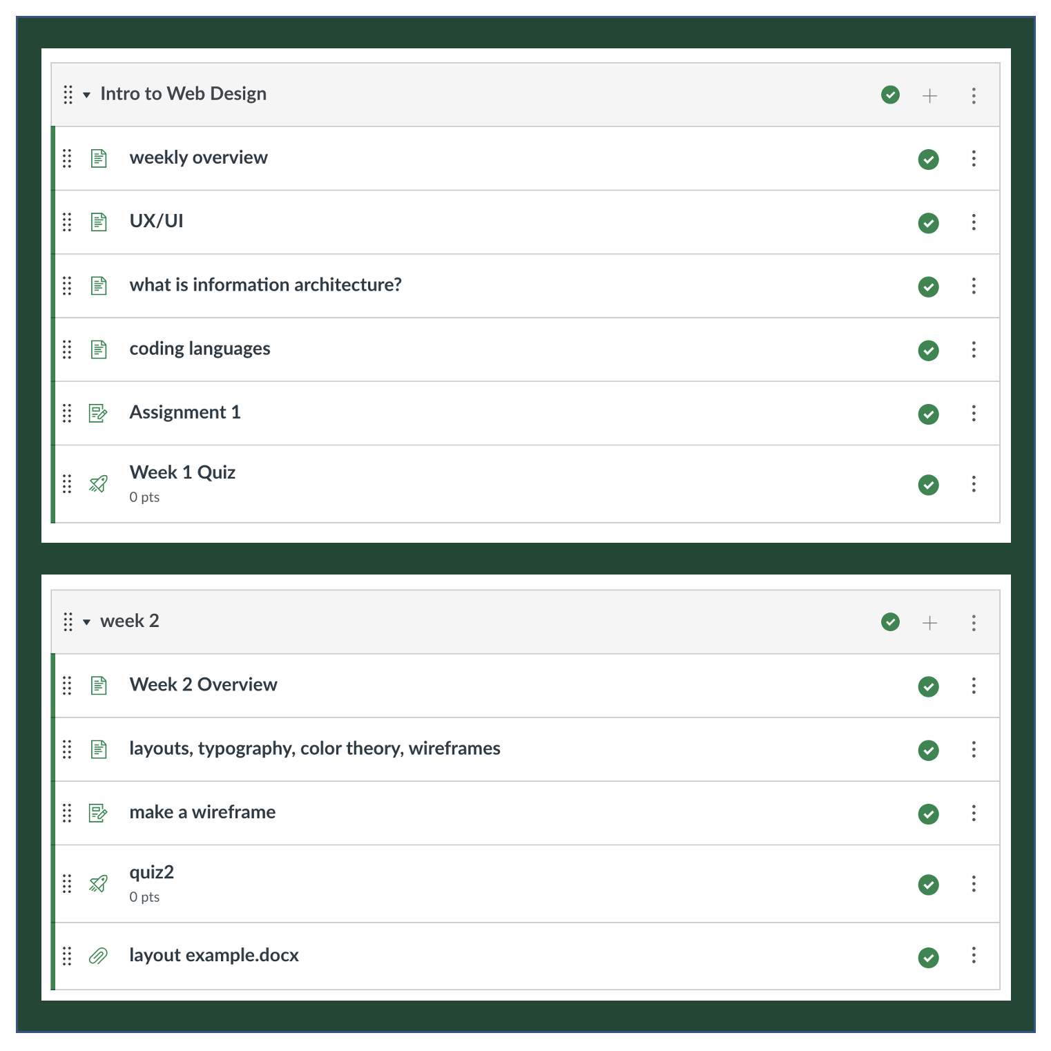
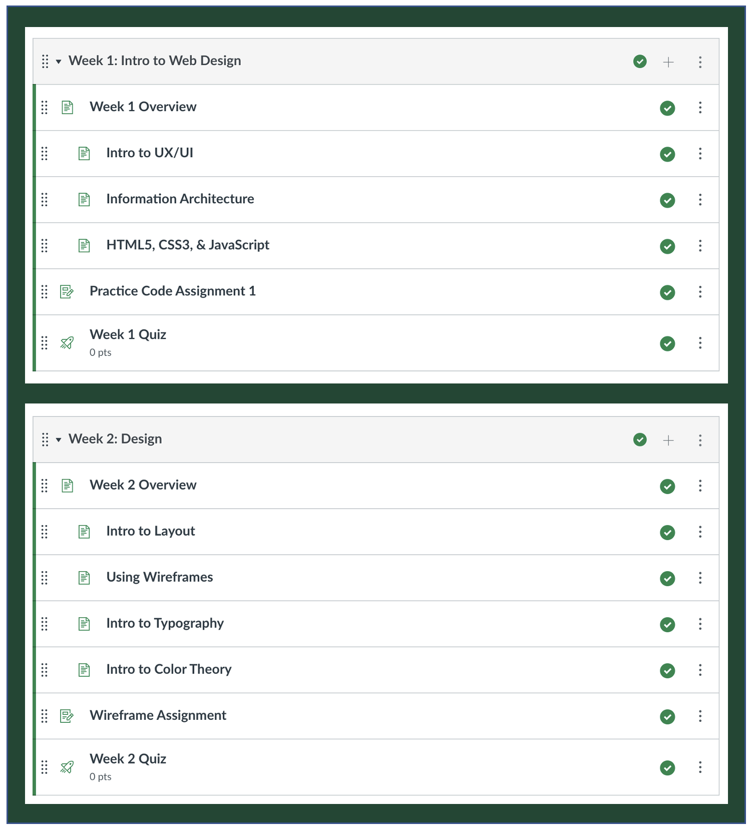
Example 1
Example 2

Slide 21
Accessibility
"Accessible design is good design – it benefits people who don't have disabilities as well as people who do. Accessibility is all about removing barriers and providing the benefits of technology for everyone."
- Steve Ballmer, former CEO of Microsoft

Slide 22
Accessibility
What is accessibility?
Design of products, environments, devices, etc. to render them useable by people with disabilities
Why pay attention to accessibility?
It allows all students to engage with the material and demonstrate their understanding in ways that are meaningful to them.
It is easier to design for accessibility at the outset than to go back to fix issues.
Small changes can have big impacts.

Slide 23
Accessibility Practices
High impact practices we'll address today:
Not using color alone to give meaning
Using Alt Text for images
Providing descriptive links
High impact practices we won't address today
Provide captions and/or transcripts for video & audio (April 6th session)
Provide accessible PDFs (April 13th session)

Slide 24
High-Impact Practices: Color Alone ≠ Meaning
Course Summary:
This is what you'll be doing in this course:
Week 1: Show up [this week is worth 10% of your grade]
Week 2: Read up [this week is worth 10% of your grade]
Week 3: Speak up [this week is worth 40% of your grade]
Week 4: Study up [this week is worth 10% of your grade]
Don't use color only to convey information.
View of color-blind user
Course Summary:
This is what you'll be doing in this course:
Week 1: Show up [this week is worth 10% of your grade]
Week 2: Read up [this week is worth 10% of your grade]
Week 3: Speak up [this week is worth 40% of your grade]
Week 4: Study up [this week is worth 10% of your grade]

Slide 25
High-Impact Practices: Color Alone ≠ Meaning
Course Summary:
This is what you'll be doing in this course:
Week 1: Show up [this week is worth 10% of your grade]
Week 2: Read up [this week is worth 10% of your grade]
Week 3: Speak up [this week is worth 40% of your grade]
Week 4: Study up [this week is worth 10% of your grade]
Don't use color only to convey information.
Use bold emphasis instead or in addition to color.
View of color-blind user
Course Summary:
This is what you'll be doing in this course:
Week 1: Show up [this week is worth 10% of your grade]
Week 2: Read up [this week is worth 10% of your grade]
Week 3: Speak up [this week is worth 40% of your grade]
Week 4: Study up [this week is worth 10% of your grade]

Slide 26
High-Impact Practices: Color Alone ≠ Meaning
Don't overuse color to emphasize content.

Slide 27
High-Impact Practices: Color Alone ≠ Meaning
Providing emphasis with bold text is less distracting and conveys the same information – especially if the different colors didn’t signify different meanings.

Slide 28
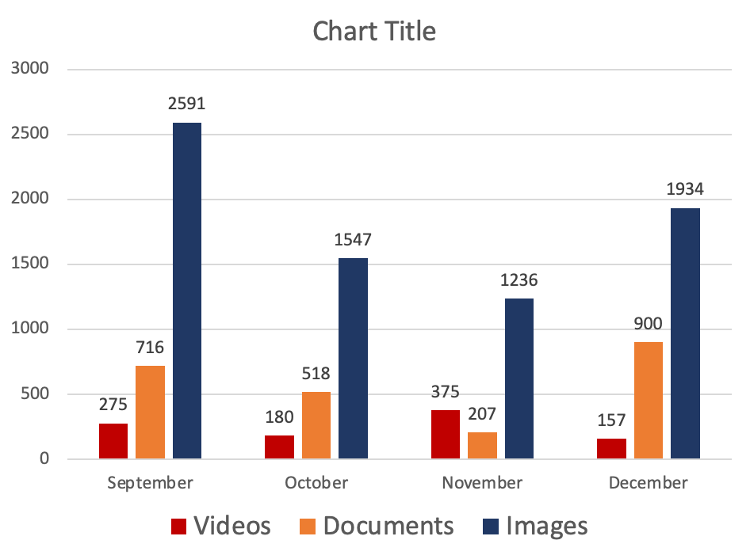
High-Impact Practices: Color Alone ≠ Meaning
Don't use color only to convey information.

Slide 29
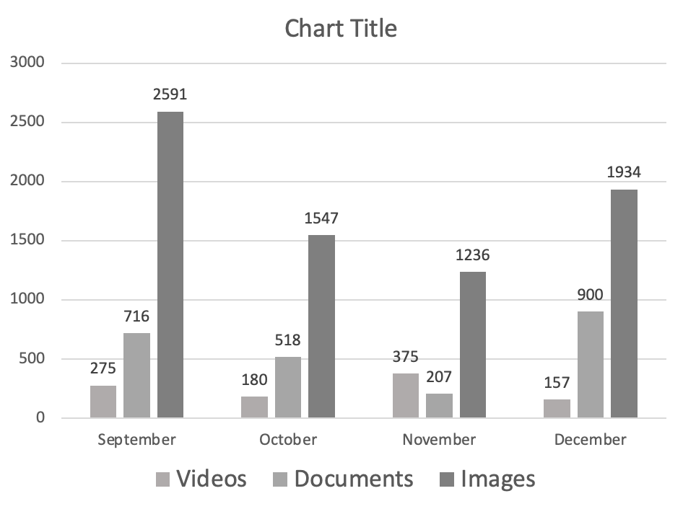
High-Impact Practices: Color Alone ≠ Meaning
Those who can't see color will miss the nuances of this graph.

Slide 30
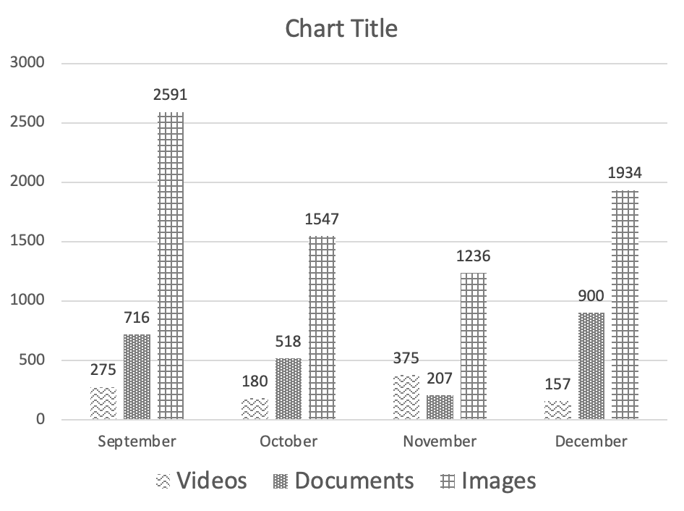
High-Impact Practices: Color Alone ≠ Meaning
Using textures in addition to color to convey information works better.

Slide 31
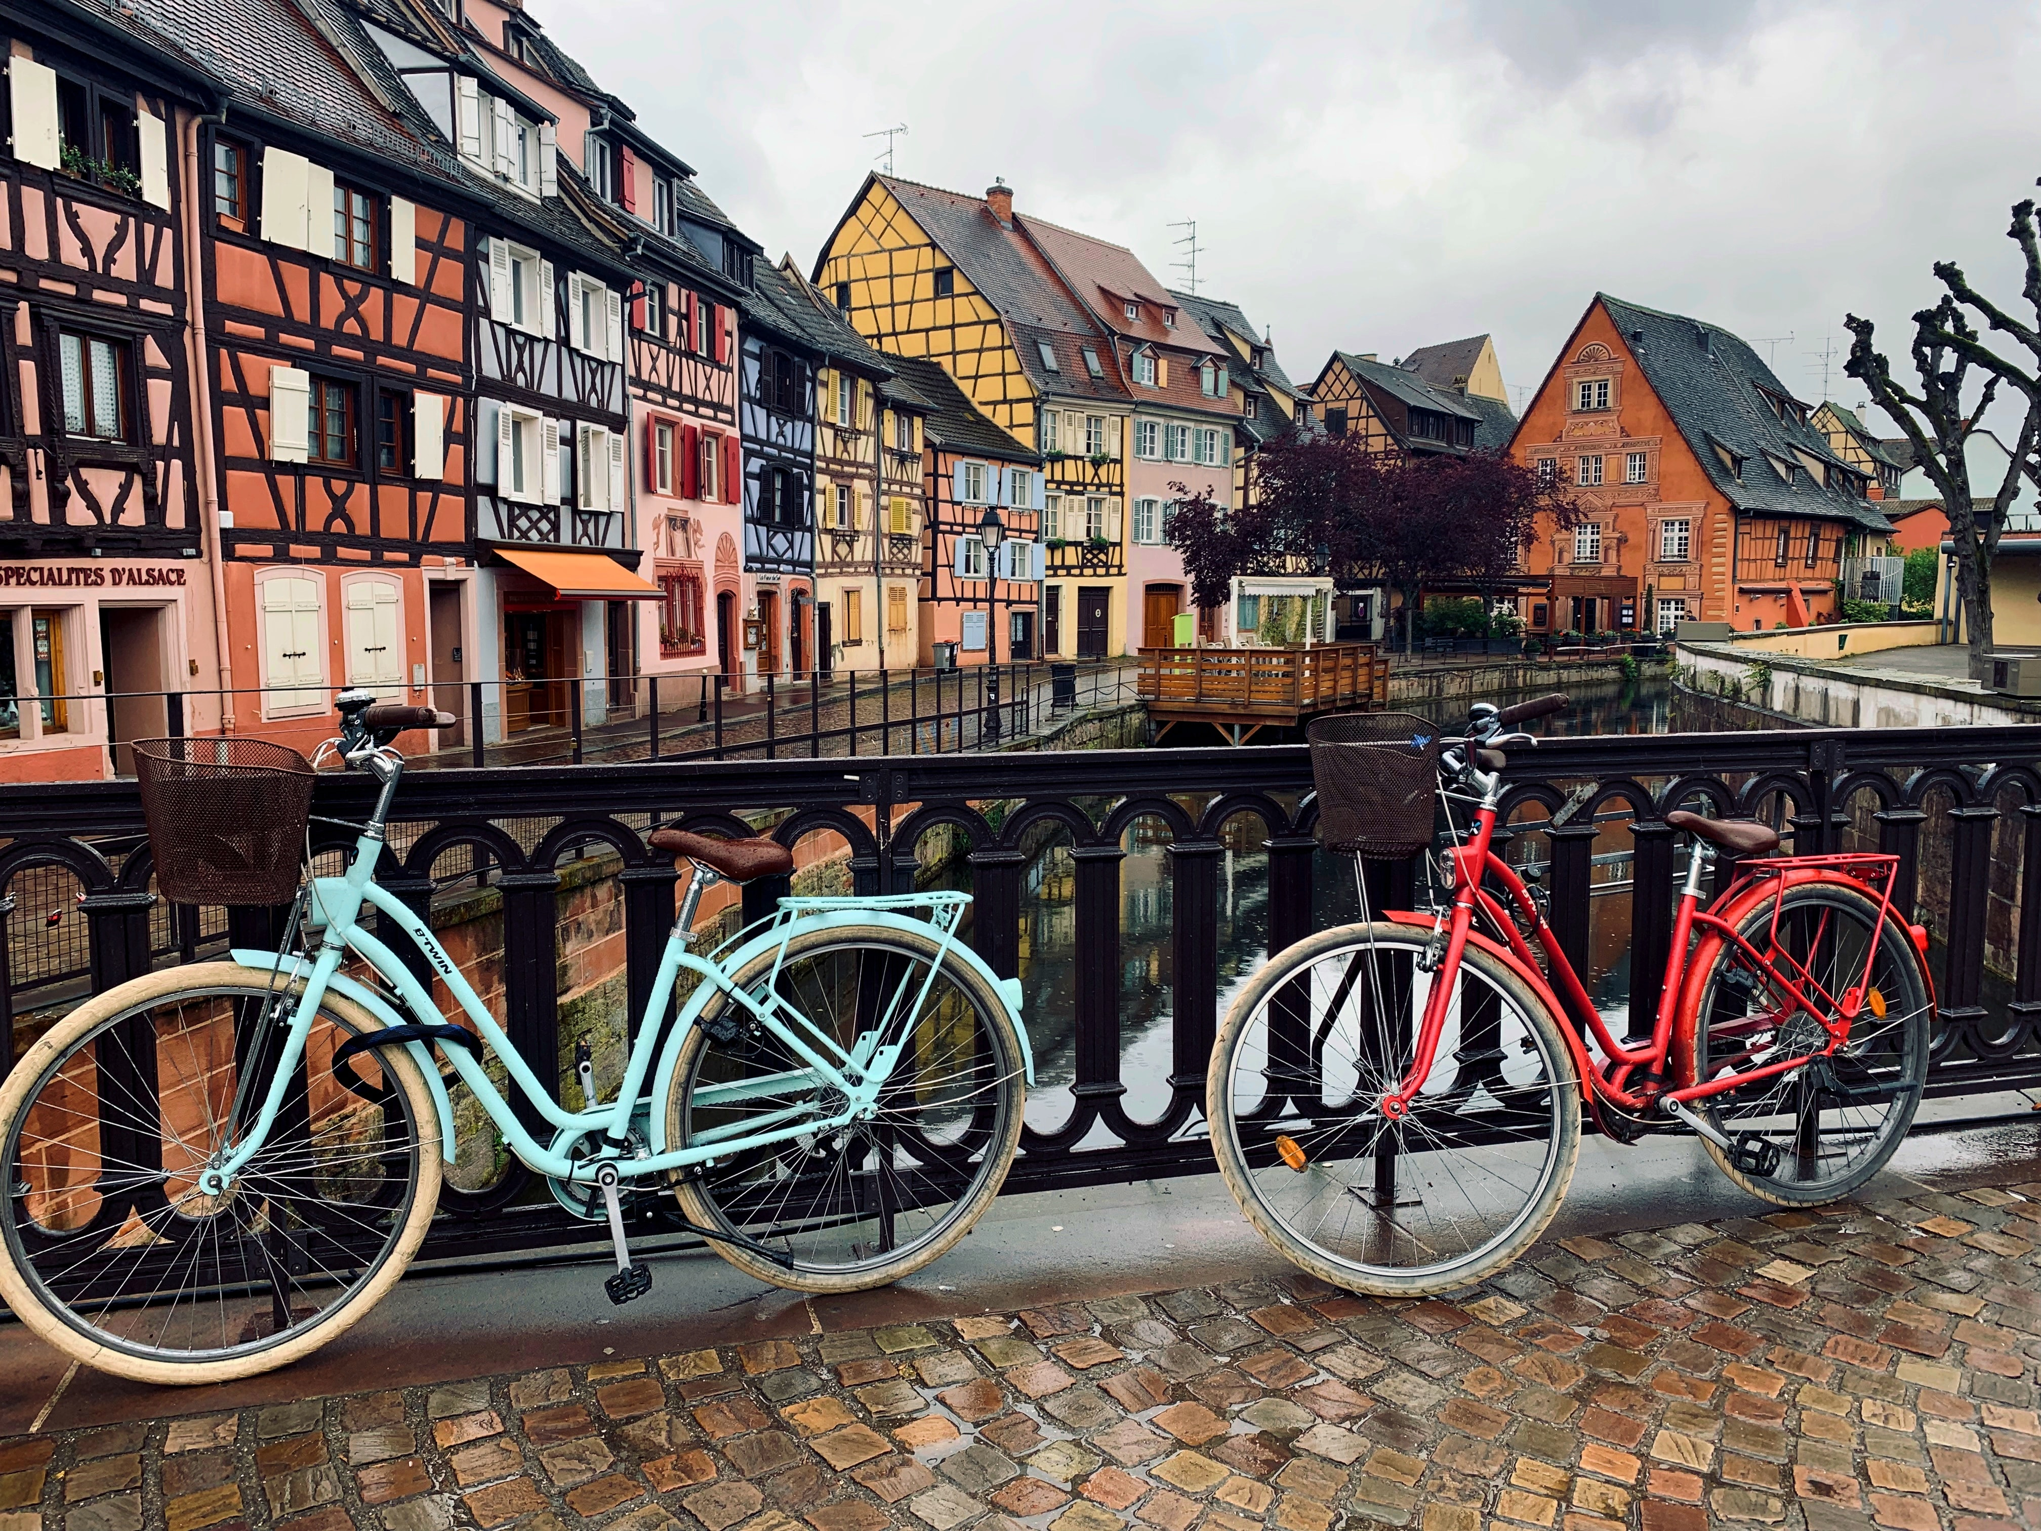
High-Impact Practices: Alt Text
Use Alt Text
Alt text refers to invisible descriptions of images which are read aloud to those using screen readers
Adding ALT text allows authors to include images, but still provide the content in an alternative text-based format.

Slide 32
High-Impact Practices: Alt Text
Use Alt Text
Alt text benefits those without vision and can also benefit those with vision if an image doesn’t display correctly
However, alt text is only helpful when actually descriptive of the image
?
Alt text: aswathy-n-MK-voups3_A-unsplash.jpg

Slide 33
High-Impact Practices: Alt Text
Use Alt Text
The alt text needs to be descriptive of the content in the image and not just a file name
Descriptions should
Be specific yet succinct
Describe information, not aesthetics
Use normal punctuation like commas and full stops
Not contain copyright info or photo credits
?
Alt text: Bicycles on a bridge in Amsterdam.
Notes:
test

Slide 34
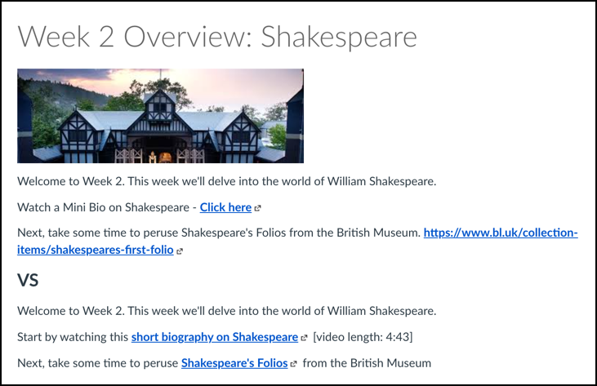
High-Impact Practices: Link Text
Provide descriptive link text
Allows screen readers to accurately describe the action to be taken and where the link will take the user
The purpose of each link can be determined from the link text
Avoid "click here" and URLs

Slide 35
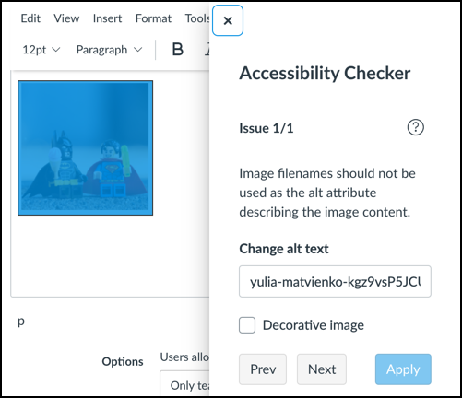
High-Impact Practices: Accessibility Checkers
Use the Canvas Accessibility Checker

Slide 36
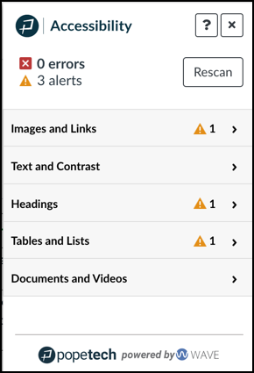
High-Impact Practices: Accessibility Checkers
Use the PopeTech Accessibility Checker
PopeTech provides detailed information and resources to improve a wide range of accessibility issues.
Simplifying Canvas Accessibility with Pope Tech ( April 14th Session)

Slide 37
Identify what you want to apply:
What is one thing you can do in your course this week that will remove a barrier and make your course more accessible?
Notes:
https://oregon.qualtrics.com/jfe/form/SV_egJEc6MFVdn0MAu

Slide 38
Questions?
Bailey Dobbs: bdobbs@uoregon.edu
Sheen Hua: sheen@uoregon.edu
Laurel Bastian: lbastian@uoregon.edu
The Accessible Education Center is available at 541-346-1155 or uoaec@uoregon.edu
Canvas Support is available Monday – Friday, 8am – 5pm
In person: PLC 68
By phone: (541) 346-1942
By email: uoonline@uoregon.edu
By live chat: livehelp.uoregon.edu
Schedule a consultation with TEP or UO Online any time at teaching.uoregon.edu

Slide 39
Thank you, and feel free to stay and practice!

